Slide 1
Modeling Client Rate and Volumes of Non-maturing Savings Accounts
Conference OR 2011, Zürich
Florentina Paraschiv

Slide 2
Agenda
Motivation
Client rate models
  Preliminaries
  Modelling client rate asymmetry
Volumes model
  Linear regression analysis
  VAR approach
Conclusion

Slide 3
Motivation
Interest and liquidity risk management in banks:
  Basel II: "Interest risk of all banking book positions must be calculated and reported"
    NMA: particular attention given their cash-flow uncertainty due to optionality;
  Basel III: liquidity ratios assets/liabilities; volumes forecast essential for planning future funding situations
Realistic NMA client rate and volumes models taking into account the optionality condition, with applicability for the risk management in banks

Slide 4
Agenda
Motivation
Client rate models
  Preliminaries
  Modelling client rate asymmetry
Volumes model
  Linear regression analysis
  VAR approach
Conclusion

Slide 5
Deposit rate characteristics
    - rigidity pattern: banks have only an incentive for adjustments when the administrative costs are smaller than the costs for not changing the rates
    - asymmetric adjustment: banks exercise their market power to optimize their margins by delaying the pass-through of higher market rates to clients

Slide 6
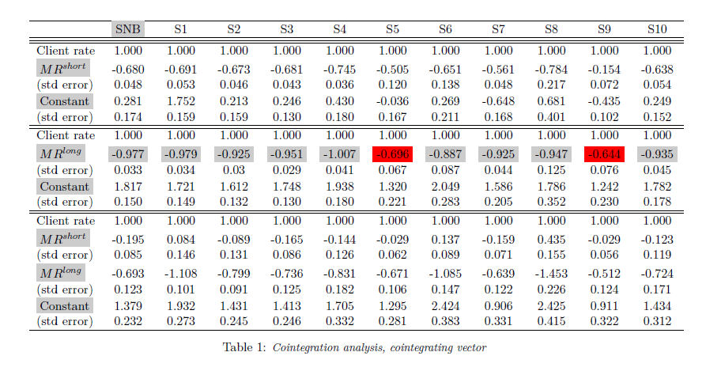
Cointegration Analysis (Numerical Results)

Slide 7
Agenda
Motivation
Client rate models
  Preliminaries
  Modelling client rate asymmetry
Volumes model
  Linear regression analysis
  VAR approach
Conclusion

Slide 8
Drivers of asymmetric adjustments
Sign of the change in market rates: banks might show different adjustment policy depending on whether market rates go up or down
Magnitude of market rate change: bank's reaction to large changes in market rates is stronger than in the case of moderate changes
Level of market rates: a change in the trend of the interest rate dynamics occurs more frequent in times of extreme than of average rates; banks want to anticipate the trend
Sign/magnitude of deviation from equilibrium: the pressure on a bank's margin for deposits increases in case of positive client rate disequilibria and, thus, a larger adjustment occurs; larger the disequilibria, larger the speed to adjust client rates back to equilibrium

Slide 9
Literature overview on client rate asymmetry
Hannan & Berger (1991), Ausubel (1992), Sharpe (1997) :
  difficulties in explaining client rate asymmetry
O'Brien (2000) comes with an important contribution:
  "under asymmetric deposit rate adjustment: unconditional expected deposit rate diverges from the unconditional mean equilibrium rate"
Crespo, Egert & Reiniger (2004), de Haan & Sterken (2005), Sander & Kleimeier (2005)
  Common practice: model in error correction form
  They assume only the first type of asymmetric adjustment: strictly positive/negative changes in market rates
  Problem: threshold fixed artificially at 0; simplistic assumption of asymmetry and therefore often inconclusive results!

Slide 10
Threshold model in error correction form
In deriving the client rate model, we take into account its deviations from the equilibrium level (error correction term derived from the cointegrating vector)
We check for the asymmetry by allowing the parameter for the market rates to differ when they are above or below some estimating threshold
    change in the deposit rate
    lagged change in the market rate
    lagged error-correction term
    random i.i.d. disturbance
The variable captures the threshold effect, where is the threshold variable, is the unknown threshold variable and the indicator function is defined as:

Slide 11
Threshold estimation
We apply Hansen's grid search (1996) to locate the most likely threshold value in the market rates or error correction term
  Model parameters are estimated by MLE ( )
  We apply the likelihood ratio statistic to test
  We reject for large values of
  p-values are derived:

Slide 12
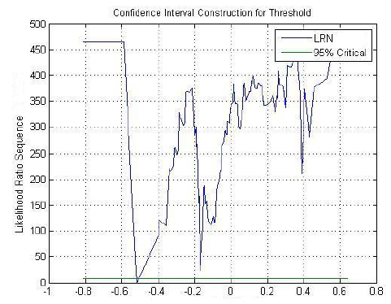
Threshold: changes in the Swap 5 year rate

Slide 13
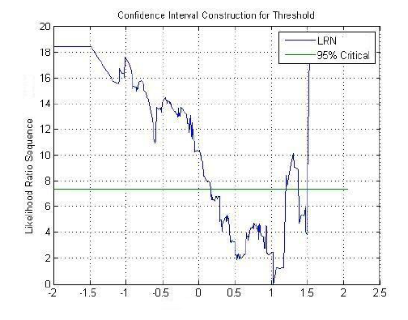
Threshold: error correction term

Slide 14
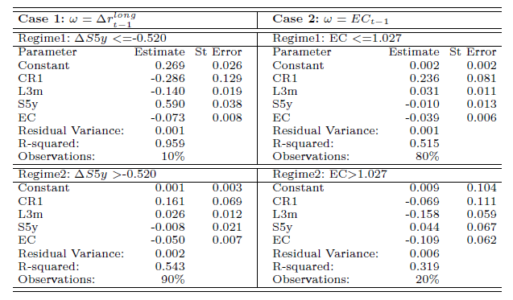
Threshold model: regime dependent coefficients

Slide 15
Out-of-sample model performance – (1998-)

Slide 16
Out-of-sample model performance – (1998-)
The model based on regimes in the EC term keeps the system in equilibrium on long-run horizon.

Slide 17
Out-of-sample model performance (2006-)
On short-run out of sample test, the threshold model based on market rates regimes helps to reflect the shocks which occurred in the client rate, including the financial crisis

Slide 18
Out-of-sample Model Performance (2006-)

Slide 19
Standard Regression Models underperforms the threshold model

Slide 20
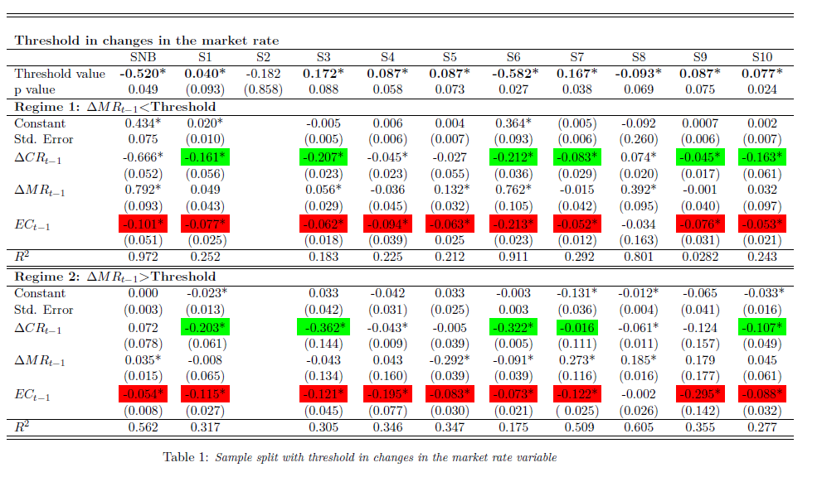
Threshold in changes in the market rate

Slide 21
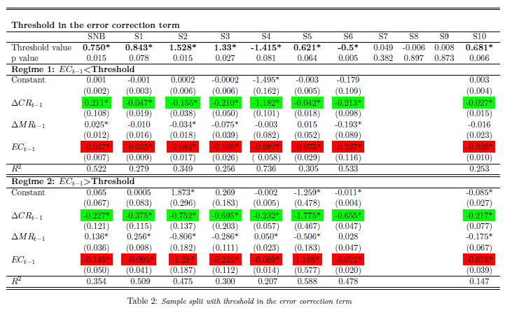
Threshold in the Error Correction Term

Slide 22
Agenda
Motivation
Client rate models
  Preliminaries
  Modelling client rate asymmetry
  Modelling client rate rigidity
Volumes model
  Linear regression analysis
  VAR approach
Conclusion

Slide 23
Literature overview
Volumes modeling: little attention among researchers; data unavailable
Selvaggio (1996), Burger (1998), Jarrow & D.R. van Deventer (1998), Janosi, Jarrow & Zullo (1999) or O’Brien (2000): simplistic assumption that the volume dynamics can be fully explained by interest rates
Hutchison & Pennacchi (1996), Frauendorfer & Schürle (2000): the volume is a (linear) function of the term structure model factors and an additional factor

Slide 24
Volumes model specification
In order to correct for serial correlation, we derive a model in autoregressive form
We model changes in the volumes, as well as changes in the market rates since the savings and the market rates are non-stationary series
represent seasonality factors.

Slide 25
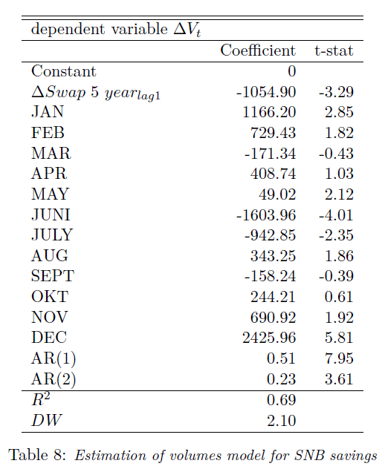
Estimation results SNB deposits

Slide 27
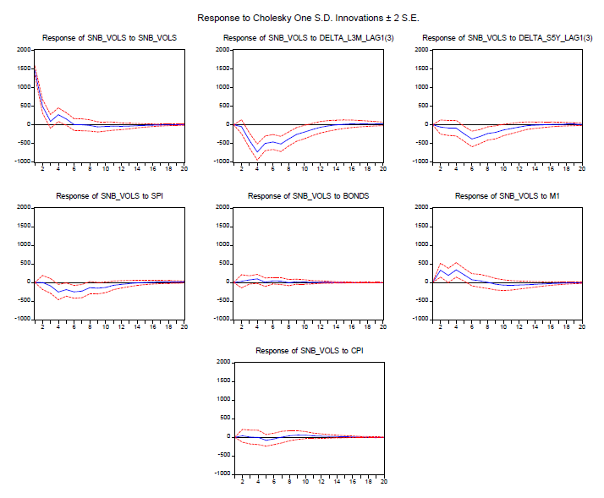
Results VAR Savings overall Swiss Banks

Slide 28
Agenda
Motivation
Client rate models
  Preliminaries
  Modelling client rate asymmetry
  Modelling client rate rigidity
Volumes model
  Linear regression analysis
  VAR approach
Conclusion

Slide 29
Conclusion#1
Banks adjust client rates only when important changes occur on the market; individual changes in market rates are not passed-through to clients
We found evidence for client rate asymmetric adjustment to a long market rate and to its deviations from the long-run equilibrium level:
  error-correction regimes: bank's strategy of how to adjust the client rate in normal regimes
  market rates regimes: bank's strategy when large shocks occur on the market in case of a crisis situation, like in 2008
Threshold models should form the sound basis for managing and measuring the interest rate risk associated to the NMA

Slide 30
Conclusion#2
The market rates are important explanatory factors and have a good forecasting power for the savings volumes dynamics
The seasonality factor is an important explanatory factor for the savings dynamics
Due to inflation, nominal savings volumes are expected to increase
  We identify responsiveness of the volumes dynamics to alternative investment opportunities:
    Swiss investors shift from their savings deposits to stocks investments with increasing stock markets
    Savings volumes show a good responsiveness to shocks in market rates
  All sensitivities can be quantified with sufficient accuracy

