Slide 1
2017 Insurance Risk and Finance Research Conference
Does insurance regulation adequately reflect cyber risk?
An Analysis of Solvency II, the Swiss Solvency Test, and the US RBC Standards
Werner Schnell*, Ph.D Candidate
(joint work with Prof. Martin Eling*)
*Institute of Insurance Economics, University of St.Gallen
Notes:
Cyber Risk might be a new type of risk:
Still trying to grasp cyber risk
Not enough data; high uncertainty (Fitch Ratings (2016) warned to downgrade insurers that write standalone products to heavily)
Risk is very fast changing and still an emerging risk (WannaCry ransomware )
Results so far: highly correlated (no geographical boundaries) and probably heavy tail (extreme events so far not realized, skewness).
Probably tail correlation (non linear correlation)
Only alternative would be scenarios (Cambridge Centre for Risk Studies)
Therefore regulatory frameworks might not be appropriate.

Slide 2
Content
Cyber Risk and Insurance
Excursion: Cyber Risk and Diversification
Methodology
Solvency II and Cyber Risk
US Risk Based Capital (RBC) and Cyber Risk
Swiss Solvency Test (SST) and Cyber Risk
Conclusion & Extensions
Notes:
- Diversification: Problem capital charges assume some diversification.

Slide 3
Cyber Risk and Insurance
Operational Cyber Risk
Solvency II: Factor approach
US Risk Based Capital: Reporting requirements (Factor approach is planned)
Swiss Solvency Test: Reporting requirements
Underwriting Cyber Risk
Solvency II: Factor approach
US Risk Based Capital: Factor approach
Swiss Solvency Test: Stochastic modelling
Notes:
- Major problem: not explicit treatment of cyber risk in any framework ->unlock how it might be applicable
Need to be modelled differently:
- Operational Cyber Risk: Insurers digitalized their operations and are therefore prone to cyber risk
- Underwriting Cyber Risk: Stand alone (dedicated) cyber risk policies or it is included in liability & property insurance. Sometimes not clear whether cyber risk is included (see Sony vs. Zürich, 2011).
-Importantly: Probably a correlation between op and underwriting cyber risk
- RBC: national association of insurance commissioners

Slide 4
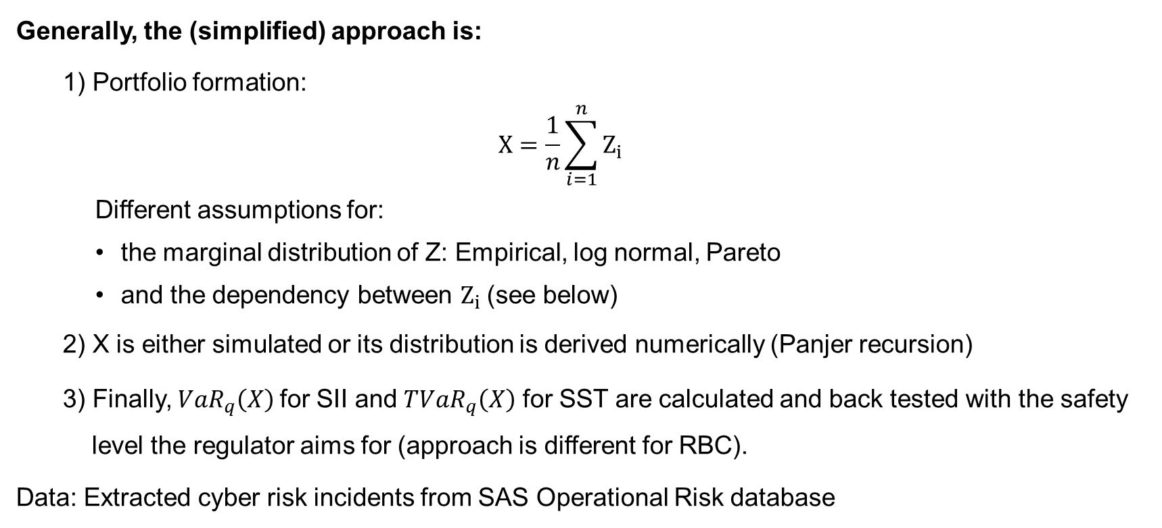
Excursion: Methodology
Generally, the (simplified) approach is:
  1) Portfolio formation:
  $$X=\frac{1}{n}\sum_{i=1}^{n}{Z_{i}}$$
    Different assumptions for:
      the marginal distribution of Z: Empirical, log normal, Pareto
      and the dependency between $Z_{i}$(see below)
  2) X is either simulated or its distribution is derived numerically (Panjer recursion)
  3) Finally, ${VaR}_{q}\left(X\right)$for SII and ${TVaR}_{q}\left(X\right)$ for SST are calculated and back tested with the safety level the regulator aims for (approach is different for RBC).
Data: Extracted cyber risk incidents from SAS Operational Risk database
Notes:
- $q:prob einen verlust nicht zu überschreiten$
- SAS Data from Biener et al. (2015)

Slide 5
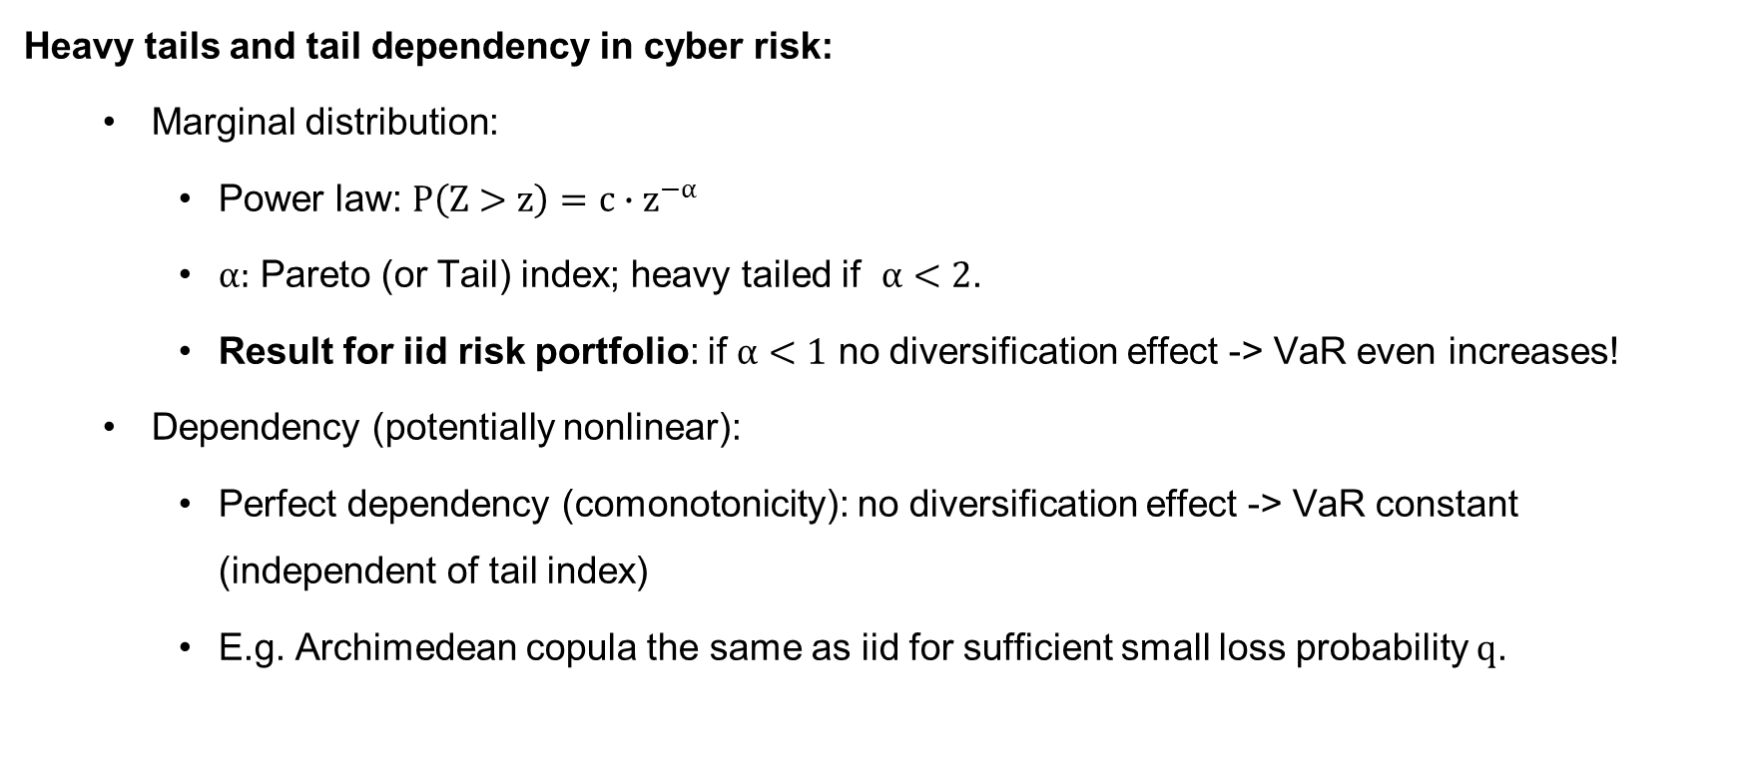
Excursion: Cyber Risk and Diversification
Heavy tails and tail dependency in cyber risk:
  Marginal distribution:
    Power law: $P\left(Z>z\right)=c∙z^{−α}$
    $α:$ Pareto (or Tail) index; heavy tailed if $α<2$.
    Result for iid risk portfolio: if $α<1$ no diversification effect -> VaR even increases!
  Dependency (potentially nonlinear):
    Perfect dependency (comonotonicity): no diversification effect -> VaR constant (independent of tail index)
    E.g. Archimedean copula the same as iid for sufficient small loss probability $q$.
Notes:
-$α<2:I$nfinite second and higher moments
- Operational risks: α < 1 ⇒infinite means E|X| = ∞!, Firm sizes, sizes of largest mutual funds, city sizes: α ≈ 1, Economic losses from earthquakes: α ∈ [0.6, 1.5]
- Border a=1 is quite important (switch from finite to infinite mean)
If α > 1 diversification is optimal over non diversifikation (Ibragimov)
Sub- vs. superaditivity
- Find that the estimated α<1

Slide 6
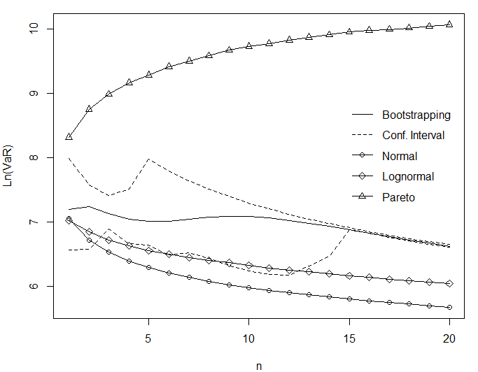
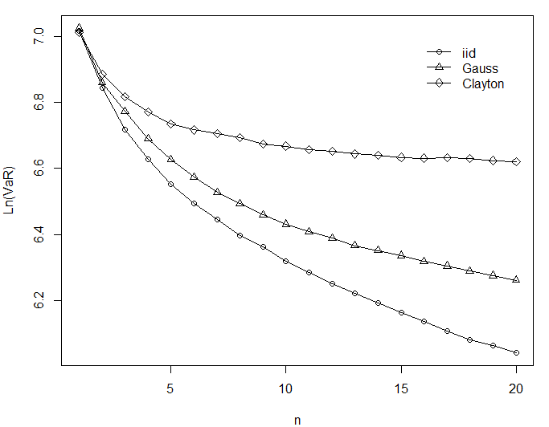
Excursion: Cyber Risk and Diversification
Merits of Diversification
Independent
Dependent
Notes:
IID case:
Keeping portfolio size constant (Sum of n RVs devided by n)
Deterministic sum here
Simulated VaR as used by SII
Normal (α=2) & lognorm lead to decreasing VaR ->Merits of diversification
Pareto: Risk increases as portfolio size does

Slide 7
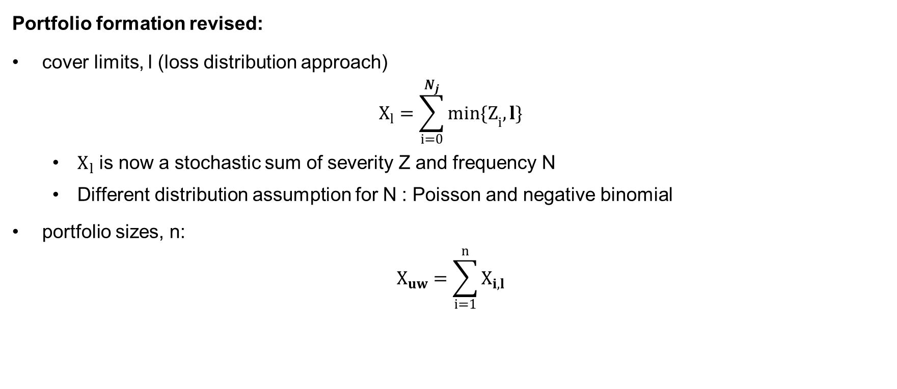
Methodology
Portfolio formation revised:
cover limits, l (loss distribution approach)
$$X_{l}=\sum_{i=0}^{N_{j}}{{min\{Z}_{i},l\}}$$
  $X_{l}$ is now a stochastic sum of severity Z and frequency N
  Different distribution assumption for N : Poisson and negative binomial
portfolio sizes, n:
$$X_{uw}=\sum_{i=1}^{n}{X_{i,l}}$$
Notes:
We need to assume how the model (of not clear) needs to be applied -> we can not ask the regulator for a ruling
- Frequency: for a portfolio of 50 (0.15*50), here Poisson model
- Severity: Caped at 50 Mio. USD, empirical distribution (defined on a lattice, h=0.1 Mio. USD)

Slide 8
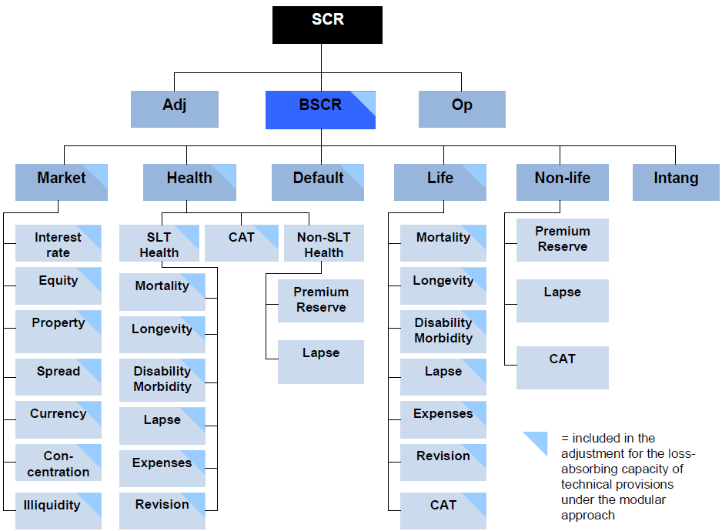
Solvency II and Cyber Risk
Operational Cyber Risk
Underwriting Cyber Risk
Notes:
Scenaria approach for market und life underwriting risk
Factor approach for non life underwriting risk
SCR relevant to avoid interventions
Square root formula simmilar to the calculation of a potfolio’s standard deviation (SCR is simply a linear transformation of the variance)
Correlation matrix
Factor multiplication is meant to approx. the VaR of a lognormal distribution (at the 99.5% confindence level)
OP risk: factor times BSCR

Slide 9
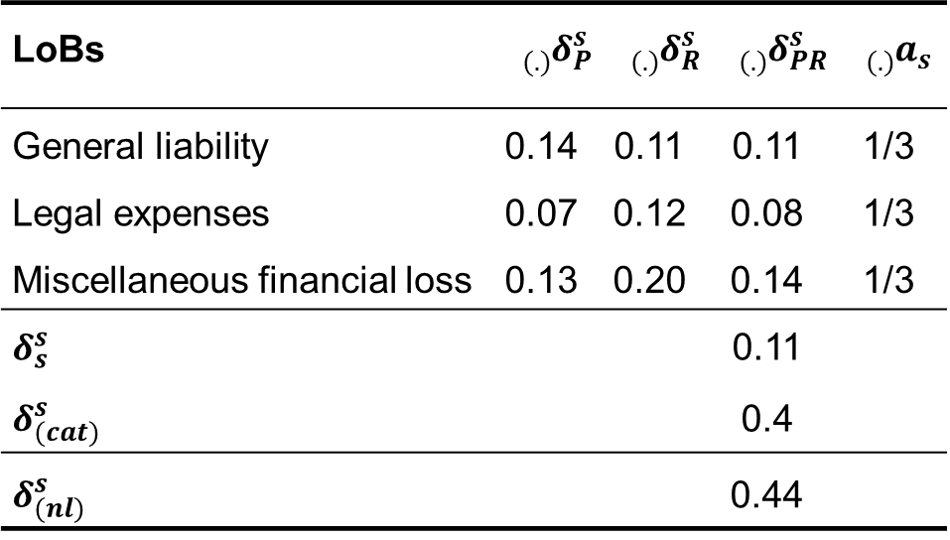

Solvency II and Cyber Risk (Underwriting)
Required capital:
$${scr}_{\text{i}}=3∙{factor}_{i} ∙v_{i}$$
Aggregation by the square root formula:
$scr=\sqrt{{scr}^{T} Σ scr}$
Value at Risk:
$${VaR}_{\text{99.5\%}}≈scr+v_{}$$
LoBs | $${{}_{(.)}^{}δ}_{P}^{s}$$ | $${{}_{(.)}^{}δ}_{R}^{s}$$ | $${{}_{(.)}^{}δ}_{PR}^{s}$$ | $${}_{(.)}^{}{a_{s}^{}}$$
General liability | 0.14 | 0.11 | 0.11 | 1/3
Legal expenses | 0.07 | 0.12 | 0.08 | 1/3
Miscellaneous financial loss | 0.13 | 0.20 | 0.14 | 1/3
$$δ_{s}^{s}$$ |  |  | 0.11
$$δ_{(cat)}^{s}$$ |  |  | 0.4
$$δ_{(nl)}^{s}$$ |  |  | 0.44
Notes:
where the factor (coefficient of variation) is given by the regulator (depending on the LoB, normal vs cat risk, and premium vs reserve risk)
and $v$ stands for the volume measure (usually total written premium or reserves).

Slide 10
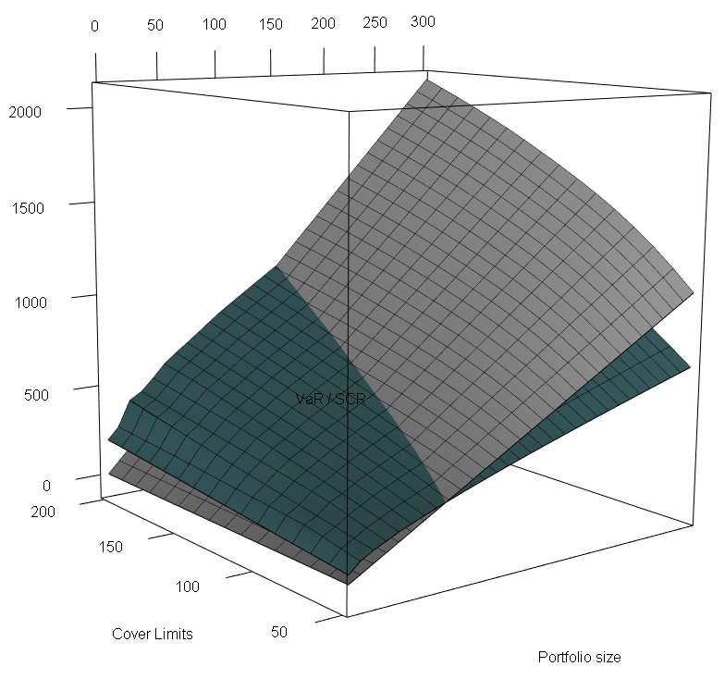
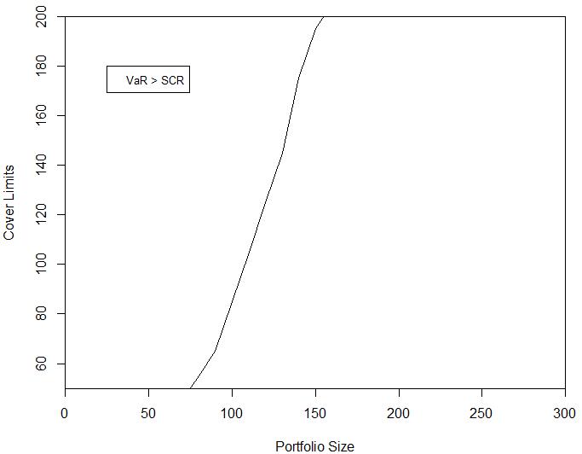
Solvency II and Cyber Risk (Underwriting)
VaR vs. SCR
Cover Limits / Portfolio Size Boundary
Notes:
- Note: While the green plane represents the VaR derived from the Poisson model, the grey plane represents the SCR (in mUSD).

Slide 11
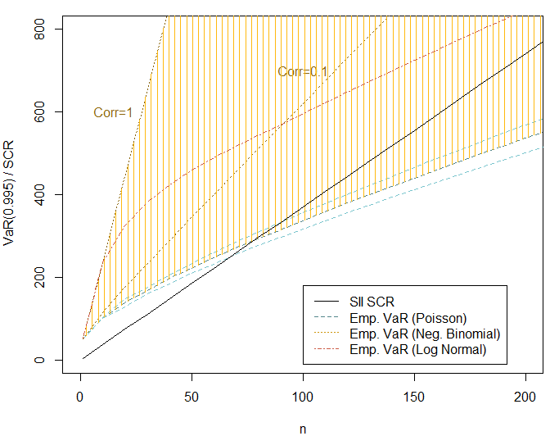
Solvency II and Cyber Risk (Underwriting)
Sliced at cover limit l= US$ 50 m
Notes:
- Solvency II misses the safety level it aims for (1 in 200) when an insurer underwrites cyber risk (even higher mismatch as the correlation increases)

Slide 12
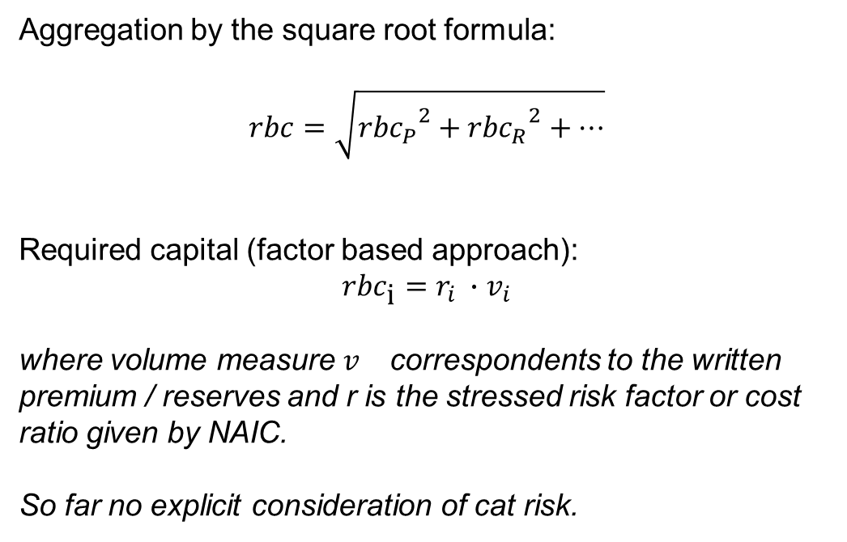
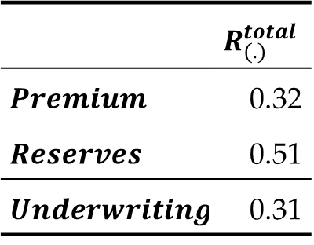
US Risk Based Capital and Cyber Risk (Underwriting)
Aggregation by the square root formula:
$$rbc=\sqrt{{{rbc}_{P}}^{2}+{{rbc}_{R}}^{2}+…}$$
Required capital (factor based approach):
$${rbc}_{\text{i}}=r_{i} ∙v_{i}$$
where volume measure $v_{}$ correspondents to the written premium / reserves and r is the stressed risk factor or cost ratio given by NAIC.
So far no explicit consideration of cat risk.
 | $$R_{(.)}^{total}$$
$$Premium$$ | 0.32
$$Reserves$$ | 0.51
$$Underwriting$$ | 0.31
Notes:
Authorized Control Level (ACL): 50% * RBC
No correlation between different risk types (R0 – Investments in Insurance Affiliates & Off-BS Risks, R1 – Fixed Income Securities, R2 – Equity Investments, R3 – Credit Risk, R4 – Reserving Risk (incl. basic & growth), R5 – Premium Risk (incl. basic & growth)

Slide 13
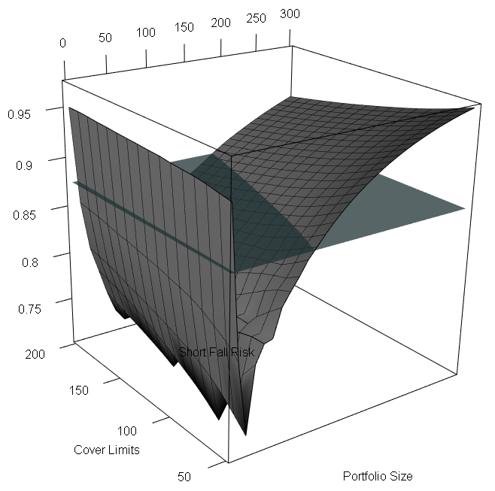
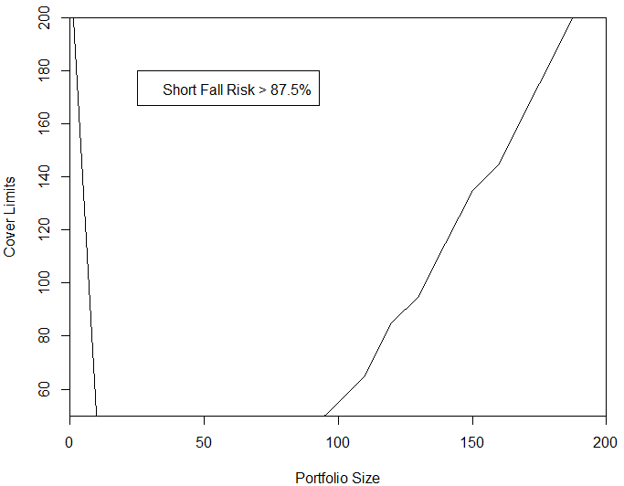
Cyber Risk and US Risk Based Capital (Underwriting)
Cover Limits / Portfolio Size Boundary
Notes:
87.5%
$a$: safety level (probability not to default)
Calculated safety level of 82% is rather low (regulator aims for 87.5%).

Slide 14
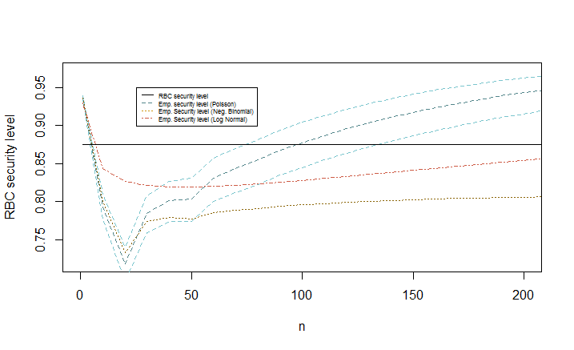
Cyber Risk and US Risk Based Capital (Underwriting)
Sliced at cover limit l= US$ 50 m

Slide 15



Cyber Risk and Swiss Solvency Test (Underwriting)
Reserves ($μ_{R}$, $σ_{R}^{2}$)
LogN($μ_{R}+μ_{N}$, $σ_{R}^{2}+σ_{N}^{2}$)
CY: Premium risk
Normal Losses ($μ_{N}$, $σ_{N}^{2}$)
Convolution
X
Extreme Losses
(comp. Pareto)
SST defines the parameters of the distributions.
Then, the distribution of the total loss is derived numerically and the ${TVaR}_{99\%}\left(X\right)$ is calculated.
Notes:
- Mu and standard deviation are calibrated according to the insurers own data.
Extreme Losses >5 Mio. CHF
Extreme losses are poisson compounded paretos.
Pareto index is given

Slide 16
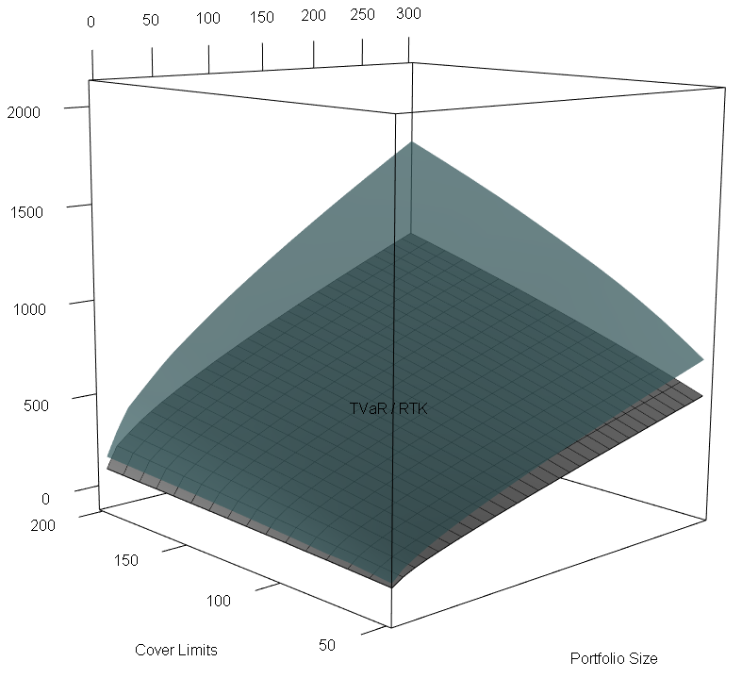
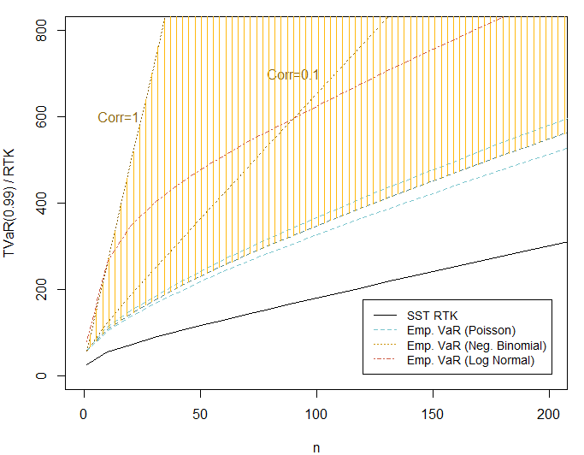
Cyber Risk and Swiss Solvency Test (Underwriting)
TVaR vs. RTK
Cover Limits / Portfolio Size Boundary

Slide 17
Conclusion
Key findings
All three regulatory models underestimate cyber risk especially for small portfolios sizes and high cover limits
This is due to the characteristics of cyber risk, such as the heavy tails and strong correlation. As a result there are adverse consequences for diversification
Disclaimer
SAS Data representative for a specific underwriting portfolio / operational cyber risk exposures?
Assumptions on how to apply the regulatory models (no rulings available)
Notes:
A major part of cyber threats distributes over the internet and therefore the correlation might be higher than for other underwriting risk. Moreover, extreme scenarios suggest that cyber risk could accumulate and become catastrophic
However, while insurers can geographically diversify cat risk, cyber risk propagated by the Internet does not know any boundary.

Slide 18
Conclusion
Recommendations
Instead of a “one fits it all” approach: specific risk factors and correlations calibrated with cyber risk data
Heavy tails would call for replacing the log normal assumption used by SII and SST by a power law distribution
Sound risk models will become even more important as the insurance industry will rely more heavily on new technologies and cyber underwriting portfolios increase
Data quality should be improved

Slide 19
Questions and Discussion
Thanks a lot for your attention!

