Slide 1
Introduction to the UN Guiding Principles on Business & Human Rights
Isabel Ebert, University of ST. GAllen, November 2023
Notes:
To do
Back-up polls
Poll One: My company has: (SELECT THE ONE THAT APPLIES)
Conducted a company-wide human rights risk analysis and we plan to repeat this on a regular basis
Conducted a company-wide human rights risk analysis but have no plans to repeat this
Not done this but we plan to
Has no current plans to do this.
Poll Two: I think the UNGPs framework for prioritization (SELECT THE ONE THAT APPLIES)
Is clear and easy to implement (for my company)
Is clear and difficult to implement (for my company
Is clear but impossible to apply (for my company)
Is unclear
None of the above
Poll Three: The most senior Executives and even the board, should be actively engaged (SELECT ALL THAT YOU THINK APPLY)
In reviewing progress and challenges in addressing priority human rights risks.
In the process of prioritization
Where human rights risks are severe and likely to re-occur.
If addressing a human rights risk requires action that impacts business strategy\
Post session survey
1. How relevant was the discussion to your current work and challenges?
Not relevant
Somewhat relevant
Very relevant
Not sure yet
2. What did you think about the quality of discussion?
High
Medium
Low
Need time to reflect
3. Do you have any advice for the design and facilitation of future sessions?
Yes
No
Need time to reflect
If yes and you have time now, please explain here:
4. Do you ideas for which aspects of the discussions / topic addressed do you think B-Tech should spotlight in the session output?
Yes
No
Need time to reflect
If yes and you have time now, please explain here:
5. Any other reflections
Note to Chloe and Gerald
Insert FB and HPE slides
Talking points / facilitation prompts
Send Slide 19 in the morning with reminder about start-time and link.

Slide 2

What are human rights?
The simple idea behind human rights is that everyone should be treated with dignity.
Human rights are rights that are inherent to all people, without discrimination.
Human rights are enshrined in international treaties and customary law binding on States.

Slide 3

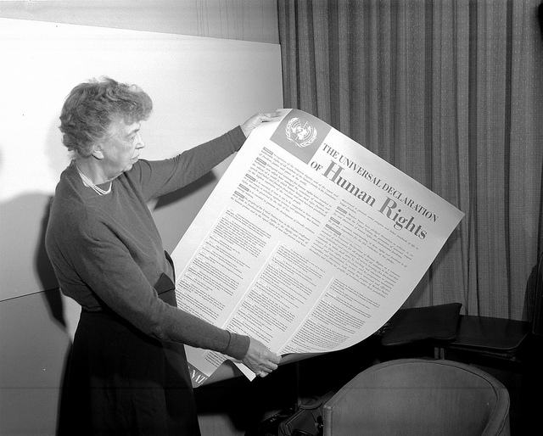
“Where, after all, do universal human rights begin? In small places, close to home…they are in the world of the individual person; the neighbourhood he lives in; the school or college he attends; the factory, farm, or office where he works. Such are the places where every man, woman, and child seeks equal justice, equal opportunity, equal dignity without discrimination. Unless the rights have meaning there, they have little meaning anywhere.”
Eleanor Roosevelt

Slide 4
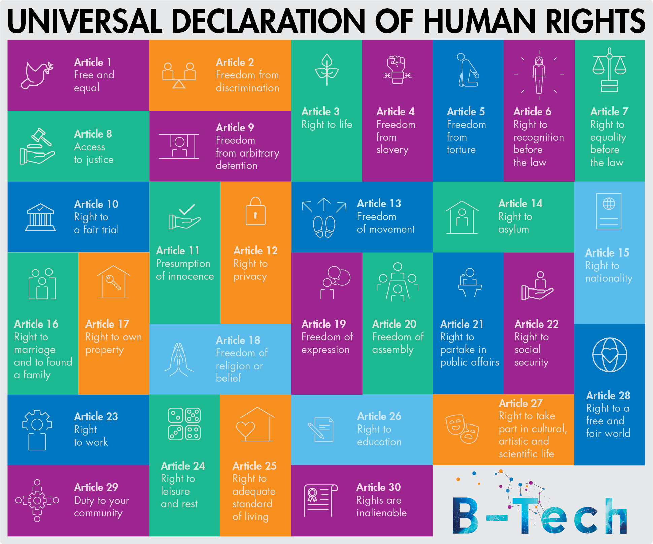

Slide 5

Structure of today‘s session
1. Introduction into Business & Human Rights
2. The revelance of Business & Human Rights in tech
3. Human Rights Due Diligence and Human Rights Impact Assessment

Slide 6
Introductory Concept
Business & Human Rights
and the UN Guiding Principles on Business & Human Rights

Slide 7

The UN Guiding Principles on Business and Human Rights
Result of six year consultative process mandated by the UN Human Rights Council, led by SRSG John Ruggie
2011: The Council unanimously endorsed the Guiding Principles for operationalizing the Protect, Respect and Remedy framework in Resolution 17/4
Endorsed by global business, civil society and trade unions
A global normative framework with a strong political foundation
‘Principled Pragmatism’
Significant uptake in business practice and regulatory frameworks

Slide 8
The Guiding Principles – Three Pillars
The State duty to protect against human rights abuses by businesses: policies, regulation, adjudication
The corporate responsibility to respect human rights : act with due diligence to avoid infringements and address adverse impacts on human rights
Access to effective remedy for victims through judicial and non-judicial grievance mechanisms
Protect
Respect
Remedy

Slide 9

2. The relevance of the UNGPs in tech – the UN Human Rights B-Tech Project

Slide 10
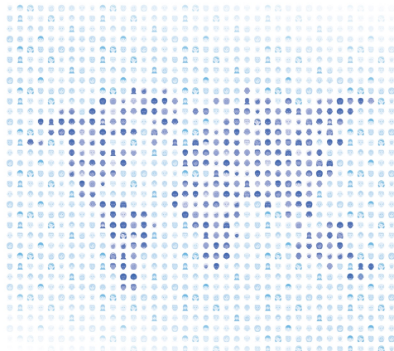
B-Tech Project modalities
Dynamic and interactive process
Conducting research and consulting with stakeholders to explore new ideas and guidance
Participation of all interested parties (States, companies, investors, civil society, academics, ...)
Foundational papers, guidance notes, good practice case studies, comments on practical dilemmas published continuously
Outreach across diverse geographic regions

Slide 11
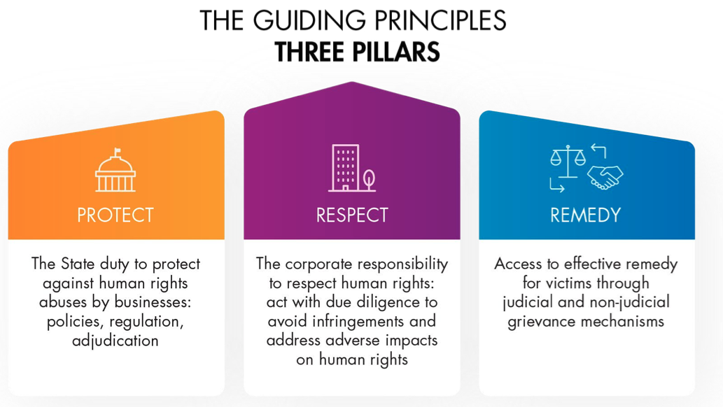
BHR lens to address challenges for human rights in tech
B-Tech project – applying the lens of the UN Guiding Principles on Business and Human Rights to digital technologies.
Focused on preventing, identifying, mitigating and addressing risk to people from digital technologies.
Working in an multi-stakeholder manner to deliver better policy responses and practical outputs

Slide 12

3. Human Rights Due Diligence

Slide 13
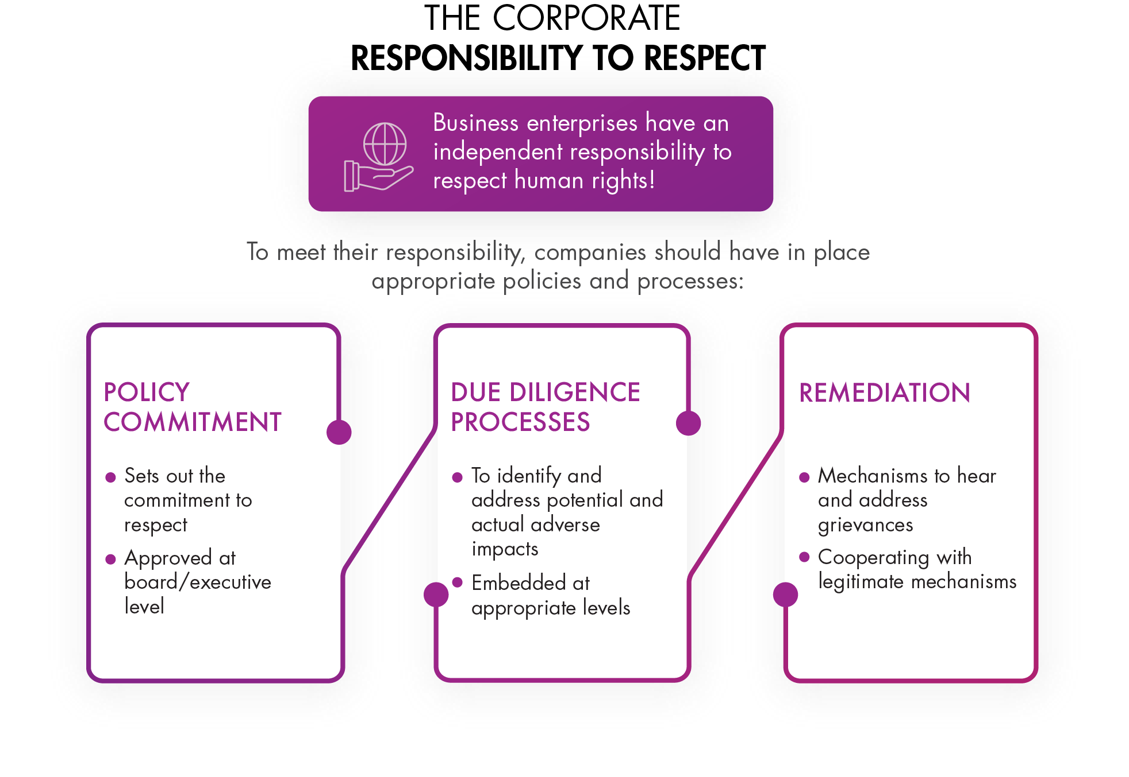
The Corporate Responsibility to Respect
Business enterprises have an independent responsibility to respect human rights!

Slide 14
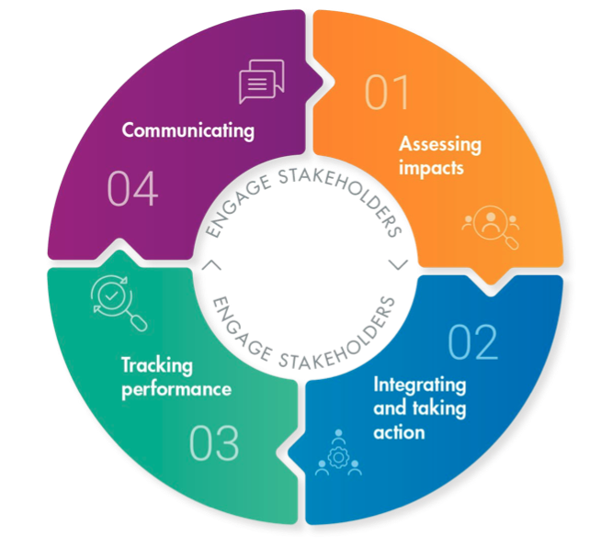
Focus Area TWO:
Human Rights Due Diligence and End-Use
The four steps of human rights due diligence process
Identifying and Assessing Impacts to gauge the nature and extent of human rights risks
Acting to prevent and mitigate risks to people, including via integration within internal functions and processes
Tracking of effectiveness of risk mitigation responses over time; and
Appropriate communication of performance with respect to addressing human rights impacts
+ B-Tech recommendationsCommunity of Practice to „test“ and fine-tune with set of tech company representatives

Slide 15
Key challenges in tech
Key Challenges
How to undertake “meaningful consultation” with potentially affected individuals and groups when the numbers are in the millions, if not billions?
How to respond to actual or potential harm can spread imminently and be transboundary nature?

Slide 16

Specific challenges in tech:
Addressing Human Rights Risks in Business Models
Demonstrate that the company is taking reasonable steps—consistent with the UNGPs—to prevent, mitigate and remediate harms to people in business models
Review performance incentives for top management and key functions to reward actions that prevent or mitigate human rights harms
Stress-test—and as necessary improve—the design of technologies in ways what demonstrably minimise the risks of severe human rights harms, versus only optimising for maximising revenue
Scrutinise plans for testing and expansion in new markets, with a focus on whether the local context exacerbates business model human rights risks
Engage in collective action with peers, professional associations, customers, civil society and government to develop and implement rights-respecting standards of business conduct and technological design
Ensure the company plays a constructive role in processes to develop laws and regulations aimed at increasing human rights protections

Slide 17
Thank you
Sign-up to our newsletter via our website

