Slide 1
ARIA 2018 ANNUAL MEETING
EXTREME CYBER RISKS AND THE NON-DIVERSIFICATION TRAP
Werner Schnell*, Ph.D Candidate
(with Prof. Martin Eling*)
*Institute of Insurance Economics, University of St.Gallen
Notes:
Welcome to my presentation (thanks)
Phd at the university of St.Gallen
- Third paper in a row on cyber risk (extending from regulatory view to economic view)

Slide 2

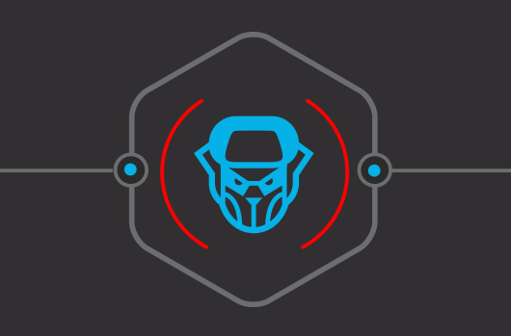
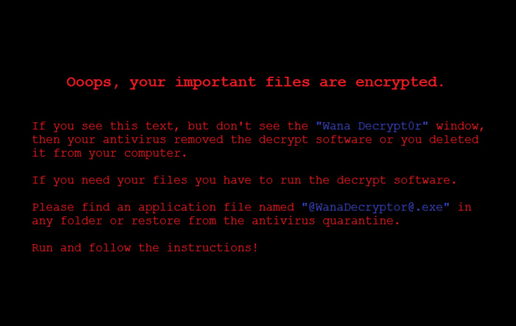

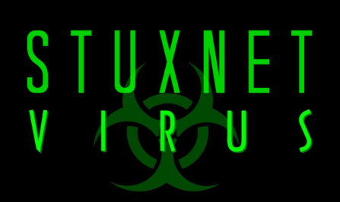
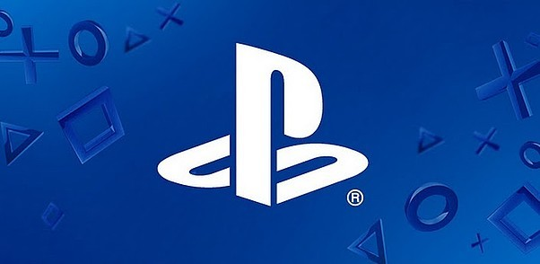

Cyber Risk Everywhere?
COZY BEAR
3 billion accounts
Up to $1 billion
Estimated global costs per year: $445 billion
$171 million
Notes:
Few examples:
WannaCry
2017; Befällt Windows-Betriebssysteme, die nicht mit von Microsoft angebotenen Patch nachgebessert wurden
The attack was estimated to have affected more than 200,000 computers across 150 countries, with total damages ranging from hundreds of millions to billions of dollars.
Sony Playstation
April 20, 2011; 77 million PlayStation Network accounts hacked; estimated losses of $171 million while the site was down for a month
Hackers gained access to full names, passwords, e-mails, home addresses, purchase history, credit card numbers and PSN/Qriocity logins and passwords.
Silent cover in liability insurance (e.g. Zürich vs Sony Corp)
Yahoo
2013-14; 3 billion user accounts; The attack compromised the real names, email addresses, dates of birth and telephone numbers of 500 million users.
Stuxnet
Date: Sometime in 2010, but origins date to 2005
Impact: Meant to attack Iran's nuclear power program, but will also serve as a template for real-world intrusion and service disruption of power grids, water supplies or public transportation systems
Das Schadprogramm wurde speziell zum Angriff auf ein System zur Überwachung und Steuerung (SCADA-System) des Herstellers Siemens
Frequenzumrichter dienen beispielsweise dazu, die Geschwindigkeit von Motoren zu steuern
Da bis Ende September 2010 der Iran den größten Anteil der infizierten Computer besaß^{[T 3]} und es zu außerplanmäßigen Störungen im iranischen Atomprogramm kam, lag es nah, dass Stuxnet hauptsächlich entstand, um die Leittechnik der Urananreicherungsanlage in Natanz^{[1]} oder des Kernkraftwerks Buschehr^{[2]} zu stören.
Cozy bear
2016; Classified as advanced persistent threat APT29, is a Russian hacker group believed to be associated with Russian intelligence
the Democratic National Committee (DNC) first stated that the Russian hacker groups Cozy Bear and Fancy Bear had penetrated their campaign servers and leaked information,
(McAfee, 2014)

Slide 3
Cyber Risk Market
Status Quo
Cyber risk market is lagging behind expectations:
  Only 6% of U.S. companies have cyber insurance (Willis, 2013b).
  In Europe only 1% of individuals possess cyber insurance (YouGov, 2014).
Europe’s cyber market is even less developed then the U.S. market.
Just a question of time or is something fundamentally wrong with cyber risk?
Notes:
U.S. show a similarly low average level of coverage of about 6 per cent, but large variations between industries among the Fortune 1000 companies (Willis, 2013b)
Capital charges assume some diversification.
Sony Corp. of America and Zurich American Insurance Co. have reached a settlement in a commercial general liability (CGL) policy coverage case stemming from the April 2011 hacking of Sony’s PlayStation online services.
The data breach had exposed personal information of tens of millions of users.
Silent cover in liability insurance (e.g. Zürich vs Sony Corp)

Slide 4

Characteristics of Cyber Risk
Developing appropriate models for cyber risk is important for policy, regulation, risk management, pricing and ultimately:
Lack of data and established models:
  Is the data we have so far representative for the future?
  Fast changing environment
  Realm of risk or uncertainty (modelling and parameter risk)?
  Only way out: modelling based on scenarios?
Development of cyber insurance market and efficiency gains!
Notes:
- Major problem: not explicit treatment of cyber risk in any framework ->unlock how it might be applicable
Need to be modelled differently:
- Operational Cyber Risk: Insurers digitalized their operations and are therefore prone to cyber risk
- Underwriting Cyber Risk: Stand alone (dedicated) cyber risk policies or it is included in liability & property insurance. Sometimes not clear whether cyber risk is included (see Sony vs. Zürich, 2011).
-Importantly: Probably a correlation between op and underwriting cyber risk
- RBC: national association of insurance commissioners
Cyber Risk might be a new type of risk:
Still trying to grasp cyber risk
Not enough data; high uncertainty (Fitch Ratings (2016) warned to downgrade insurers that write standalone products to heavily)
Risk is very fast changing and still an emerging risk (WannaCry ransomware )
Results so far: highly correlated (no geographical boundaries) and probably heavy tail (extreme events so far not realized, skewness).
Probably tail correlation (non linear correlation)
Only alternative would be scenarios (Cambridge Centre for Risk Studies)
Therefore regulatory frameworks might not be appropriate.

Slide 5
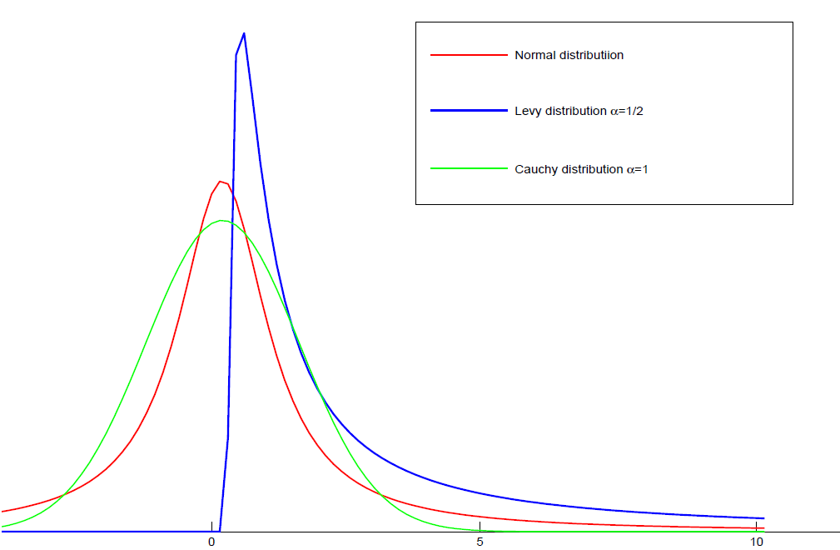
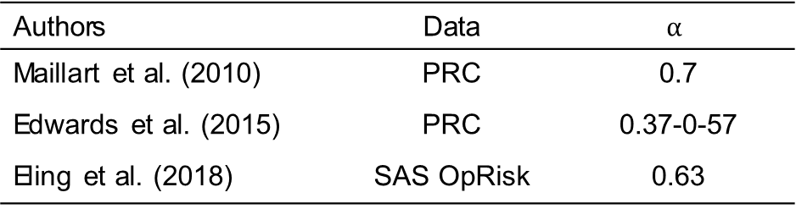

Characteristics of Cyber Risk
Preliminary findings
Power law: $P\left(Z>z\right)=c∙z^{−α}$
Potentially strong and nonlinear dependency (Böhme et al., 2006; Herath et al., 2011; Mukhopadhyay et al., 2013)
Authors | Data | $$α$$
Maillart et al. (2010) | PRC | 0.7
Edwards et al. (2015) | PRC | 0.37-0-57
Eling et al. (2018) | SAS OpRisk | 0.63
Notes:
Similar tail index can be found for cat / terror / operational risk.
$α:$ Pareto (or Tail) index
(extremely) heavy tailed if$(α<1) α<2$
-$α<2:I$nfinite second and higher moments
- Operational risks: α < 1 ⇒infinite means E|X| = ∞!, Firm sizes, sizes of largest mutual funds, city sizes: α ≈ 1, Economic losses from earthquakes: α ∈ [0.6, 1.5]
- Border a=1 is quite important (switch from finite to infinite mean)
If α > 1 diversification is optimal over non diversifikation (Ibragimov)
Sub- vs. superaditivity
Find that the estimated α<1
Eling & Wirfs (2016) suggest a lognormally distributed body and a Pareto distributed tail
Asymmetric information (Biener et al., 2015)
- We assume strong negative tail dependency
Maybe due to significant spill-overs in times of extreme events
-> Clayton copula
Diversification: Problem

Slide 6

Cyber Risk Data
Baseline
Robustness check
  Cyber incidents extracted from the SAS Operational Risk database (credits to Jan Wirfs)
  Privacy Rights Clearinghouse (PRC) data breaches (since 2005)
Notes:
Cyber risk exposure is modeled based on publicly available data:
SAS
1,579 cyber risk losses SAS
1995-2014
Publicly reported cyber insidents; globaly
PRC
Records Brechend: 10 Billion; reported in the US
Problem of reporting bias (for SAS only above 100’ USD).

Slide 7
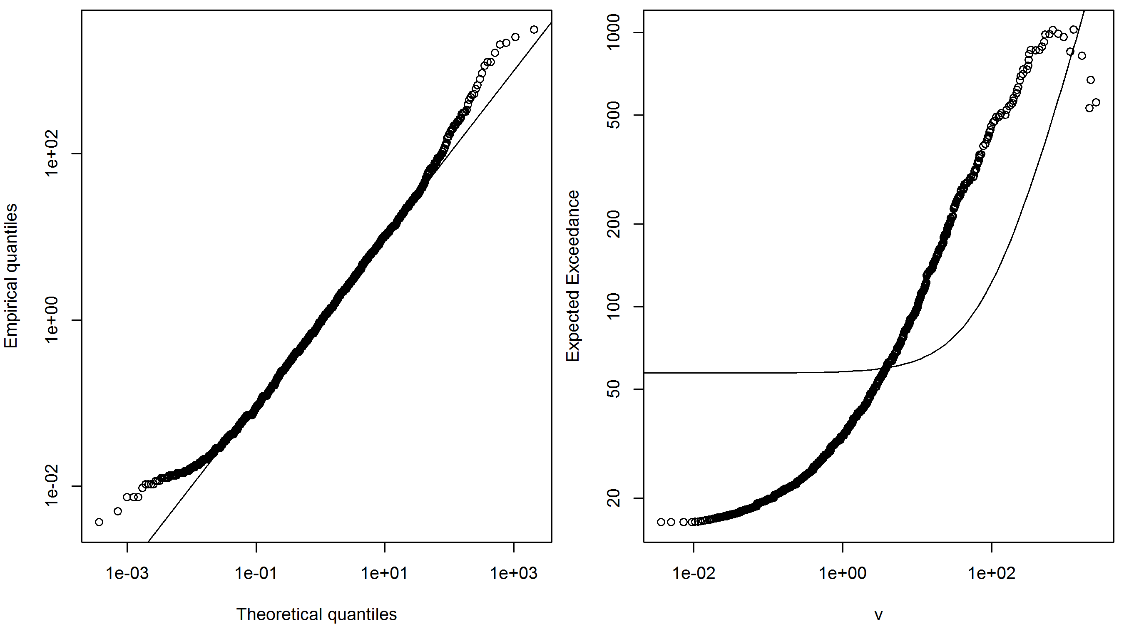
Characteristics of Cyber Risk
QQ Plot (vs. Lognormal)
Expected Exceedance
Notes:
- Major problem: not explicit treatment of cyber risk in any framework ->unlock how it might be applicable
Need to be modelled differently:
- Operational Cyber Risk: Insurers digitalized their operations and are therefore prone to cyber risk
- Underwriting Cyber Risk: Stand alone (dedicated) cyber risk policies or it is included in liability & property insurance. Sometimes not clear whether cyber risk is included (see Sony vs. Zürich, 2011).
-Importantly: Probably a correlation between op and underwriting cyber risk
- RBC: national association of insurance commissioners

Slide 8
Characteristics of Cyber Risk
 | LogLik | AIC | BIC | KS | AD
Normal | -11’619 | 23’243 | 23’254 | 0.46 | -
Lognormal | -4’498 | 9’000 | 9’010 | 0.08 | 17.26
Generalized Pareto | -4’461 | 8’929 | 8’945 | 0.07 | 7.24
Peaks over threshold (POT) | -4’456 | 8’922 | 8’949 | 0.06 | 11.05
Goodness-of-Fit
Notes:
- Böhme et al emphasise that better data would be required in order to estimate suitable copulas and parameters empirically.
pandemics (Bolot and Lelarge, 2009). Highly interconnected (dense) and low clustering networks provide an optimal environment for the spreading of malicious code. On the other hand, a local destruction of physical components, such as the breakdown of a submarine cable, will have more severe effects if the Internet’s topology has low density and high clustering. Thus, the same network properties can potentially increase the vulnerability to one threat and simultaneously enhance resilience to another one. As it is usually assumed that the Internet is a rather decentralised and dense network (e.g. Ahamad, 2012), pandemic-like attacks pose a bigger threat than to the local destruction of physical components.
Note: LogLik stands for the logarithmic likelihood of the maximum likelihood (ML) estimation, AIC for the Akaike information criterion, BIC for Bayesian information criterion, KS for the Kolmogorow-Smirnow test, and AD for the Anderson-Darling test. The POT approach slices a lognormal body and a Pareto distribution from the 80% quantile upwards.

Slide 9
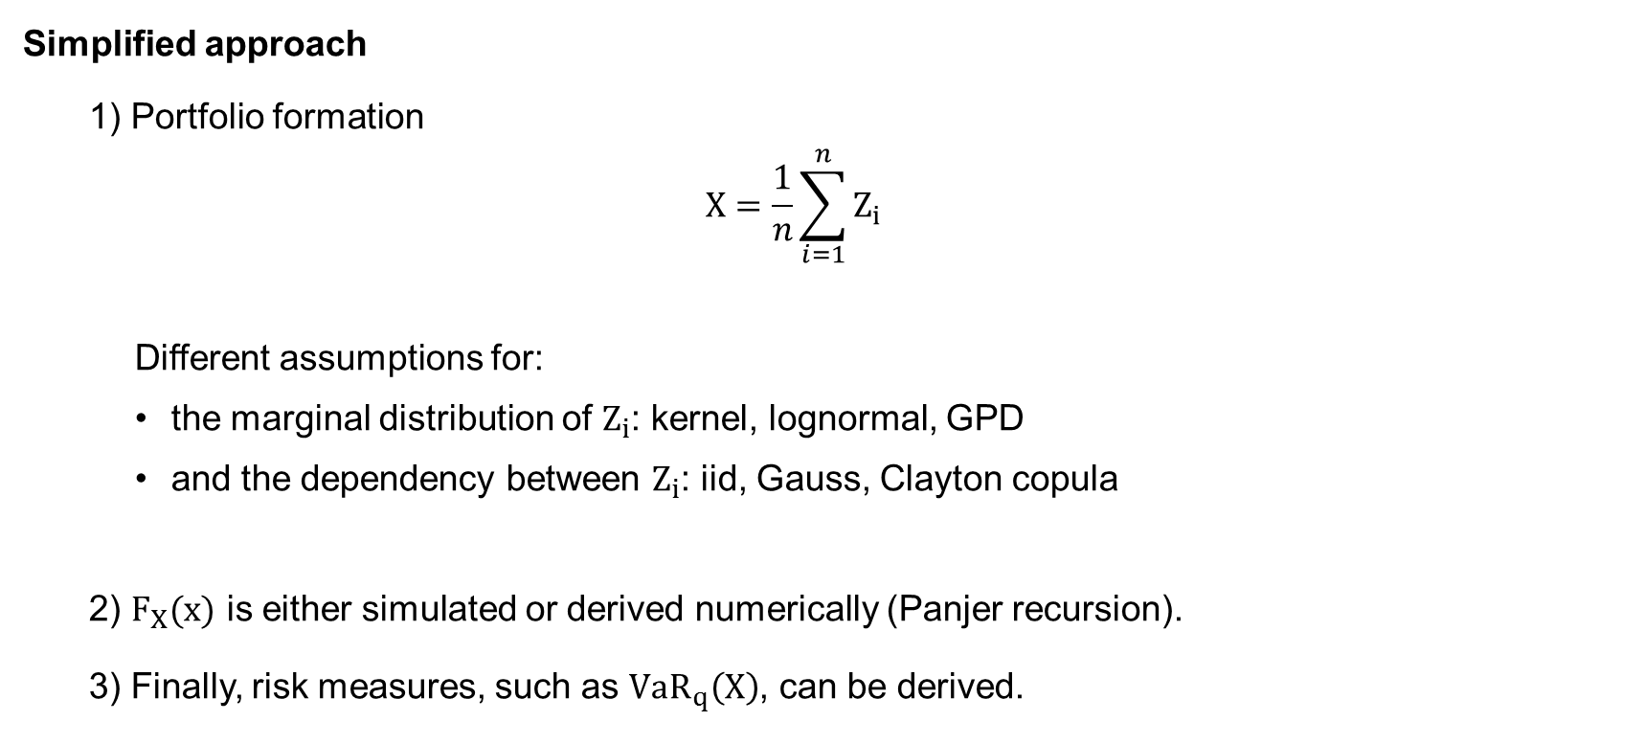
Excursion: Cyber Risk and Diversification
Simplified approach
  1) Portfolio formation
  $$X=\frac{1}{n}\sum_{i=1}^{n}{Z_{i}}$$
    Different assumptions for:
      the marginal distribution of $Z_{i}$: kernel, lognormal, GPD
      and the dependency between $Z_{i}$: iid, Gauss, Clayton copula
  2) $F_{X}(x)$ is either simulated or derived numerically (Panjer recursion).
  3) Finally, risk measures, such as ${VaR}_{q}\left(X\right)$, can be derived.
Notes:
- $q:prob einen verlust nicht zu überschreiten$
SAS Data from Biener et al. (2015)
Panjer recursion is only applicable to a certain class of frequency distribution
$F_{X}(x)$=${F_{Z}(Z_{i}) }^{∗n}$ numerically not solvable.
IID case:
Keeping portfolio size constant (Sum of n RVs devided by n)
Deterministic sum here
Simulated VaR as used by SII

Slide 10
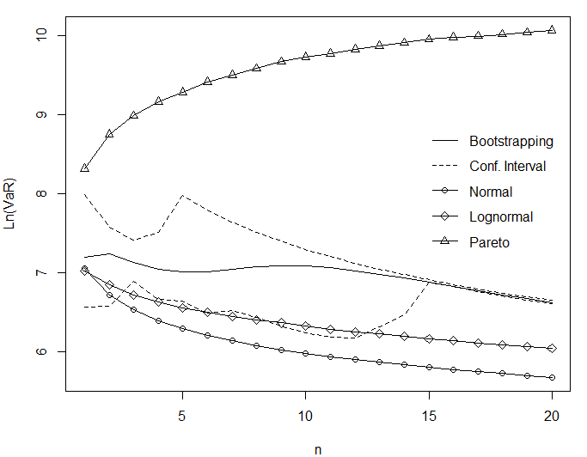
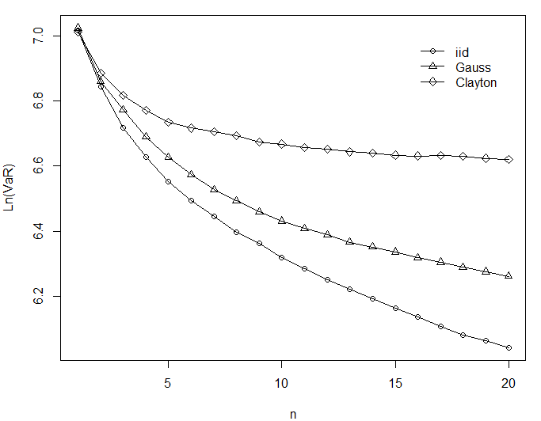

Excursion: Cyber Risk and Diversification
Merits of Diversification
$α<1$
Independent
Dependent
Notes:
Normal (α=2) & lognorm lead to decreasing VaR ->Merits of diversification
Pareto: Risk increases as portfolio size does
Perfect dependency (comonotonicity): no diversification effect -> ${VaR}_{q}$ constant (independent of tail index)
E.g. Archimedean copula the same as iid for sufficient small loss probability $q$.

Slide 11

Methodology
Portfolio formation revised (1)
1) Cover limits
$$\hat{Z}=\left\{\begin{aligned}cl, if Z<cl \\ Z, if Z≥cl\end{aligned}\right.$$
2) Loss distribution approach (frequency & severity)
$${\tilde{Z}}_{i}=p+I∙{\hat{Z}}_{i}$$
Notes:
- $q:prob einen verlust nicht zu überschreiten$
SAS Data from Biener et al. (2015)
-$I$ is Bernoulli distributed meaning it is one with a probability $q$ and 0 with a probability $(1−q)$.

Slide 12

Methodology
Portfolio formation revised (2)
3) Portfolio formation
$$X=s^{−1}\sum_{i=1}^{N}{{\tilde{Z}}_{i}}$$
  Different assumptions for:
    the marginal distribution of $Z_{i}$: Kernel, lognormal, GPD, POT
    and the dependency between $Z_{i}$

Slide 13

Methodology
Portfolio formation revised (3)
4) Limited liability ($ll$)
  $$\hat{X}=\left\{\begin{aligned}ll, if X<ll \\ X, if X≥ll\end{aligned}\right.$$
5) X is either simulated or its distribution is derived numerically (Panjer recursion)
6) Finally portfolio value is evaluated (see next slide)
Notes:
We need to assume how the model (of not clear) needs to be applied -> we can not ask the regulator for a ruling
- Frequency: for a portfolio of 50 (0.15*50), here Poisson model
- Severity: Caped at 50 Mio. USD, empirical distribution (defined on a lattice, h=0.1 Mio. USD)

Slide 14
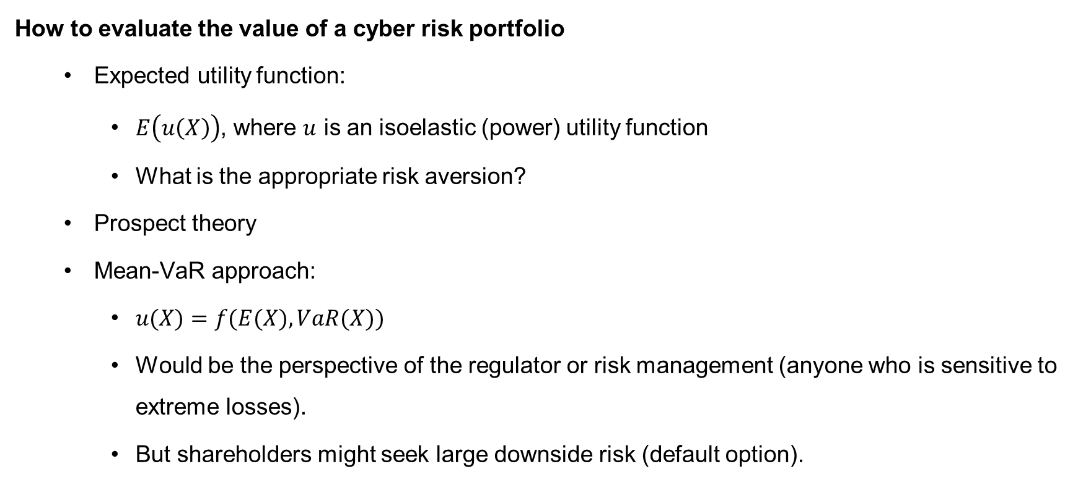
Methodology
How to evaluate the value of a cyber risk portfolio
  Expected utility function:
    $E\left(u\left(X\right)\right)$, where $u$ is an isoelastic (power) utility function
    What is the appropriate risk aversion?
  Prospect theory
  Mean-VaR approach:
    $u(X)=f(E(X), VaR(X))$
    Would be the perspective of the regulator or risk management (anyone who is sensitive to extreme losses).
    But shareholders might seek large downside risk (default option).
Notes:
Expected utility neglects loss aversion and probability weighting
PT shoud mitigate this problem

Slide 15
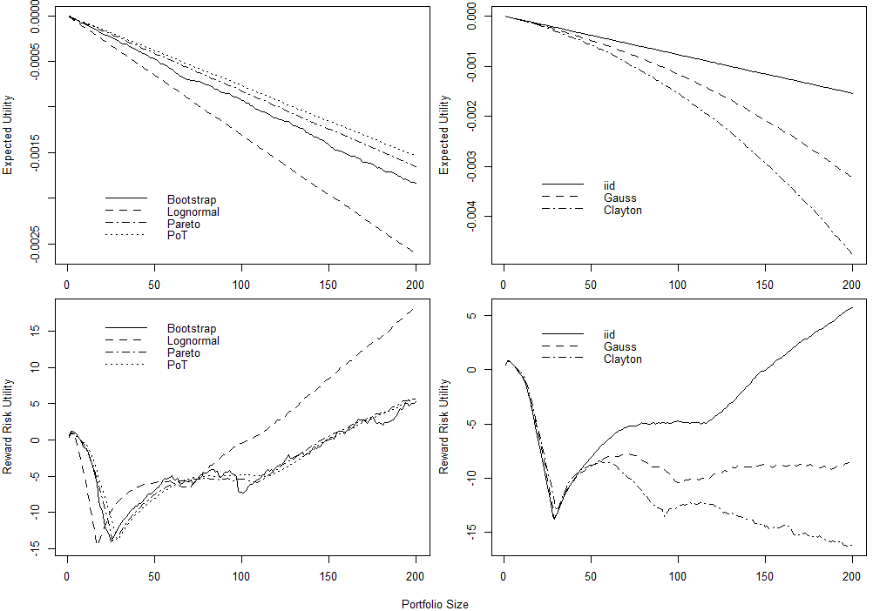
One Insurer

Slide 16
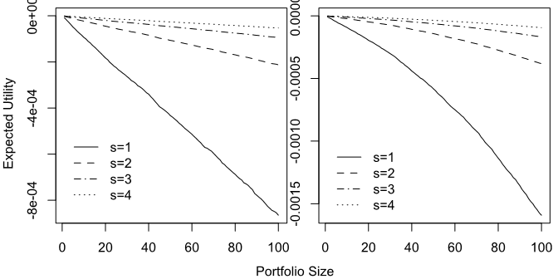
Pool with Several Insurers
Notes:
-Similar for other valuation models & ambiguity (uncertainty) aversion.
- The deadweight costs of bankruptcy, including a loss in the value of
the managers’ human capital, could then motivate the unwillingness of firms to
participate in the catastrophe insurance.
- have largely failed.
In this paper, we argue that the observed dynamic pattern of widely varying
supply conditions for catastrophe insurance and reinsurance could reflect
a multiple equilibrium system, with the market sometimes reaching a coordinated
reinsurance/diversification equilibrium, but at other times falling into
what we call a nondiversification trap.

Slide 17
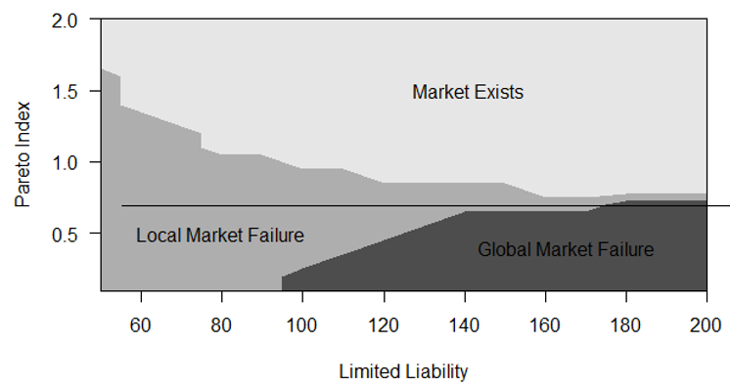
Market Outcome Dependent on Parameters

Slide 18
Conclusion
Findings
  Very heavy tails and strong (tail) dependencies cause diversification to fail:
    Genuine diversification trap
    Market stays underdeveloped unless subsidized.
    However, a subsidized market might not be desirable from a welfare perspective.
  Very heavy tails combined with cover limits / limited liability might cause a U-shaped portfolio value:
    Market stays underdeveloped if coordination problem is not solved.
    Utility negative on an individual level but positive on a market level
    Public coordination desirable

Slide 19
Conclusion
Recommendations
To overcome the diversification trap, the government could
  incentivize risk pools
  encourage the use and development of reinsurance (e.g. TRIA)
  make insurance supply compulsory (e.g. TRIA)
  provide public insurance (e.g. NFIP)
Data quality and models should be improved:
    Data pools
    Reporting requirements
Disclaimer
Is the data representative for underwriting cyber risk exposure?
Information asymmetries inherent in the cyber risk market not addressed.
Notes:
-National Flood Insurance Program (NFIP)
Terrorism Risk Insurance Act (TRIA)
Unable to accurately model or price terrorism exposures, reinsurers largely withdrew from the market for terrorism coverage. Without reinsurance, primary insurers were then compelled to exclude terrorism. Most state insurance regulators approved terrorism exclusions for use by primary insurers.
Congress responded by enacting TRIA in November 2002 to provide a government reinsurance backstop in case of large-scale terrorist attacks, requiring that business insurers offer terrorism coverage for the types of insurance included in the act

Slide 20
Conclusion
Recommendations
Regulatory models
  should consider heavy tails and tail dependency (introducing dedicated risk categories)
  must account for that the risk does not decrease as the underwriting portfolio gets larger (no capital reduction for diversification)
However, this would hinder the development of a cyber insurance market.
Notes:
-E.g. SII is based on the lognormal; this seems not to be appropriate if the risk is heavy tailed.
-The availability of better data in the future would open up new research opportunity.
-As there seems to be a game theoretical coordination problem

Slide 21
Questions and Discussion
Thanks a lot for your attention!

Slide 22
Conclusion
Implications
  Generally, we can’t rely on classical mean variance analysis and results.
  Raison d’être of insurers questionable if they can not diversify.
  Non-diversification leaves idiosyncratic risk price relevant and the premium charged by insurers even increases as more risks are pooled.
  Multi-equilibrium could emerge:
    Dynamically (times where reinsurance is available and when it is not)
    Segmentation of cyber market (separating different types of cyber risk)
Notes:
A major part of cyber threats distributes over the internet and therefore the correlation might be higher than for other underwriting risk. Moreover, extreme scenarios suggest that cyber risk could accumulate and become catastrophic
However, while insurers can geographically diversify cat risk, cyber risk propagated by the Internet does not know any boundary.
The limitation of this paper lays with the quality of available data and whether the data represents cyber risk in general well.
Diversification does not reduce VaR as expected: The regulator thus must account for that.
For example, since the risk does not decrease with diversification there should be no capital discount for diversification.
insurance). The traditional framework uses concave
optimization (e.g., via expected utility), with thin-tailed risks (e.g. normal
distributions), and without distortions (unlimited liability, no frictions and no
fixed costs). If any of these assumptions fails, diversification may not always be
preferred.5

Slide 23
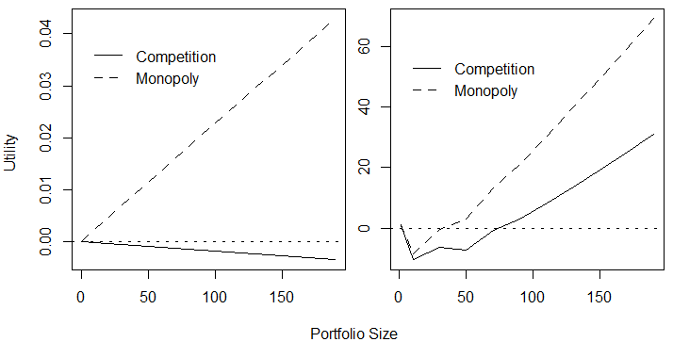
Competition vs Monopoly

