Slide 1
Truth by war:
Reducing uncertainty by violence
Session in Basel, SSA, September 9, 2024
Patrik Aspers

Slide 2
Knowledge conditions
1. Certainty (complete knowledge)
2. Risk (calcuable)
3. Uncertainty (unknown)
4. Ambiguity (indeterminable)

Slide 3
Uncertainty (Knight 1921)
Uncertainty means that we cannot know the ‘future consequences of present action’ (March 1994: 5, cf. 178; Arrow 1974: 33-4). Put differently, we do not know which of different states that is, or will be, the correct one. Or put even more simple: “we do not know what will happen”
It is an epistemic problem, lack of knowledge
If we can assign probabilities to the categorized things and calculate the likelihood of various outcomes of the decision alternatives, that is, by putting numbers on different means and ends so that there are probabilities of the different outcomes, we speak of risk, as Frank Knight (1921) puts it.
Ambiguity, “interpretative openness”
Transfer and commensuration from ambiguity, uncertainty to (the discourse of) risk

Slide 4

Open Access by Oxford University Press 2024

Slide 5
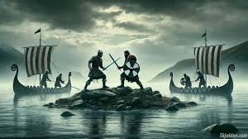

Slide 6
Truth by war:
Reducing uncertainty by violence
Session in Basel, SSA, September 9, 2024
Patrik Aspers

