Slide 1



Interdependent core components of steering marketing communication mix selection
Interactive Focus Group - Findings of the first study
Prof. Dr. Sven Reinecke & Philipp Kaufmann
IMC-HSG
Notes:
Thank you very much for joining the interactive focus group
As promised, I'll be sharing the findings of my research with you. To keep it interactive (not a lecture), we very much welcome your feedback on the results and any ideas for future research - future research that keeps answering how firms can effectively and efficiently choose the marketing communication mix.
Before we start… I would like to introduce Prof. Dr. Sven Reinecke - my supervisor, who focuses his research - beside other research area - on controlling and marketing performance

Slide 2
Research Question 1
What are the core components of effective and efficient marketing communication mix steering?
Notes:
As a quick recap, the first research question was…

Slide 3
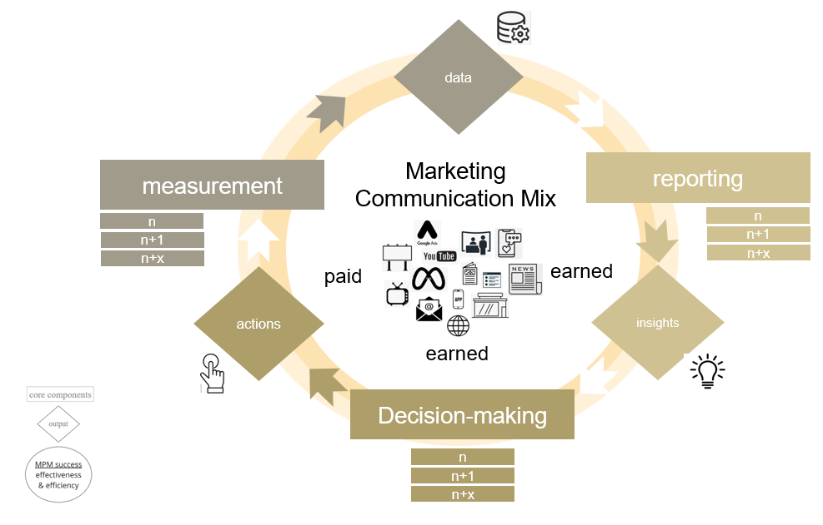
Marketing Communication Mix Steering Framework
Paid, earned, and owned tools/channels build the marketing communication mix (I).
Successful MCM steering means MCM goal attainment (effectiveness) and efficiently allocating the budget across the MCM (efficiency) (II).
It consists of measurement, reporting and decision-making core components.
Marketing communication mix steering framework
(own illustration)
(I) Comello et al, 2021, p.1, Batra and Keller (2016), Lovett & Staelin (2016), Brekenfeld & Lamsfuss MRSG (2023) p. 14
(II) Keh et al, 2006: Thomas, 2000; Reinecke & Janz, 2007
Notes:
Based on the interviews, the marketing communication mix steering framework has been created.
every company has a marketing communication mix that consists of paid, earned, owned media. So basically, the research focuses on the “promotional” P in the 4P marketing mix. It is important to mention that these channels are not autark - they are influenced by other channels as well (for example, TV ads can drive brand search on Google).
The MCM success consists of MCM effectiveness which is defined individually by a firm and can for example be profitability goals (e.g. lead generation) or branding goals (e.g. increasing brand awareness) and MCM efficiency, “getting out the most for the investment”
What we will see in the findings of the research is the MCM success depends on core components in measurement, reporting and decision-making process steps and their output variables; data, insights and actions
The core components build the marketing communication mix steering framework.

Slide 4
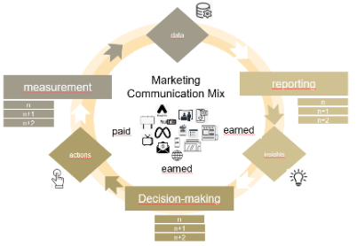

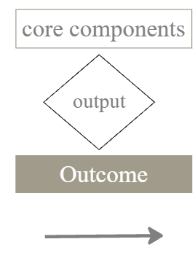
MCM steering is an Interdependent Process
MCM steering is an interdependent process of core components, outputs & an outcome (MCM success)
Availability of structured records of MCM performance (II)
“So like you continuously feed new data into the model (...) So like having reporting mechanisms to you know both like assess the performance of the model (...)" (I-28)
“(...) if you put actionability in the core request forecasts request simulations and verify their accuracy over time.” (I-28)
Holistic
steering of marketing communication mix
Actionable insights
for MCM allocation and optimization (II)
Marketing communication mix steering framework
(own illustration)
“I think reporting is super essential (...). If you communicated it effectively, then at the end you have to make a decision in your team." (I-29)
Notes:
What is also important to mention is that these components are interdependent, which you can also see in the quotes (that is why it is a cyclic process). To give you a quick overview how the process works:
Measurement should lead to relevant data which is the basis for reporting which should lead to actionable insights which is the basis for decision-making which should lead to strategic steering of the marketing communication mix which is the basis for measuring its performance and the cycle starts again.
In the next slides, I am going to present the 20 core components to select an effective and efficient marketing communication mix.

Slide 5
Research Question I1 - Deep dive into the “measurement methods” core components
How can companies effectively leverage measurement methods for marketing communication mix steering?
“The trifecta approach includes marketing mix models, attribution, and experimentation. All three buckets are key for understanding the incremental impact of marketing efforts and for making decisions on where to spend resources.” - I-20
Notes:
Now to the second research question. As you can see in an example quote below, measurement methods are the “heart” of the measurement process step
and because many interview partners mentioned the importance of measurement methods to make an successful MCM steering, I focused a second interview questions on …

Slide 6
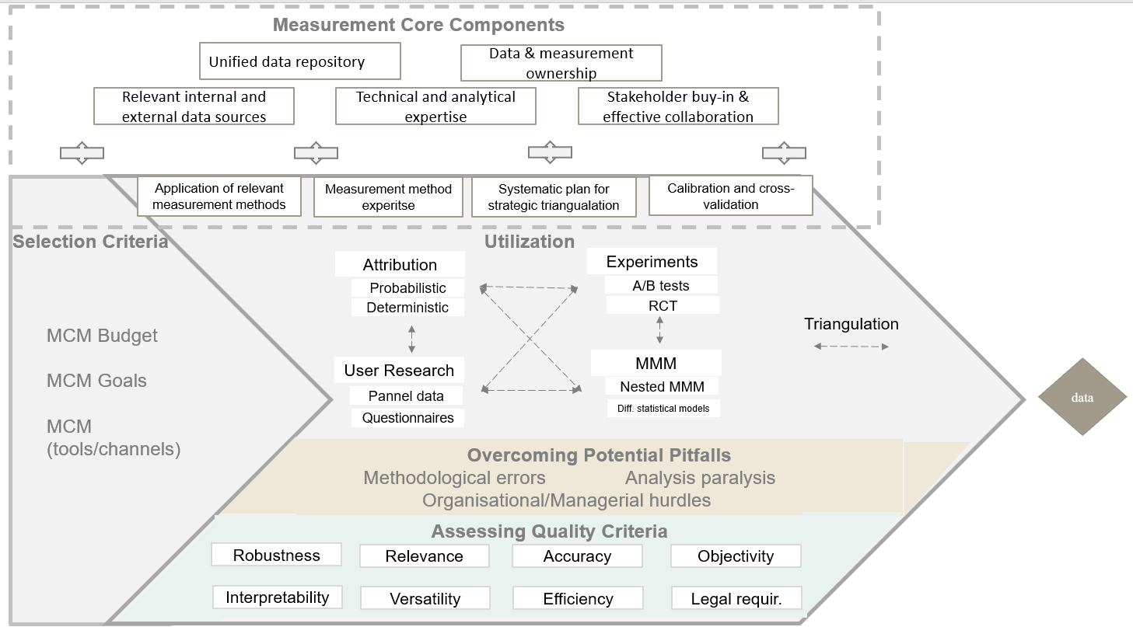
Measurement Methods Framework
Firstly, marketing managers have to select suitable measurement methods (this depends on several selection criteria). Once in place, marketing managers have to beware of common pitfalls. Quality criteria help to assess the measurement framework.
Measurement method framework
(own illustration, based on Andrl et al., 2013; Hanssens & Pauwels, 2016)
Notes:
To answer the research question, based on the interviews, a measurement method framework was created. It indicates how companies can leverage suitable measurement methods for their business context. The foundation of the measurement method framework are four primarily mentioned measurement methods; attribution, MMM, experiments and user research (this also expands the Google measurement playbook).
The interview findings suggest that not every measurement method is relevant for every firm, therefore, marketing managers must think about steering criteria. They first have to think which measurement method(s) they need. For example;
MMM is relevant after a certain yearly media budget (many said after approx. one million, others said a higher amount)
Similar to experimentation, such as when conducting geolift experiments, it is only advantageous if the ability to split regions into comparable groups is possible to ensure a valid and reliable analysis
Or attribution that requires access to first party data to be as accurate as possible
But if you have a complex tool/channel mix with online and offline media with a large budget and branding and performance goals, you probably need more than attribution.
Also, many pitfalls have been mentioned in the interviews for all measurement methods (even with teams with lots of experience). A common one was methodological errors. Some that were mentioned included:
steering bias in user surveys
misinterpreting causation for correlation
or errors in experimental design
The quality criteria, extracted from a literature review analysis, can help assess the current setup. If done right, a firm effectively leverages the right measurement methods and has measurement expertise.

