Slide 1
Governance in Vocational and Professional Education and Training (GOVPET)
SERI conference on VET research Thun, 6/7 March 2025
Matthias Haslberger and Anna Wilson

Slide 2
The Team

Slide 3
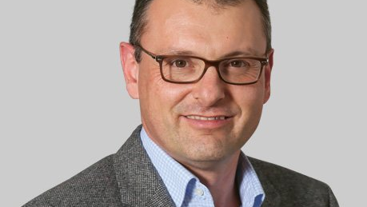








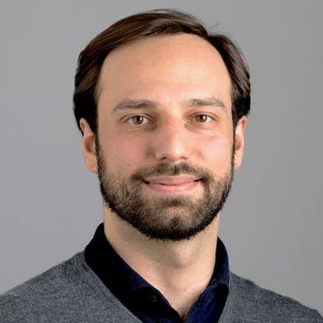




Prof. Giuliano Bonoli
Prof. Patrick Emmenegger
Dr. Anna
Wilson
Prof. Annatina
Aerne
Dr. Alina
Felder-Stindt
Dr. Matthias
Haslberger
Kousha Vahidi,
PhD candidate
Giovanni Greco,
PhD candidate
Scherwin Bajka,
PhD candidate
Cecilia Ivardi,
PhD candidate
Dr. Linda Wanklin
Notes:
Project based in Lausanne and SG
Postdocs: success of recent postdocs on job market (Lina just reelected to Bundestag)

Slide 4
The Research Programme

Slide 5
The GOVPET research programme
Notes:
Overarching interest in structural pressures on employer coordination and social solidarity, and potential trade-offs
2.2: technological and organizational changes linked to KE
2.3: ongoing high immigration makes VET crucial for economic integration
More approachable terminology: governance challenge: right skills for employers while keeping system inclusive, this being constantly challenged (not immigration research, immigrants are the least likely case!)

Slide 6
The GOVPET research programme
Methodological pluralism
Comparative perspectives
Broad theoretical debates
Policy relevance
Notes:
Methodologically pluralist approach: experiments, surveys, qualitative interviews and archival work, discourse analysis, etc.
Switzerland features prominently, but comparative perspective (not limited to CSFS countries) is important
Ambition to engage with broad political-economic debates around technological change, immigration, demographic change, etc., how VET can help deal with challenges
And thereby also ensure policy relevance; GOVPET researchers have contributed to OECD reports, etc.

Slide 7

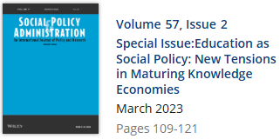
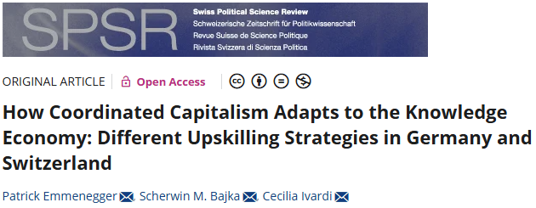

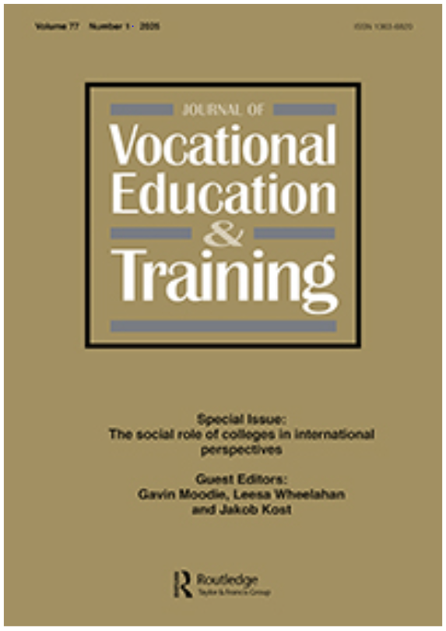

Recent headline publications
Chuard, C., Aerne, A., Eugster, B. & Hodler, R. (2025, forthcoming). Ethnic clustering in schools and early career outcomes. Economics of Education Review.
Otmani, I. (2024). Towards a ‘low ambition equilibrium’: Managing refugee aspirations during the integration process in Switzerland. Journal of Ethnic and Migration Studies, 50(4), 854-872.
Graf, L., Lohse, A. P., & Bernhard, N. (2024). Varieties of Work-based Higher Education: France, Germany and the United States Compared. International Journal of Training and Development, 1-19.
Carstensen, M. B. & Emmenegger, P. (Eds.) (2023). Special Issue: Education as Social Policy: New Tensions in Maturing Knowledge Economies. Social Policy and Administration, 57(2).
Emmenegger, P., Bajka, S. M. & Ivardi, C. (2023). How Coordinated Capitalism Adapts to the Knowledge Economy: Different Upskilling Strategies in Germany and Switzerland. Swiss Political Science Review, 29(4), 355-378.
Giudici, A., Gingrich, J., Chevalier, T. & Haslberger, M. (2023). Center-right Parties and Post-War Secondary Education. Comparative Politics, 55(2), 193-218.
Graf, L., Strebel, A. & Emmenegger, P. (2023). State‐led bricolage and the extension of collective governance: Hybridity in the Swiss skill formation system. Regulation & Governance, 17(1), 103-120.
Bonoli, G. & Emmenegger, P. (Eds.) (2022). Collective Skill Formation in the Knowledge Economy. Oxford: Oxford University Press.
…
Notes:
To give a taste of this work, a few recent headline publications
Not too political sciency

Slide 8
Ongoing Projects
(Selection)
Notes:
Small selection of our numerous ongoing projects, to give a more concrete impression

Slide 9
A selection of our ongoing projects
General population survey on prestige and attractiveness of educational tracks
Survey of Swiss training firms
Survey of adolescents on occupational preferences and gender segregation in VET
Labour market integration of refugees through VET
VET and adult education as re-skilling strategies in the age of skill shortage
Effects of VET on wage inequality in the knowledge economy
Notes:
Broad range of topics (by no means exhaustive)
Survey: people‘s views and preferences
Work with practitioners on LM integration
Survey: concerns and priorities of Swiss training firms
Mention prominently: not just doing surveys
Non-initial VET as a strategy for dealing with skill shortage
Macro effects of dual VET systems in comparative perspective
Young people‘s preferences and gender dynamics

Slide 10
A look into the future…
Overarching interest in the tensions between efficiency and inclusiveness of vocational education and training but adapt focus to take into account socio-structural changes as well as developments in policy and academic debates:
Labour and skill shortage
Skill requirements of the twin transition
Four focus areas:
  The link between social policies and skill formation in the age of skill shortage
  Making the most of the human capital brought by migration
  The political economy of skill formation for the twin transition
  Generative artificial intelligence and skill formation
Notes:
Future GOVPET research will maintain the overarching interest but sharpen focus on current/emerging challenges
How can VET help alleviate labour and skill shortages?
How can VET help meet the skill requirements of the twin transition (green/digital)?

Slide 11
Today

Slide 12
Today we highlight…
Reconciling employer coordination and social solidarity
Survey on prestige and attractiveness of educational tracks
When Top-Down Imposition Meets Bottom-Up Skepticism: The Relative Attractiveness Deficit of VET in Europe
Adapting skill formation to the knowledge economy
The Missing Link: Technological Change, Dual VET, and Social Policy Preferences

Slide 13
Survey on prestige and attractiveness of educational tracks
Aerne, Bajka, Bonoli, Emmenegger, Haslberger, Ivardi, Vahidi and Wilson

Slide 14
Objectives
What’s the attractiveness of vocational education and training (VET) relative to more general and academic forms of education?
General population survey 7 diverse European countries (Denmark, Germany, Switzerland, England, France, Portugal, and Sweden) (n=1’600/country, total ca. N=11’000)
Cross-national differences and similarities in factors promoting attractiveness
Notes:
Reference policy relevance

Slide 15
Objectives
Does VET have an attractiveness deficit in the first place and what are the individual characteristics associated with suitability for VET and general education (GE) → Vignette experiment 1
The dimensions that make an upper-secondary education program attractive → Vignette experiment 2
Do (mis)perceptions of VET have an impact on its attractiveness → Information treatment
The impact of increasing the permeability from VET to higher education → Relative attractiveness of upper secondary education tracks

Slide 16
When Top-Down Imposition Meets Bottom-Up Skepticism: The Relative Attractiveness Deficit of VET in Europe
Patrick Emmenegger
Matthias Haslberger
Anna Wilson

Slide 17
Introduction
Political attempts to boost vocational education and training (VET) have proliferated (Bonoli and Emmenegger, 2022)
How do citizens respond to these attempts to promote VET?
The paper examines the relative attractiveness of VET as an educational option compared to its main alternative, GE
Notes:
Talk about relative attractiveness (unlike previous research), people evaluate options relative to others

Slide 18
Introduction
Factorial survey experiment
Four fictitious profiles of 15-year-olds (academic performance, level and type of motivation, sociodemographics)
„Would you recommend that this young person pursues VET or GE?” (1-10 Likert scale)

Slide 19
Theory
Sociological and political economy literatures to probe the perceptions of the attractiveness of educational tracks
Perceived Educational Hierarchies
Social biases
System characteristics
Notes:
Shorter, not too negative

Slide 20
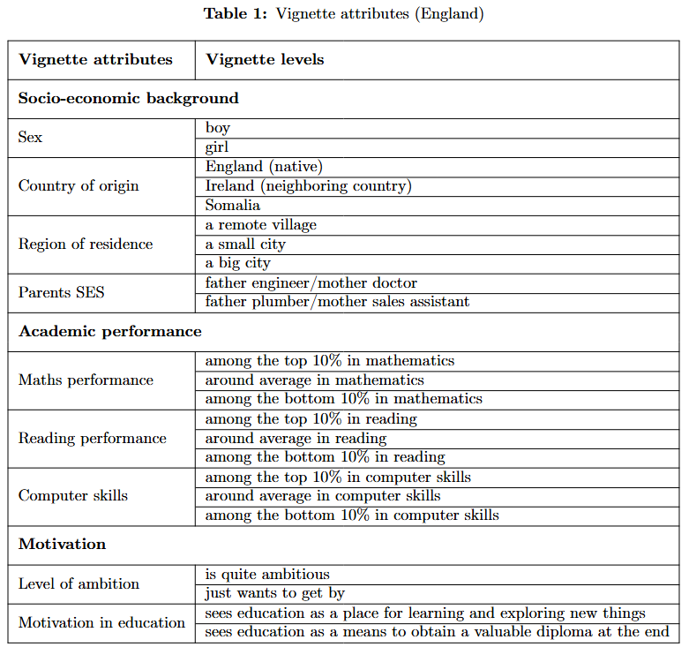
The vignette
Social biases
Perceived educational hierarchies

Slide 21
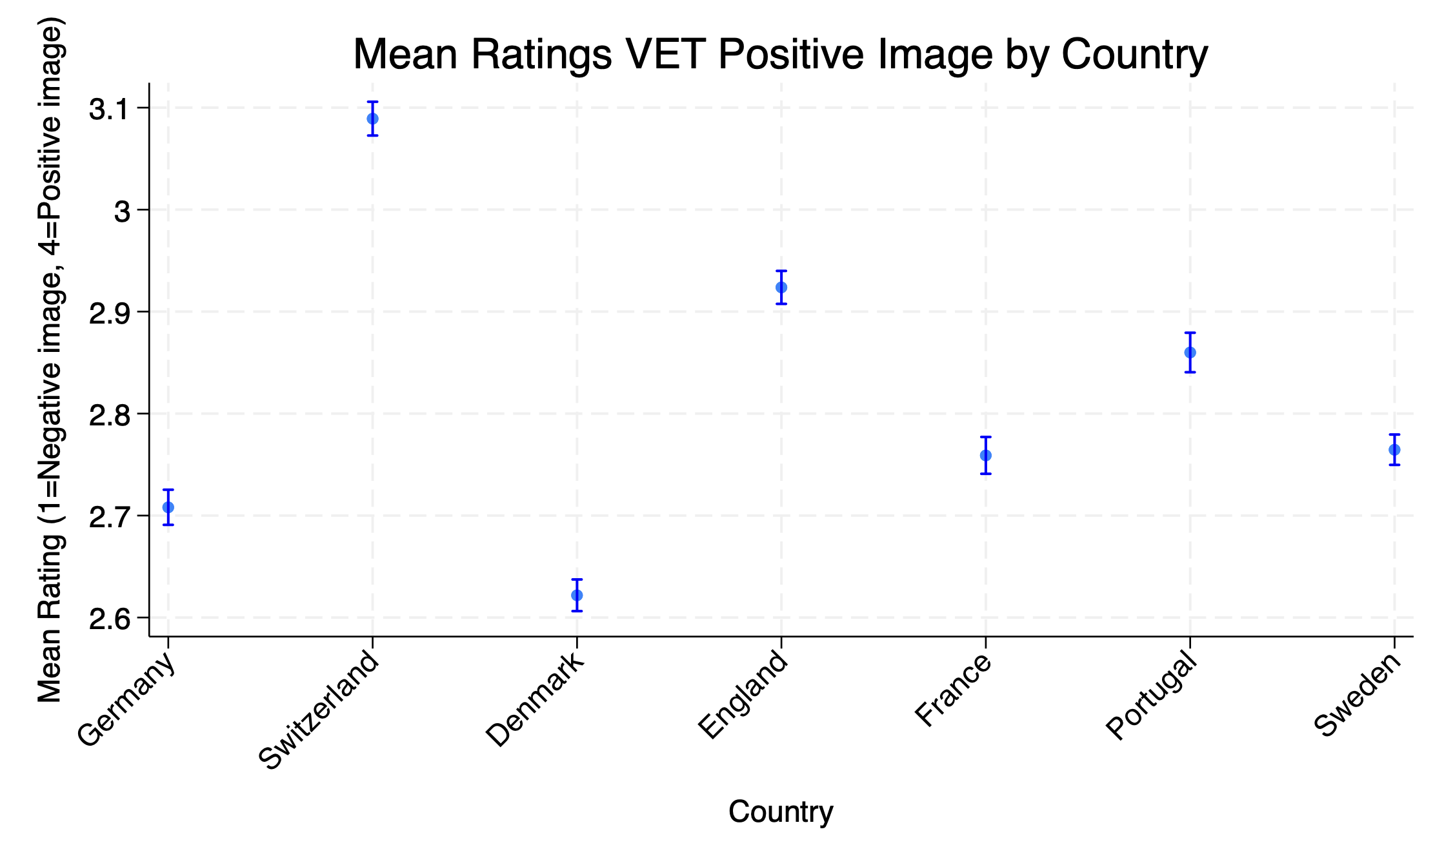
Results

Slide 22
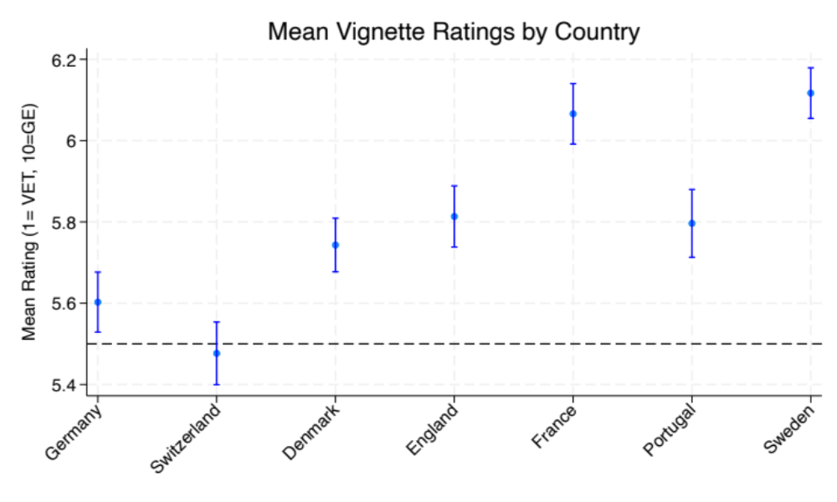
Results

Slide 23
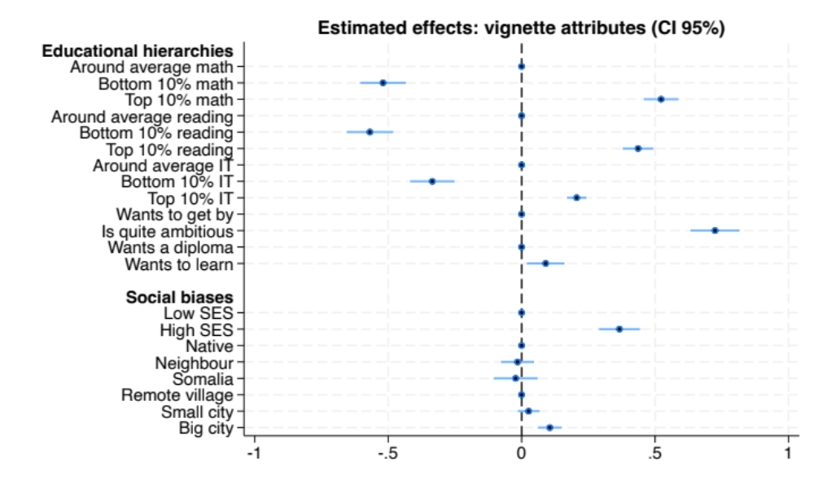
Results
Notes:
Reference absolute and relative effects

Slide 24
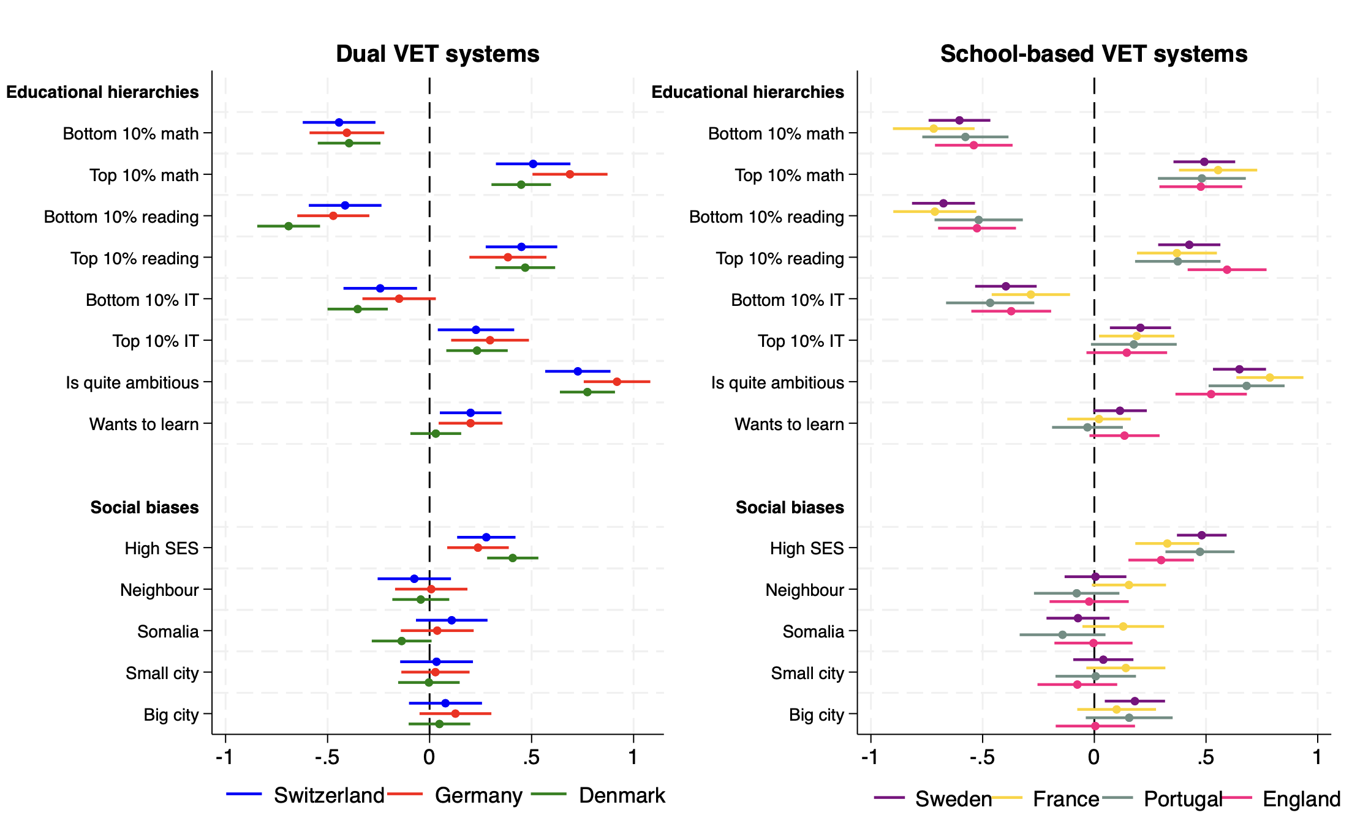
Results
Notes:
Highlight Switzerland earlier

Slide 25


Conclusions
VET is perceived as attractive – but less attractive in relation to GE
Educational hierarchy between GE and VET
Social biases for low social classes and rural dwellers
Switzerland not an exception (although general support is the highest)
Solution: open up access as much as possible (Swiss vocational baccalaureates and UAS growing in popularity, positive development)

Slide 26
The Missing Link: Technological Change, Dual VET, and Social Policy Preferences
Matthias Haslberger
Patrick Emmenegger
Niccolo Durazzi
Notes:
The second project we want to highlight is a paper that‘s currently under review at Comparative Political Studies. The paper deals with a very prominent debate in the comparative politics/political behaviour literature – how does technological change impact social policy preferences? – and argues that the formative role of education (in particular, dual VET) has been unduly neglected
Not too much about SPP, is an expression of people being worried

Slide 27
Introduction
Growing literature on individual concerns surrounding technological change
  Demand for protection, e.g. compensatory social policy (SP)
Surprising absence of skills and training in debates about responses to technological change (Gallego and Kurer 2022; Özkiziltan and Hassel 2020)
We examine the role of dual VET both in shaping SP preferences and in moderating the relationship between automation risk and SP preferences

Slide 28
Theory
Drawing on labour economics, political behaviour, and varieties of capitalism literature
Central argument: Dual VET in automation context makes people less supportive of compensatory SP (contra VoC)
Mechanisms:
  Material self-interest
  Workplace socialization
  Skill certification
Notes:
Existing literatures have looked at issues in pairs: skills – technology (labour economics); technology – SPP (political behaviour); skills – SPP (VoC) → mention missing link
Posited mechanisms are not mutually exclusive
Risk and concerns

Slide 29
Approach
European Social Survey (23 countries)
“Is it the government's responsibility to ensure a reasonable standard of living for the unemployed?” (0 = not government's responsibility at all; 10 = entirely government's responsibility)
Separate analyses for DACH countries, where approximate distinction between dual and school-based VET is possible
Notes:
Mediation analyses for mechanisms

Slide 30
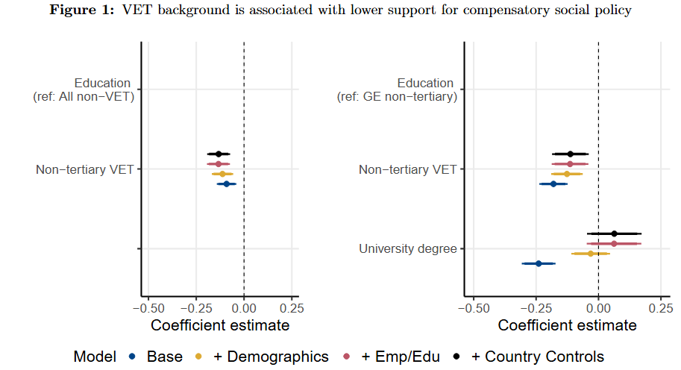
Results
Notes:
This is the static result without interaction with automation risk
Comparing VET with everyone else (left) or same US level but different orientation (right) shows identical results

Slide 31
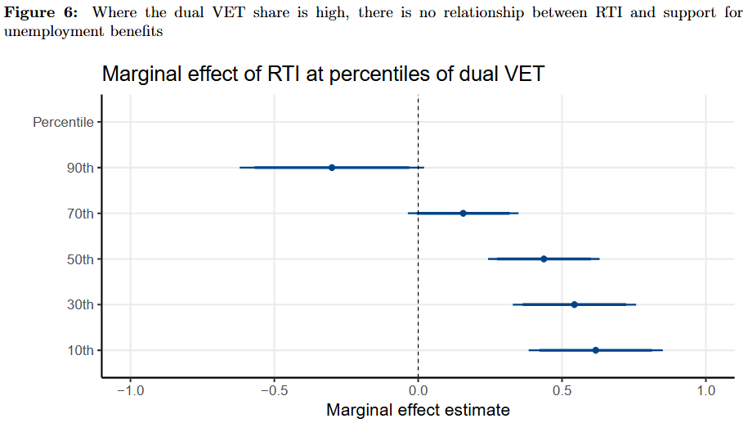
Results
Notes:
Key result in existing literature: high RTI (automation risk) is associated with support for compensatory SP
We show: this is only the case in places without meaningful dual VET system (but this is cross-level interaction, we need to look at individual-level effects)

Slide 32
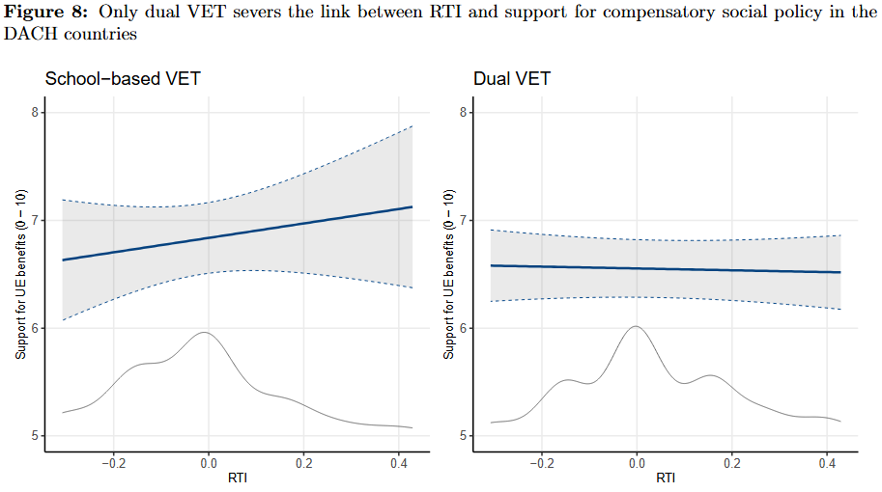
Results
Notes:
We do this in DACH countries, where we can distinguish (approximately) between school-based and dual VET
Supports previous analysis: individuals with dual VET background show no reaction to RTI, people with school-based VET do

Slide 33
Conclusions
VET background is associated with lower support for compensatory social policy
Additionally, dampens the link between automation risk and social policy preferences
(Dual) VET background as a „risk mitigator“
  Contra asset theory of social policy preferences
  VET perceived as protecting against technological risk
Notes:
Highlight that VET perceived as protecting against risk

Slide 34






To summarize…
Contributions to broad theoretical debates, using various methods and data sources
Systematic research on contemporary and future challenges in the governance of VET
Policy relevant output, useful insights for policymakers and practitioners
Pertinent research areas for the future: tensions between economic efficiency and invlusiveness of VET in times of structural change
Notes:
Contribute to theoretical debates around knowledge economy, skill shortages, immigration, and other issues, inserting a VET angle into these debates
Aim to systematically map and study contemporary and future challenges in the governance of VET
And thereby produce not only academically rigorous but also policy-relevant insights for practitioners and policymakers
Future GOVPET research will continue on this path, highlighting new challenges such as labour shortage, AI, and green transition

Slide 35


Thank you!
Contact us:
Matthias.Haslberger@unisg.ch
Anna.Wilson@unil.ch
GOVPET’s
SERI website
GOVPET’s
home website
Contact the PIs:
Patrick.Emmenegger@unisg.ch
Giuliano.Bonoli@unil.ch

