Slide 1
2018 PiF Seminar
Capital requirements for cyber risk and cyber risk insurance: an analysis of Solvency II, the US Risk-Based Capital Standards, and the Swiss Solvency Test
Werner Schnell*, Ph.D Candidate
(joint work with Prof. Martin Eling*)
*Institute of Insurance Economics, University of St.Gallen
Notes:
Cyber Risk might be a new type of risk:
Still trying to grasp cyber risk
Not enough data; high uncertainty (Fitch Ratings (2016) warned to downgrade insurers that write standalone products to heavily)
Risk is very fast changing and still an emerging risk (WannaCry ransomware )
Results so far: highly correlated (no geographical boundaries) and probably heavy tail (extreme events so far not realized, skewness).
Probably tail correlation (non linear correlation)
Only alternative would be scenarios (Cambridge Centre for Risk Studies)
Therefore regulatory frameworks might not be appropriate.

Slide 2


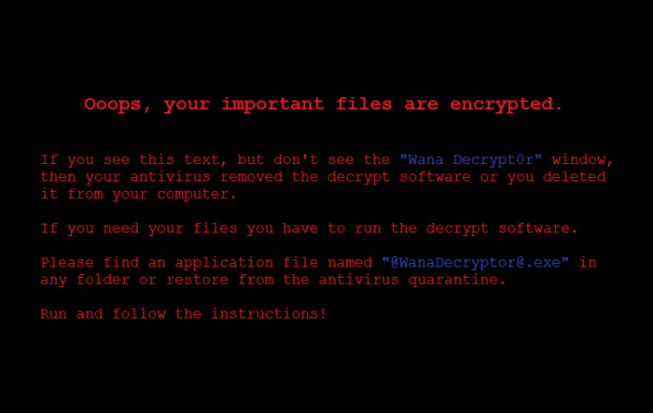




Cyber Risk Everywhere?
COZY BEAR
3 billion accounts
Up to $1 billion
Estimated global costs per year: $445 billion
$171 million
Notes:
WannaCry
Date: 2017
Befällt Windows-Betriebssysteme, die nicht mit von Microsoft angebotenen Patch nachgebessert wurden
The attack was estimated to have affected more than 200,000 computers across 150 countries, with total damages ranging from hundreds of millions to billions of dollars.
Sony Playstation
Date: April 20, 2011
Impact: 77 million PlayStation Network accounts hacked; estimated losses of $171 million while the site was down for a month
Hackers gained access to full names, passwords, e-mails, home addresses, purchase history, credit card numbers and PSN/Qriocity logins and passwords.
Silent cover in liability insurance (e.g. Zürich vs Sony Corp)
Yahoo
Date: 2013-14
Impact: 3 billion user accounts
The attack compromised the real names, email addresses, dates of birth and telephone numbers of 500 million users.
Stuxnet
Date: Sometime in 2010, but origins date to 2005
Impact: Meant to attack Iran's nuclear power program, but will also serve as a template for real-world intrusion and service disruption of power grids, water supplies or public transportation systems
Das Schadprogramm wurde speziell zum Angriff auf ein System zur Überwachung und Steuerung (SCADA-System) des Herstellers Siemens
Frequenzumrichter dienen beispielsweise dazu, die Geschwindigkeit von Motoren zu steuern
Da bis Ende September 2010 der Iran den größten Anteil der infizierten Computer besaß^{[T 3]} und es zu außerplanmäßigen Störungen im iranischen Atomprogramm kam, lag es nah, dass Stuxnet hauptsächlich entstand, um die Leittechnik der Urananreicherungsanlage in Natanz^{[1]} oder des Kernkraftwerks Buschehr^{[2]} zu stören.
Cozy bear
Classified as advanced persistent threat APT29, is a Russian hacker group believed to be associated with Russian intelligence
In June 2016, the Democratic National Committee (DNC) first stated that the Russian hacker groups Cozy Bear and Fancy Bear had penetrated their campaign servers and leaked information
(McAfee, 2014)

Slide 3

Cyber Risk as an Emerging Risk
Cyber risk is not well understood (see Biener et al., 2015 and Eling & Schnell, 2016, for an overview):
  So far mainly analyzed from a technical (IT security) perspective.
  How should it be defined? man made, data breaches, terror, cyber war, etc.
  Is the data we have so far representative for the future?
    Fast changing environment
    Realm of risk and uncertainty (modelling and parameter risk)?
  Only way out: modelling based on scenarios?
Notes:
- Major problem: not explicit treatment of cyber risk in any framework ->unlock how it might be applicable
Need to be modelled differently:
- Operational Cyber Risk: Insurers digitalized their operations and are therefore prone to cyber risk
- Underwriting Cyber Risk: Stand alone (dedicated) cyber risk policies or it is included in liability & property insurance. Sometimes not clear whether cyber risk is included (see Sony vs. Zürich, 2011).
-Importantly: Probably a correlation between op and underwriting cyber risk
- RBC: national association of insurance commissioners

Slide 4
Aim of the Paper
Developing appropriate models for cyber risk is important for
  policy & regulation,
  risk management,
  pricing and
  ultimately the development of a cyber insurance market (Eling & Schnell, 2018).
Here we apply previous findings to validate insurance regulation models:
«Do regulatory models account adequately for the characteristics observed in cyber risk»

Slide 5

Cyber Risk Data
Cyber risk exposure is modeled based on publicly available data:
Baseline
Robustness check
  SAS Op Risk Database: Cyber incidents extracted from the SAS Operational Risk database (credits to Jan Wirfs)
  Privacy Rights Clearinghouse (PRC) data breaches (since 2005)
Notes:
SAS
1,579 cyber risk losses SAS
1995-2014
Publicly reported cyber insidents; globaly
PRC
Records Brechend: 10 Billion; reported in the US
Problem of reporting bias (for SAS only above 100’ USD).

Slide 6
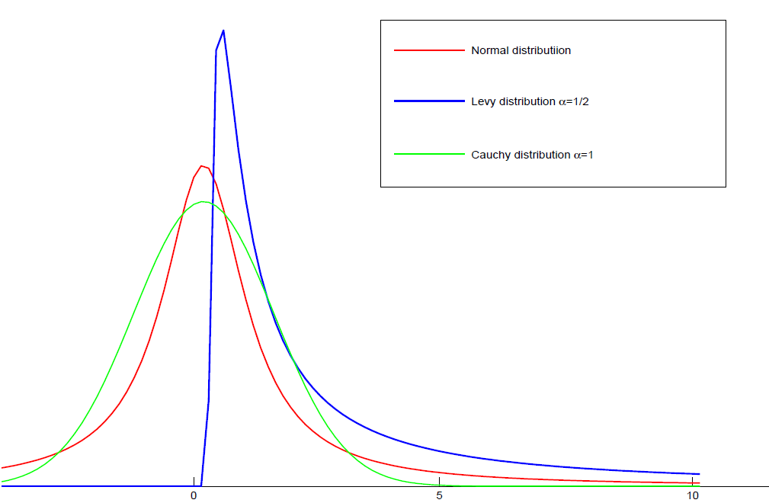
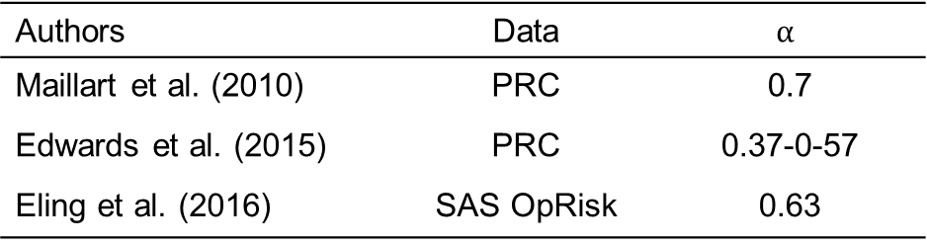
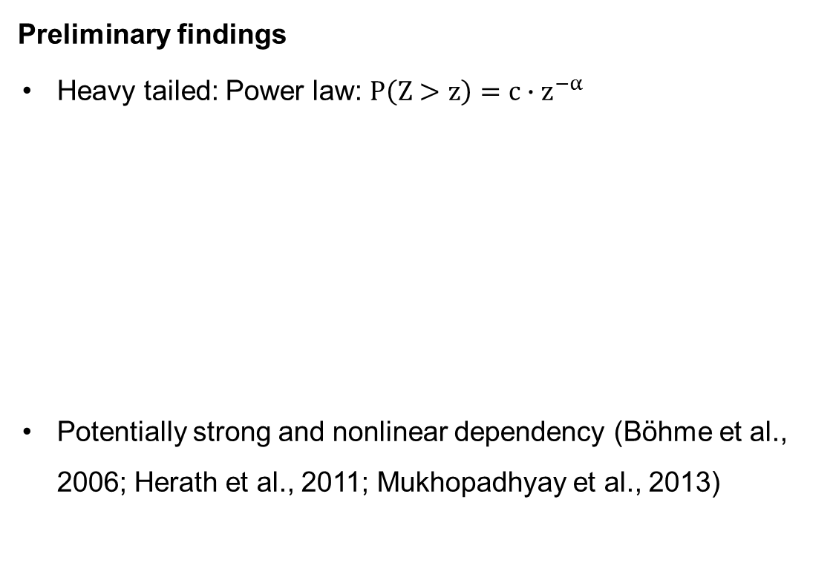
Characteristics of Cyber Risk
Preliminary findings
Heavy tailed: Power law: $P\left(Z>z\right)=c∙z^{−α}$
Potentially strong and nonlinear dependency (Böhme et al., 2006; Herath et al., 2011; Mukhopadhyay et al., 2013)
Authors | Data | $$α$$
Maillart et al. (2010) | PRC | 0.7
Edwards et al. (2015) | PRC | 0.37-0-57
Eling et al. (2016) | SAS OpRisk | 0.63
Notes:
Similar tail index can be found for cat / terror / operational risk.
$α:$ Pareto (or Tail) index
(extremely) heavy tailed if$(α<1) α<2$
-$α<2:I$nfinite second and higher moments
- Operational risks: α < 1 ⇒infinite means E|X| = ∞!, Firm sizes, sizes of largest mutual funds, city sizes: α ≈ 1, Economic losses from earthquakes: α ∈ [0.6, 1.5]
- Border a=1 is quite important (switch from finite to infinite mean)
If α > 1 diversification is optimal over non diversifikation (Ibragimov)
Sub- vs. superaditivity
Find that the estimated α<1
Eling & Wirfs (2016) suggest a lognormally distributed body and a Pareto distributed tail
Asymmetric information (Biener et al., 2015)

Slide 7
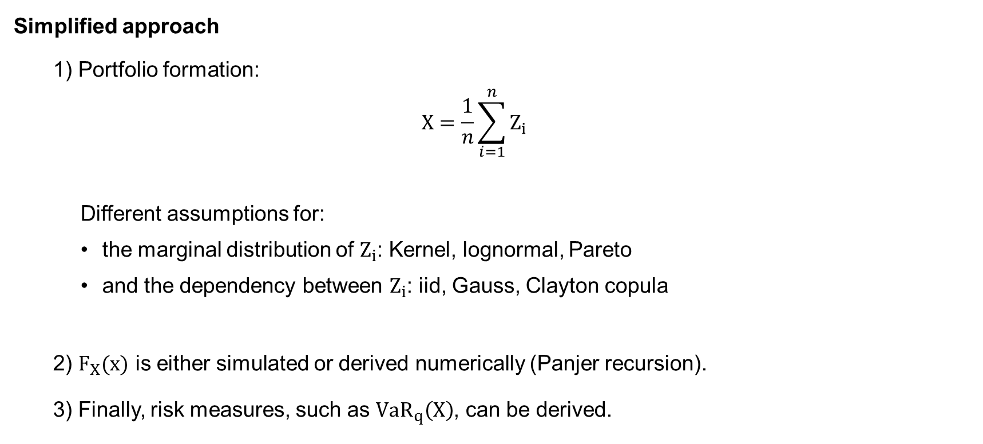
Excursion: Cyber Risk and Diversification
Simplified approach
  1) Portfolio formation:
  $$X=\frac{1}{n}\sum_{i=1}^{n}{Z_{i}}$$
    Different assumptions for:
      the marginal distribution of $Z_{i}$: Kernel, lognormal, Pareto
      and the dependency between $Z_{i}$: iid, Gauss, Clayton copula
  2) $F_{X}(x)$ is either simulated or derived numerically (Panjer recursion).
  3) Finally, risk measures, such as ${VaR}_{q}\left(X\right)$, can be derived.
Notes:
- $q:prob einen verlust nicht zu überschreiten$
SAS Data from Biener et al. (2015)
Panjer recursion is only applicable to a certain class of frequency distribution
$F_{X}(x)$=${F_{Z}(Z_{i}) }^{∗n}$ numerically not solvable.

Slide 8
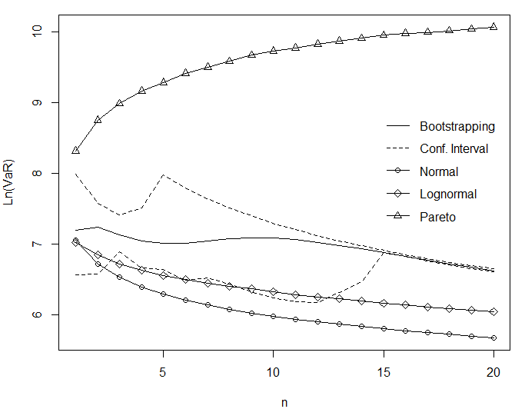
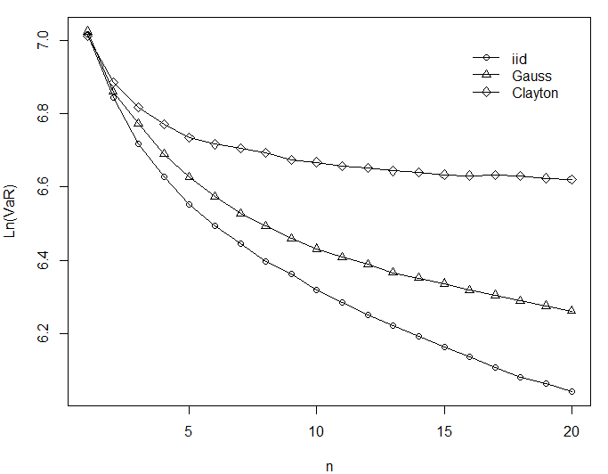

Excursion: Cyber Risk and Diversification
Merits of Diversification
$α<1$
Independent
Dependent
Notes:
IID case:
Keeping portfolio size constant (Sum of n RVs devided by n)
Deterministic sum here
Simulated VaR as used by SII
Normal (α=2) & lognorm lead to decreasing VaR ->Merits of diversification
Pareto: Risk increases as portfolio size does
Perfect dependency (comonotonicity): no diversification effect -> ${VaR}_{q}$ constant (independent of tail index)
E.g. Archimedean copula the same as iid for sufficient small loss probability $q$.

Slide 9
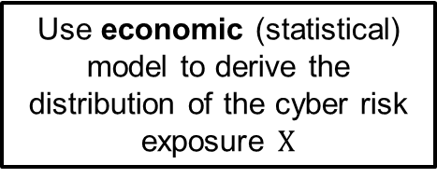
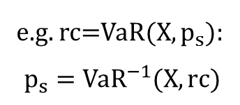

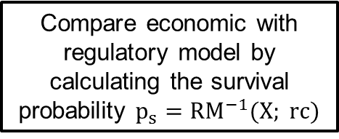
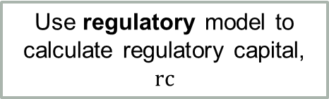
Methodology
Use SAS OpRisk data to calibrate models
Use economic (statistical) model to derive the distribution of the cyber risk exposure $X$
Use regulatory model to calculate regulatory capital, $rc$
$$rc=m\left(n,v,s\right)$$
Compare economic with regulatory model by calculating the survival probability $p_{s}={RM}^{−1}(X; rc)$
e.g. rc=VaR(X, $p_{s}$):
$$p_{s}={VaR}^{−1}(X,rc)$$
Notes:
- Regulatory model different for all three regulatory models

Slide 10
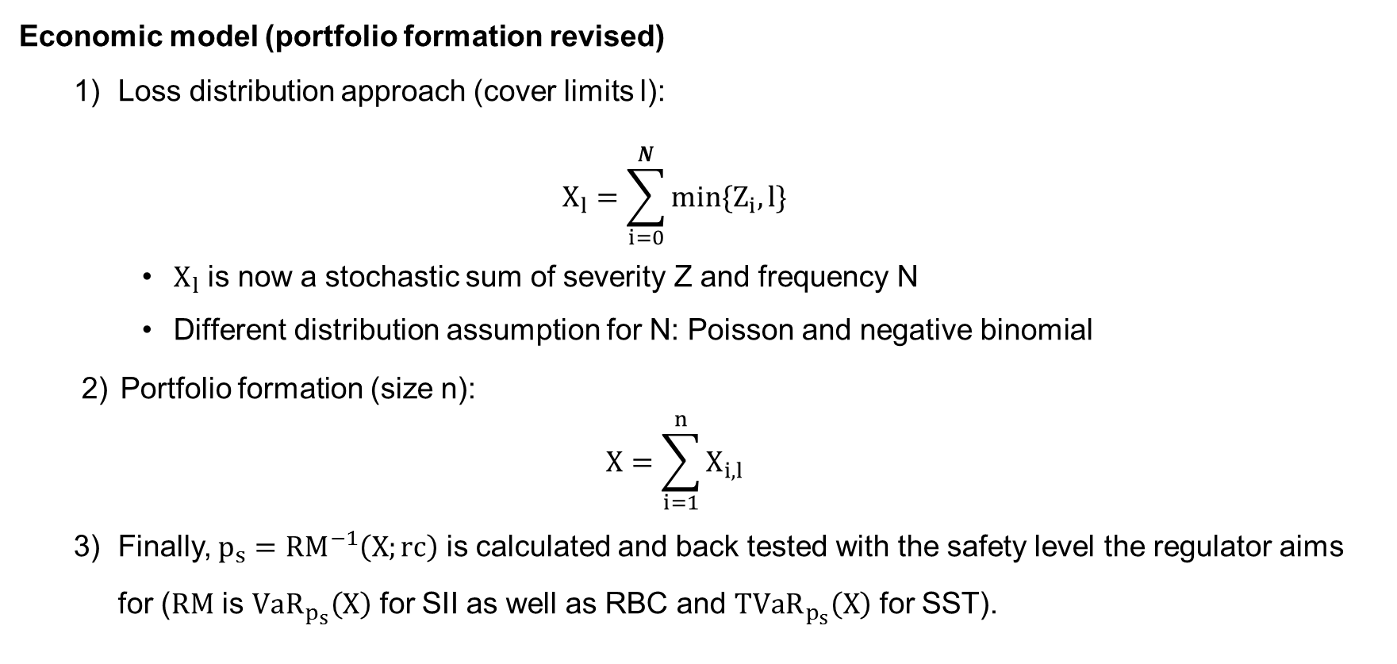
Methodology
Economic model (portfolio formation revised)
  Loss distribution approach (cover limits l):
  $$X_{l}=\sum_{i=0}^{N}{{min\{Z}_{i},l\}}$$
    $X_{l}$ is now a stochastic sum of severity Z and frequency N
    Different distribution assumption for N: Poisson and negative binomial
  Portfolio formation (size n):
  $$X=\sum_{i=1}^{n}{X_{i,l}}$$
  Finally, $p_{s}={RM}^{−1}\left(X;rc\right)$ is calculated and back tested with the safety level the regulator aims for ($RM$ is ${VaR}_{p_{s}}\left(X\right)$ for SII as well as RBC and ${TVaR}_{p_{s}}\left(X\right)$ for SST).
Notes:
We need to assume how the model (of not clear) needs to be applied -> we can not ask the regulator for a ruling
- Frequency: for a portfolio of 50 (0.15*50), here Poisson model
- Severity: Caped at 50 Mio. USD, empirical distribution (defined on a lattice, h=0.1 Mio. USD)

Slide 11
Cyber Risk and Insurance Regulation
Operational Cyber Risk
  Solvency II: Factor approach
  US Risk Based Capital: Reporting requirements (Factor approach to come)
  Swiss Solvency Test: Reporting requirements
Underwriting Cyber Risk
  Solvency II: Factor approach
  US Risk Based Capital: Factor approach
  Swiss Solvency Test: Stochastic modelling
Notes:
- Major problem: not explicit treatment of cyber risk in any framework ->unlock how it might be applicable
Need to be modelled differently:
- Operational Cyber Risk: Insurers digitalized their operations and are therefore prone to cyber risk
- Underwriting Cyber Risk: Stand alone (dedicated) cyber risk policies or it is included in liability & property insurance. Sometimes not clear whether cyber risk is included (see Sony vs. Zürich, 2011).
-Importantly: Probably a correlation between op and underwriting cyber risk
- RBC: national association of insurance commissioners

Slide 12
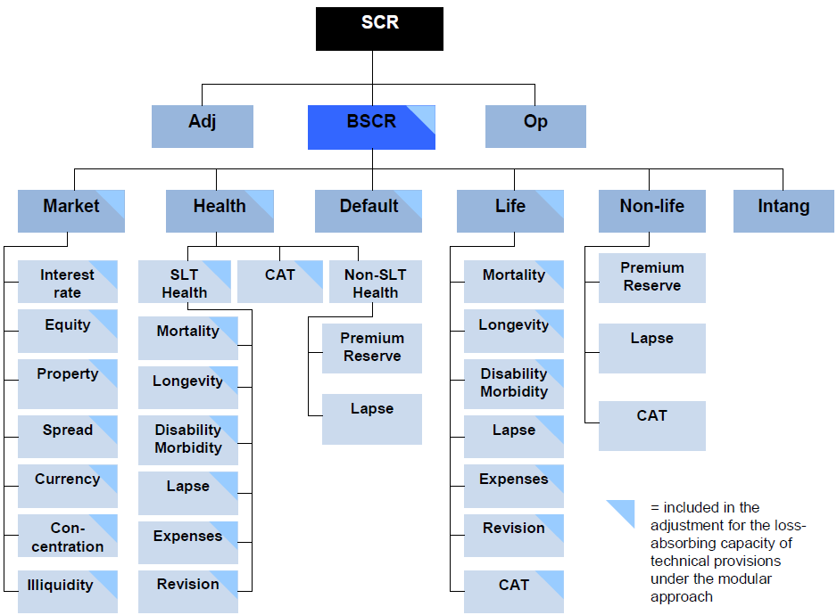
Solvency II and Cyber Risk
Operational Cyber Risk
Underwriting Cyber Risk
Notes:
Scenaria approach for market und life underwriting risk
Factor approach for non life underwriting risk
SCR relevant to avoid interventions
Square root formula simmilar to the calculation of a potfolio’s standard deviation (SCR is simply a linear transformation of the variance)
Correlation matrix
Factor multiplication is meant to approx. the VaR of a lognormal distribution (at the 99.5% confindence level)
OP risk: factor times BSCR

Slide 13
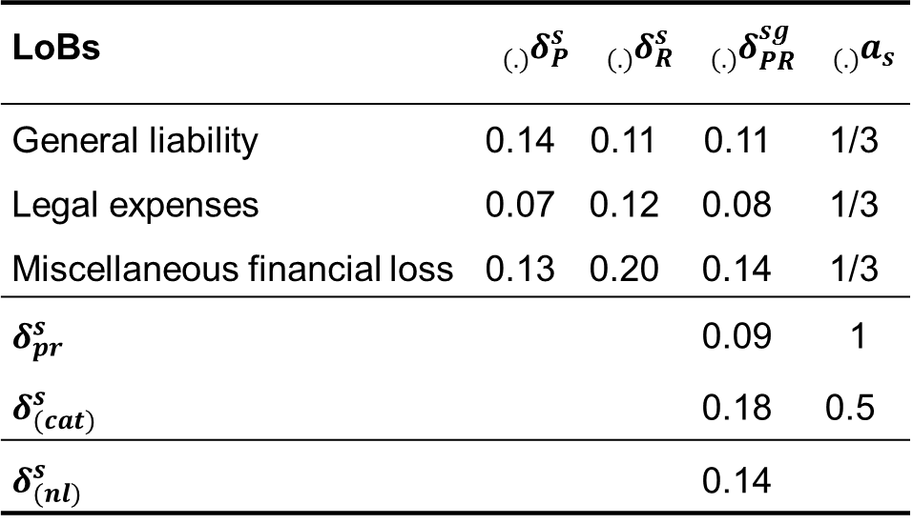
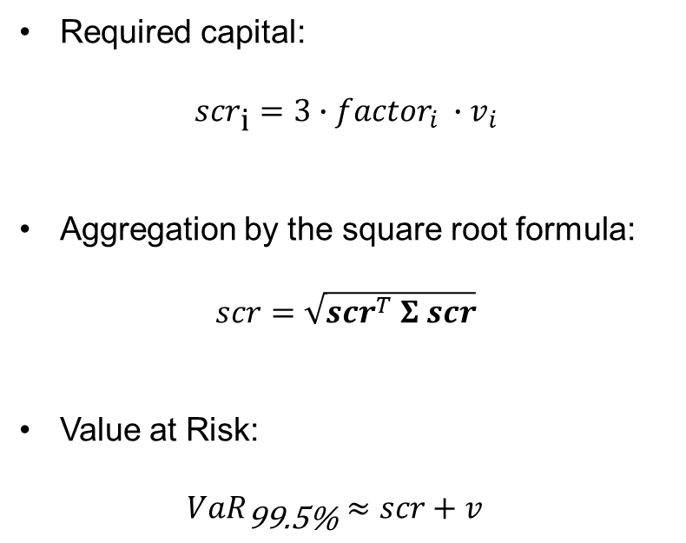
Solvency II and Cyber Risk (Underwriting)
Required capital:
$${scr}_{\text{i}}=3∙{factor}_{i} ∙v_{i}$$
Aggregation by the square root formula:
$scr=\sqrt{{scr}^{T} Σ scr}$
Value at Risk:
$${VaR}_{\text{99.5\%}}≈scr+v_{}$$
LoBs | $${{}_{(.)}^{}δ}_{P}^{s}$$ | $${{}_{(.)}^{}δ}_{R}^{s}$$ | $${{}_{(.)}^{}δ}_{PR}^{sg}$$ | $${}_{(.)}^{}{a_{s}^{}}$$
General liability | 0.14 | 0.11 | 0.11 | 1/3
Legal expenses | 0.07 | 0.12 | 0.08 | 1/3
Miscellaneous financial loss | 0.13 | 0.20 | 0.14 | 1/3
$$δ_{pr}^{s}$$ |  |  | 0.09 | 1
$$δ_{(cat)}^{s}$$ |  |  | 0.18 | 0.5
$$δ_{(nl)}^{s}$$ |  |  | 0.14
Notes:
where the factor (coefficient of variation) is given by the regulator (depending on the LoB, normal vs cat risk, and premium vs reserve risk)
and $v$ stands for the volume measure (usually total written premium or reserves).

Slide 14
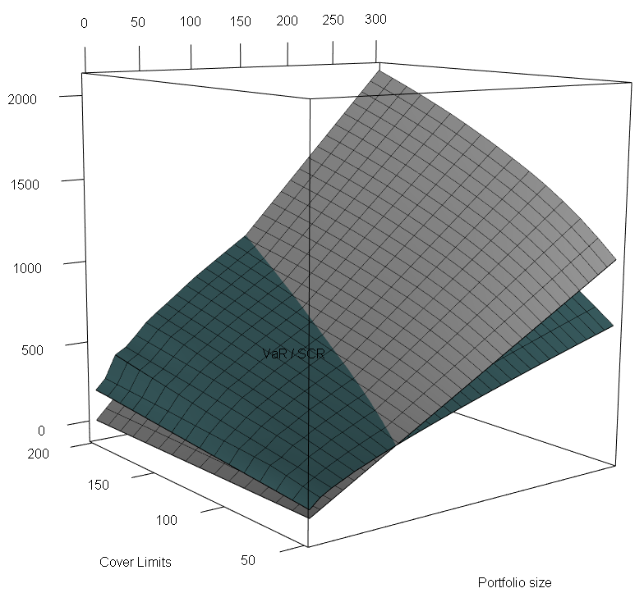
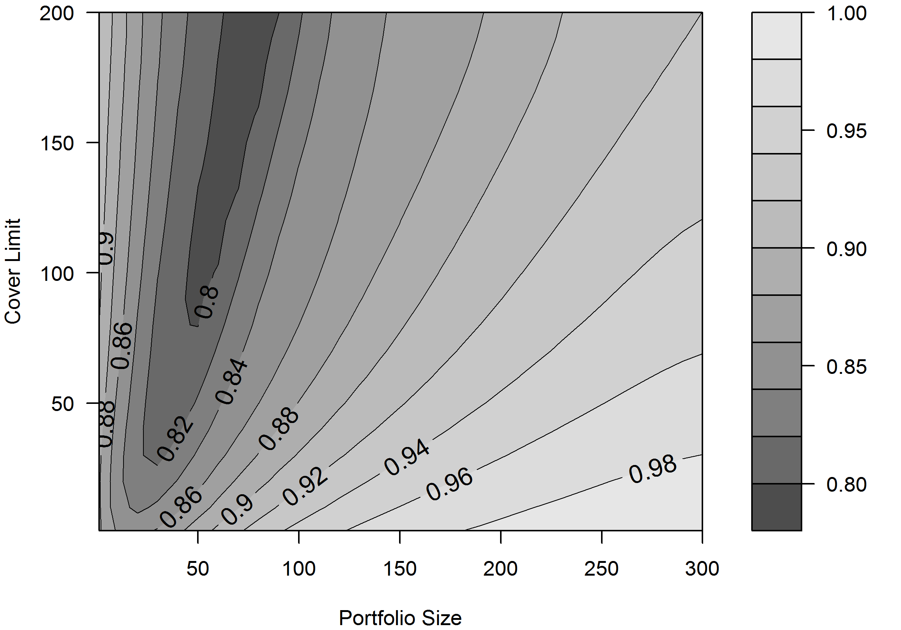

Solvency II and Cyber Risk (Underwriting)
VaR vs SCR (gray)
Survival Probability ($p_{s}$)
Notes:
- Note: While the green plane represents the VaR derived from the Poisson model, the grey plane represents the SCR (in mUSD).

Slide 15
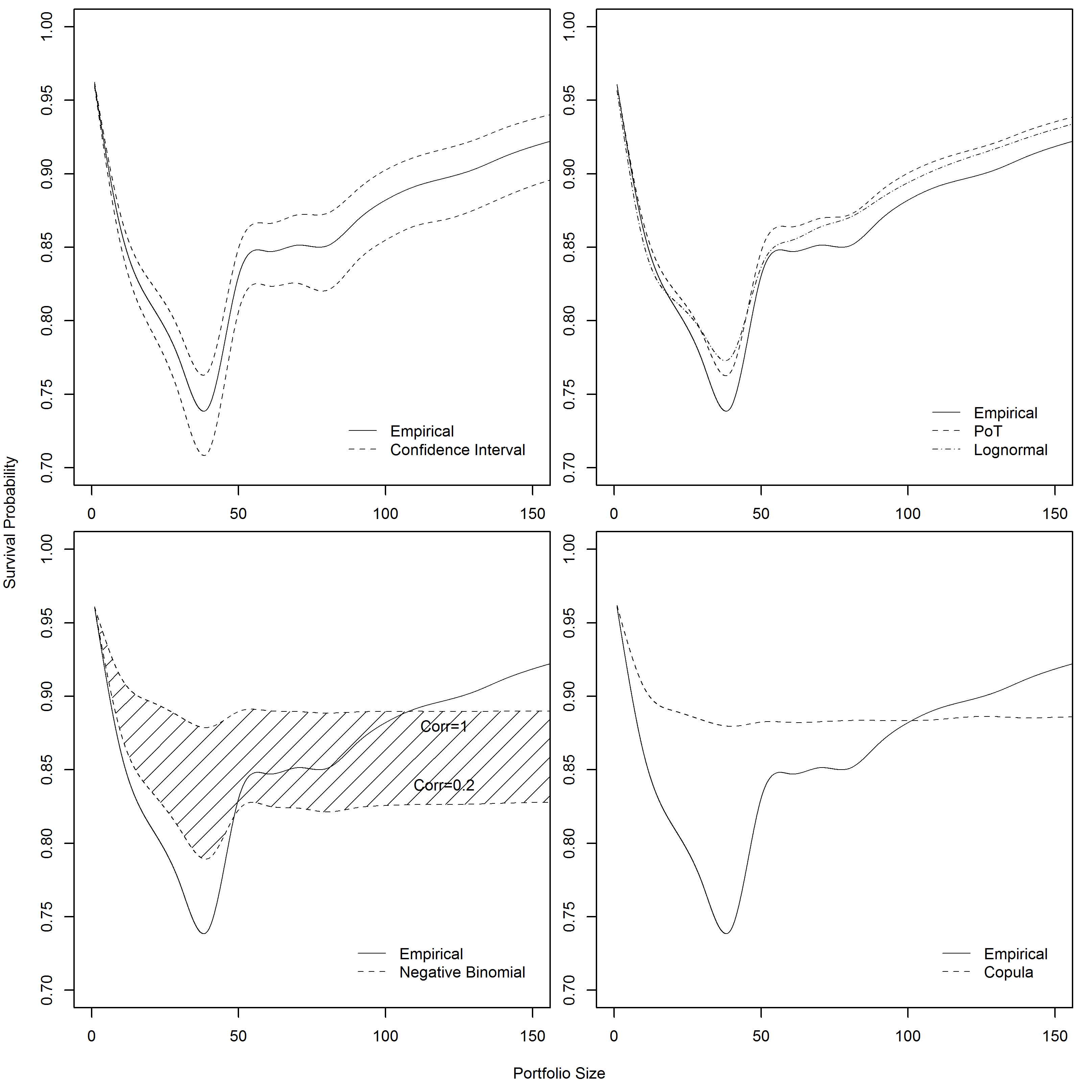
Solvency II and Cyber Risk (Underwriting)
Sliced at cover limit l= $ 50 m
Notes:
- Solvency II misses the safety level it aims for (1 in 200) when an insurer underwrites cyber risk (even higher mismatch as the correlation increases)

Slide 16
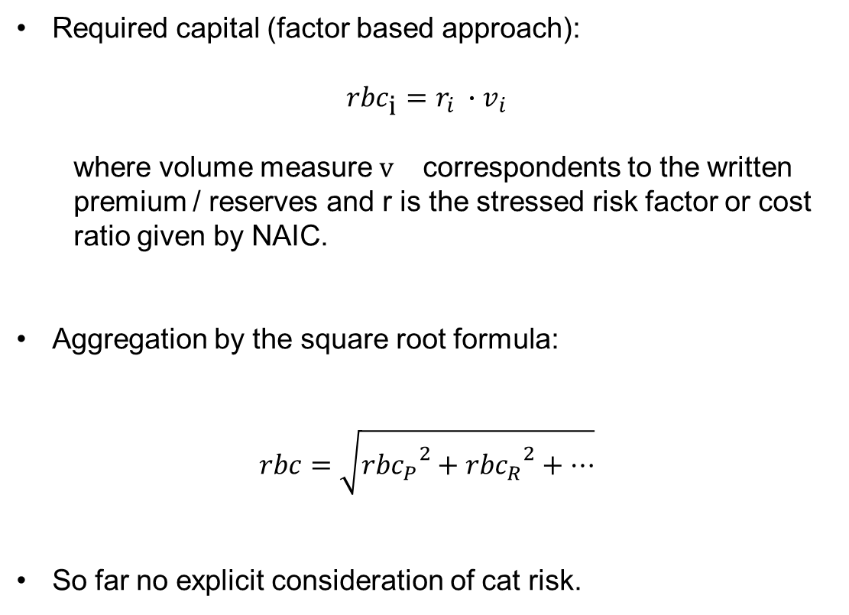
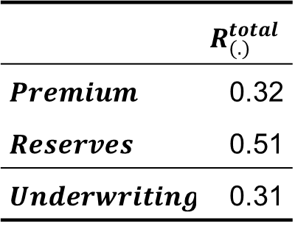
US RBC and Cyber Risk (Underwriting)
Required capital (factor based approach):
$${rbc}_{\text{i}}=r_{i} ∙v_{i}$$
  where volume measure $v_{}$ correspondents to the written premium / reserves and r is the stressed risk factor or cost ratio given by NAIC.
Aggregation by the square root formula:
$$rbc=\sqrt{{{rbc}_{P}}^{2}+{{rbc}_{R}}^{2}+…}$$
So far no explicit consideration of cat risk.
 | $$R_{(.)}^{total}$$
$$Premium$$ | 0.32
$$Reserves$$ | 0.51
$$Underwriting$$ | 0.31
Notes:
Authorized Control Level (ACL): 50% * RBC
No correlation between different risk types (R0 – Investments in Insurance Affiliates & Off-BS Risks, R1 – Fixed Income Securities, R2 – Equity Investments, R3 – Credit Risk, R4 – Reserving Risk (incl. basic & growth), R5 – Premium Risk (incl. basic & growth)

Slide 17
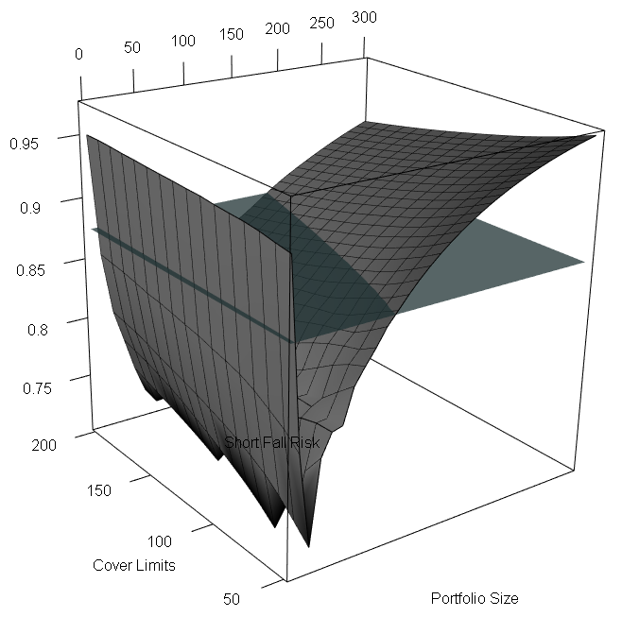
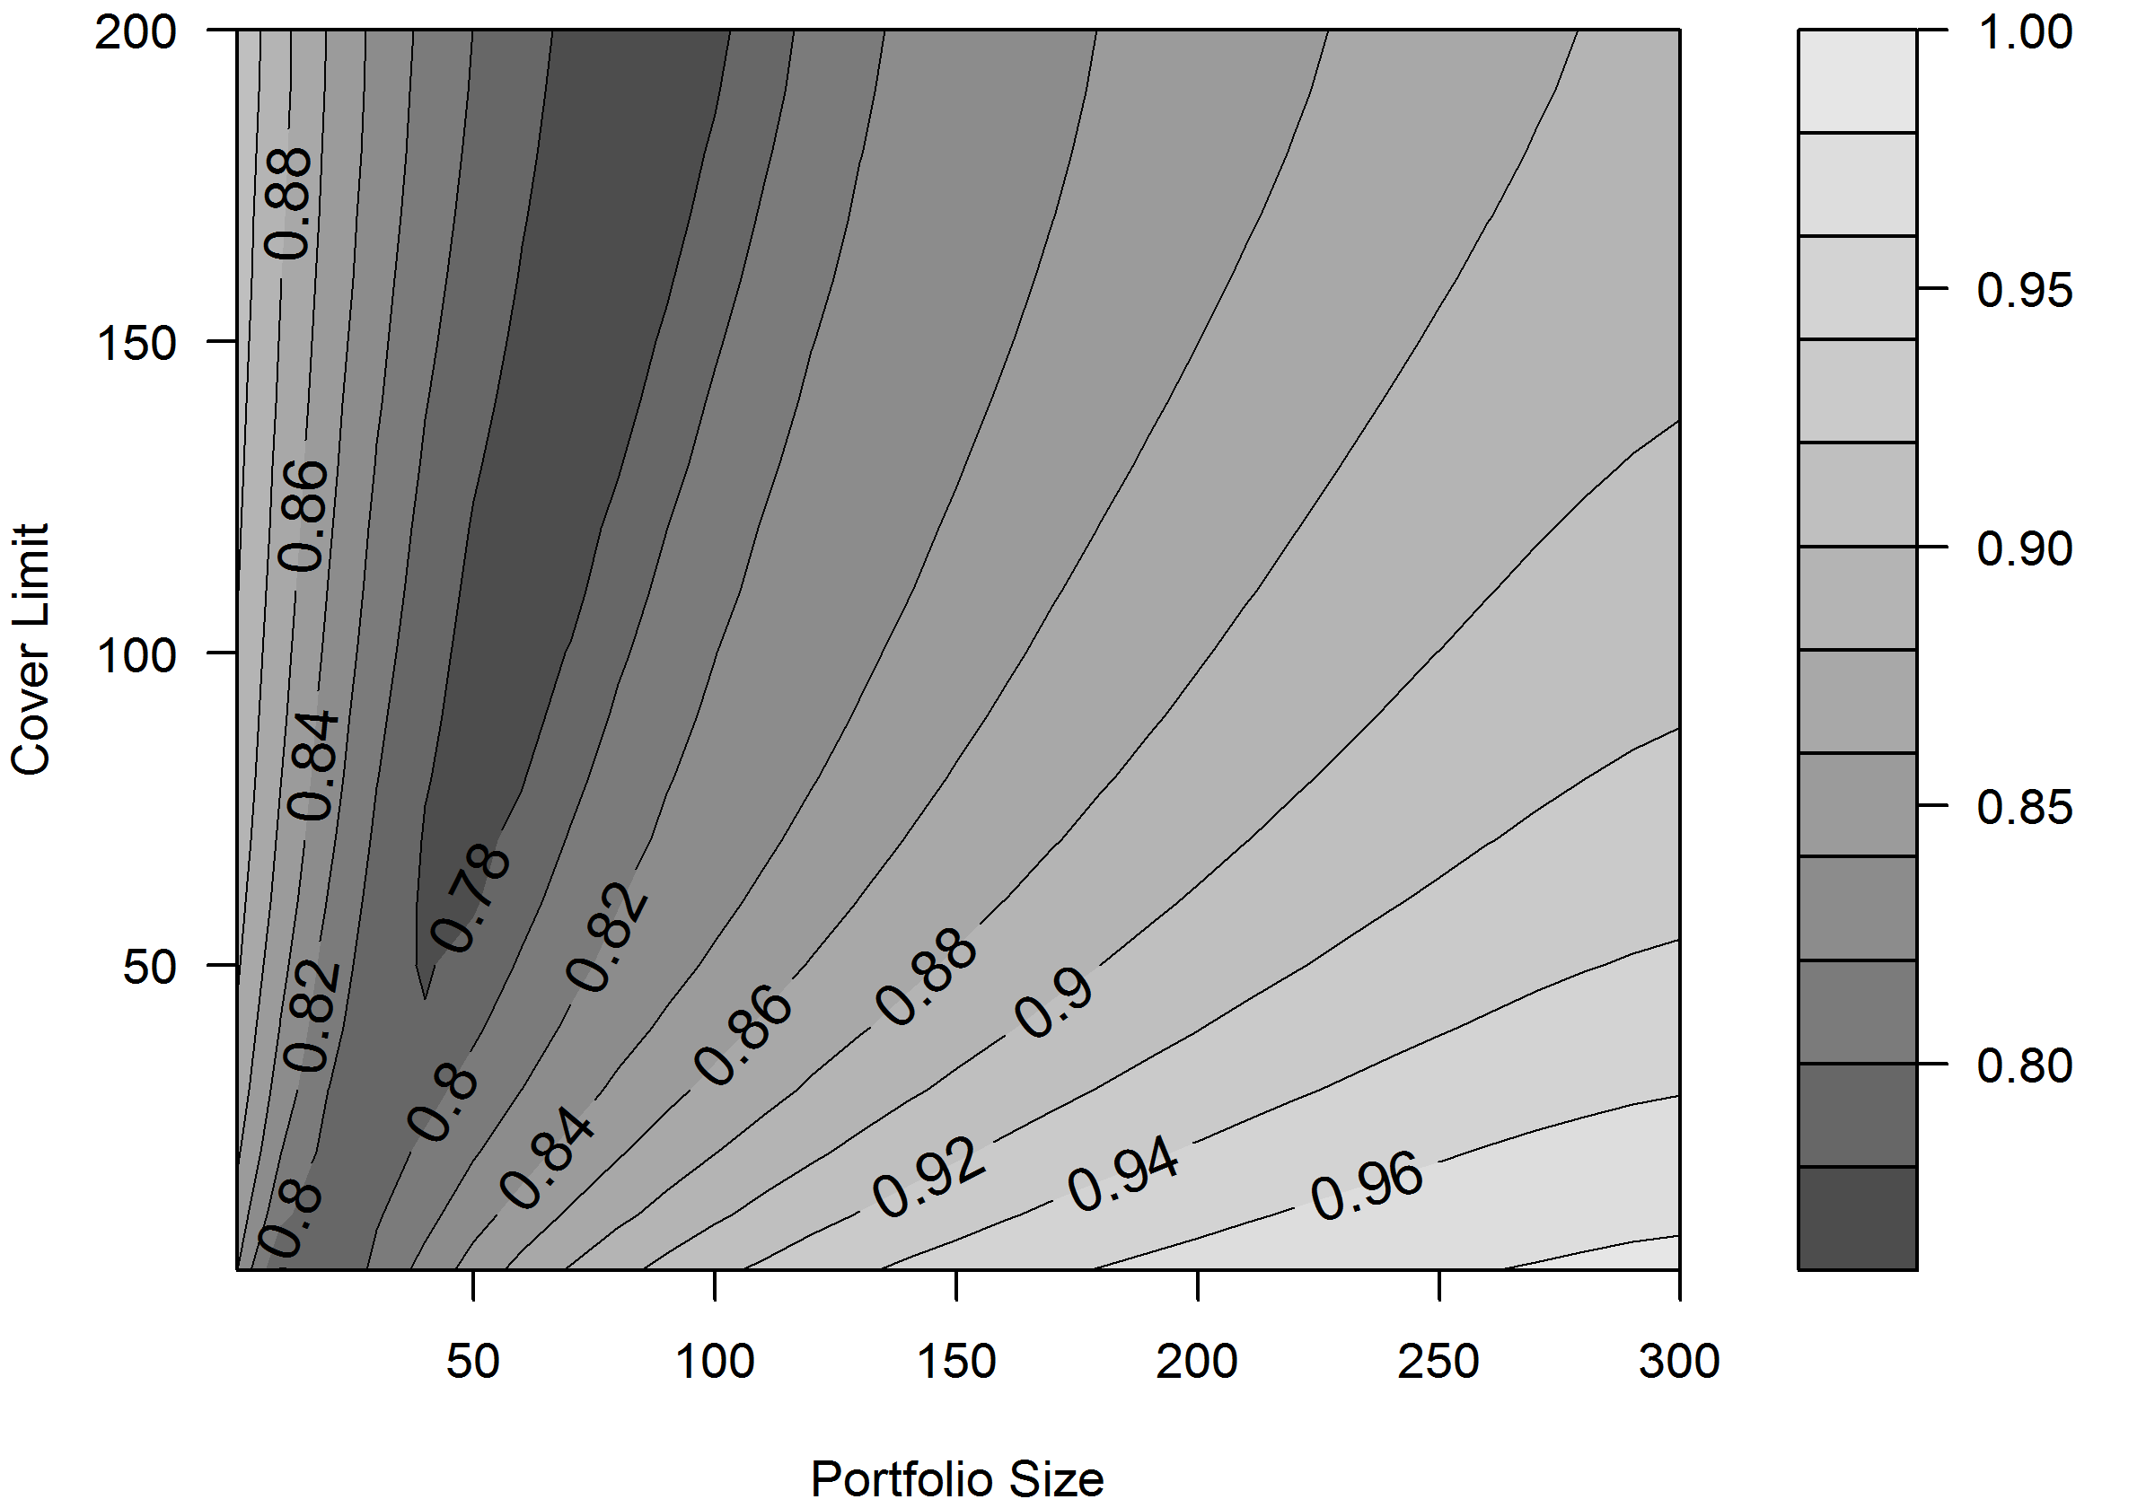

US RBC and Cyber Risk (Underwriting)
Survival Probability ($p_{s}$)
Notes:
87.5%
$a$: safety level (probability not to default)
Calculated safety level of 82% is rather low (regulator aims for 87.5%).

Slide 18
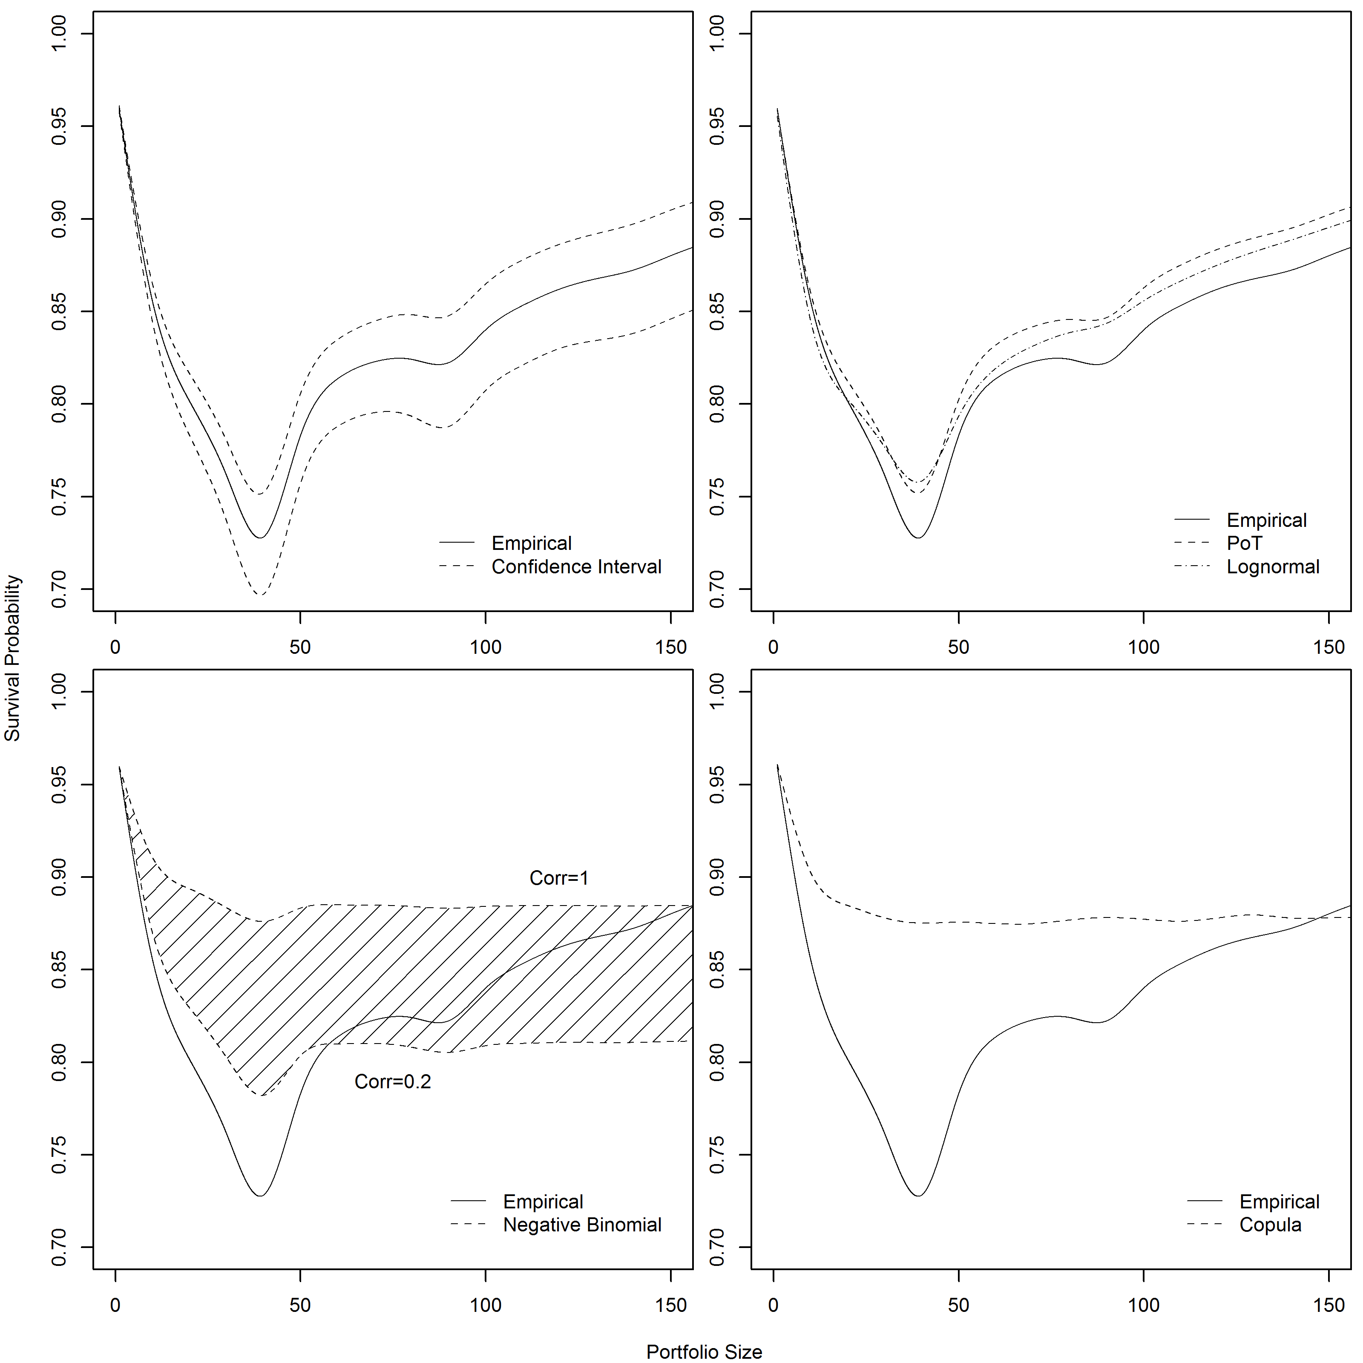
US RBC and Cyber Risk (Underwriting)
Sliced at cover limit l= $ 50 m

Slide 19



SST and Cyber Risk (Underwriting)
Reserves ($μ_{R}$, $σ_{R}^{2}$)
LogN($μ_{R}+μ_{N}$, $σ_{R}^{2}+σ_{N}^{2}$)
Premium risk
Normal Losses ($μ_{N}$, $σ_{N}^{2}$)
Convolution
X
Extreme Losses
(comp. Pareto)
SST defines the parameters of the distributions.
Then, the distribution of the total loss is derived numerically and the ${TVaR}_{99\%}\left(X\right)$ is calculated.
Notes:
- Mu and standard deviation are calibrated according to the insurers own data.
Extreme Losses >5 Mio. CHF
Extreme losses are poisson compounded paretos.
Pareto index is given

Slide 20
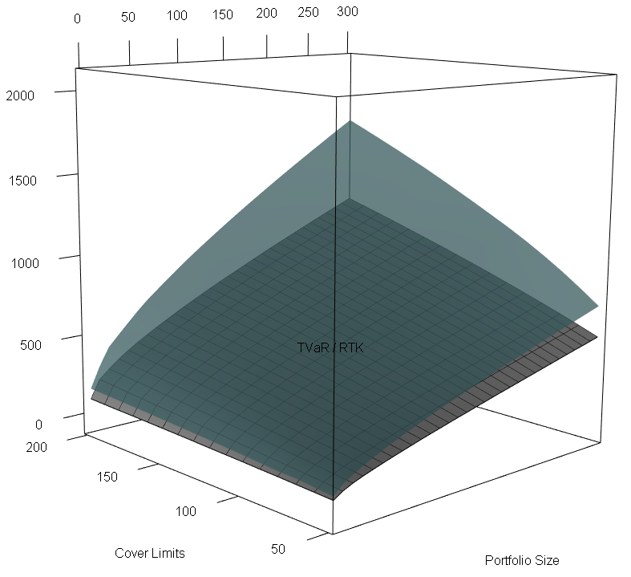
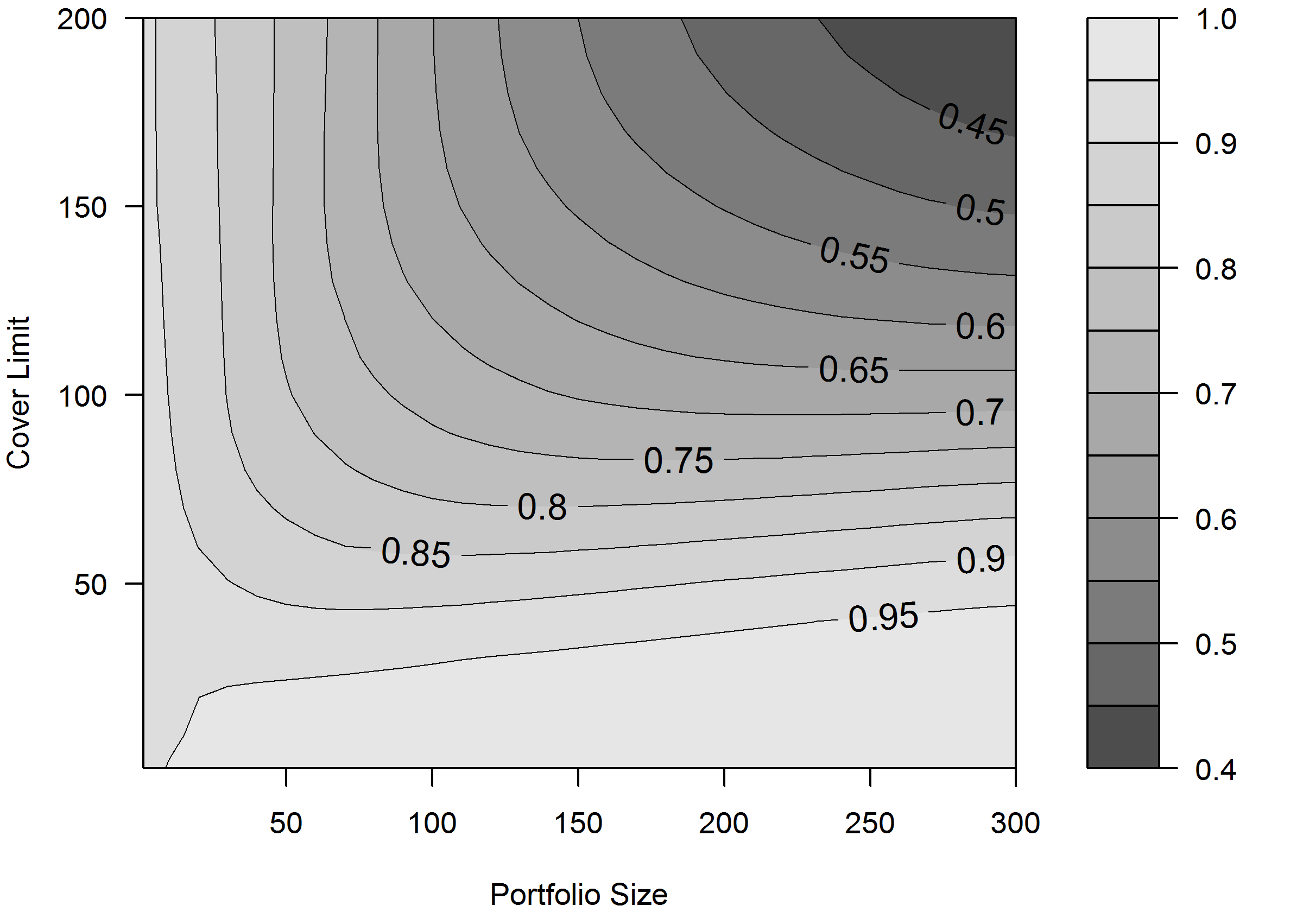
SST and Cyber Risk (Underwriting)
TVaR vs RTK (gray)
Survival Probability ($p_{s}$)

Slide 21
Conclusion
Key findings
  All three regulatory models underestimate cyber risk especially for small portfolio sizes and high cover limits.
  This is due to the characteristics of cyber risk, such as the heavy tails and strong correlation. -> Adverse consequences for diversification
Disclaimer
  Are the data representative for a specific underwriting / operational cyber risk exposure?
  Assumptions on how to apply the regulatory models (no rulings available).
Notes:
A major part of cyber threats distributes over the internet and therefore the correlation might be higher than for other underwriting risk. Moreover, extreme scenarios suggest that cyber risk could accumulate and become catastrophic
However, while insurers can geographically diversify cat risk, cyber risk propagated by the Internet does not know any boundary.

Slide 22
Conclusion
Recommendations
  Instead of a “one fits it all” approach: Use specific risk factors and correlations calibrated with cyber risk data.
  Heavy tails would call for replacing the lognormal assumption used by SII and SST by a power law distribution.
  Regulatory models will need to adapt quickly as the insurance industry will rely more heavily on new technologies and underwrite cyber policies more aggressively.
  Data quality should be improved
Notes:
- Exchange of cyber data.

Slide 23
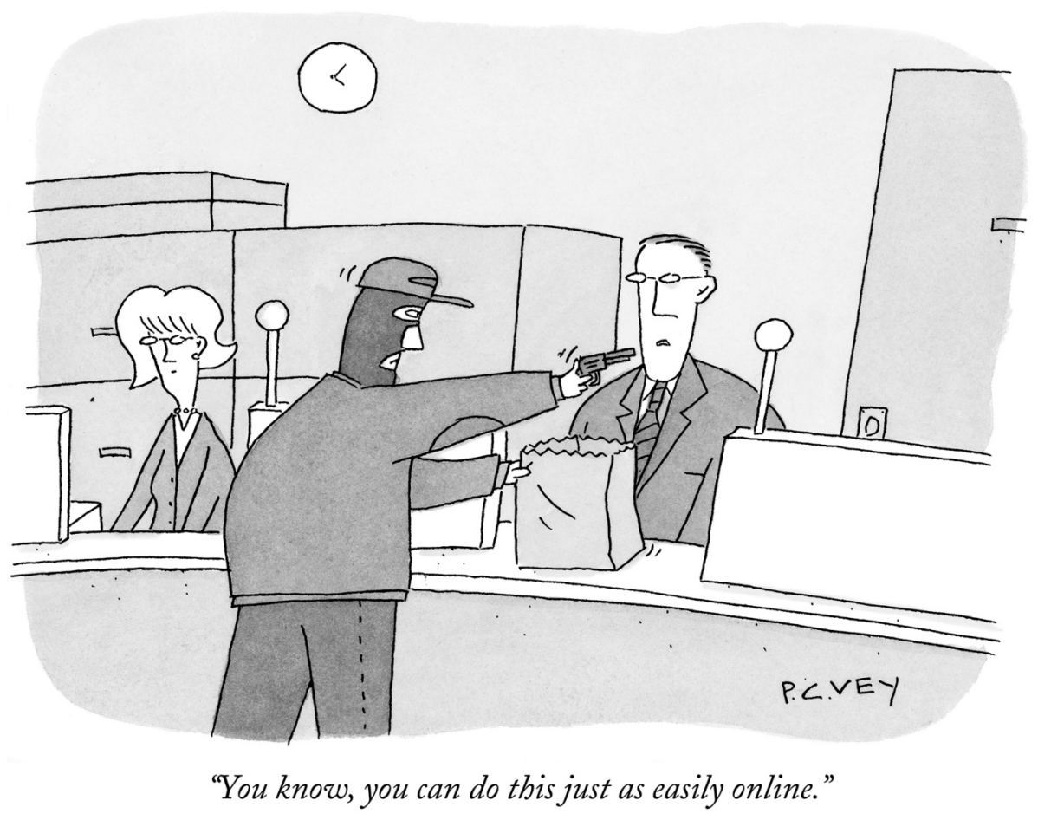
Questions and Discussion
Thanks a lot for your attention!

