Slide 1
The Impact of Varieties of Institutional Systems on
Forms of Corporate Diplomacy on SDG 16
Awaiting licensing approval from co-author
Academy of Management Conference
August 7th 2023
Catherine McDonald, University of St. Gallen
Professor Dr. Michelle Westermann-Behaylo, University of Amsterdam

Slide 2
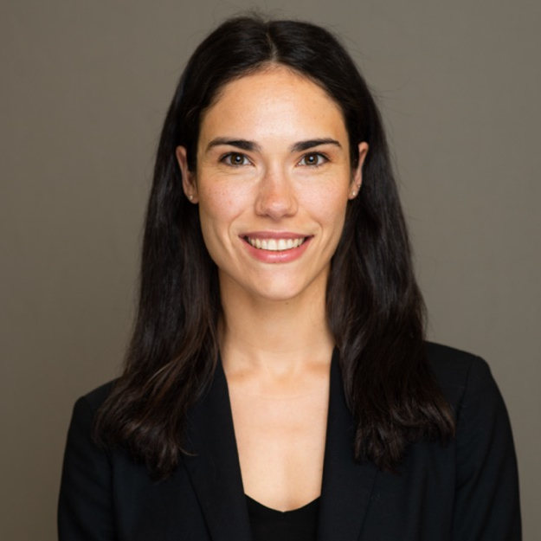
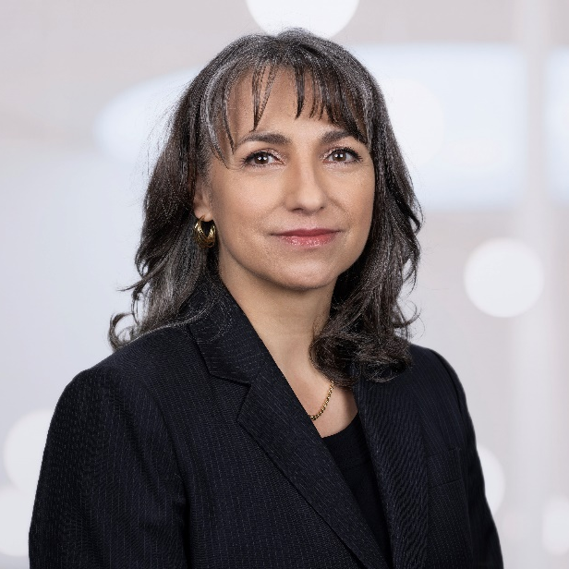
Catherine McDonald
PhD Candidate (late 2024)
University of St. Gallen (Switzerland)
Michelle Westermann-Behaylo
Assistant Professor
University of Amsterdam Business School (Netherlands)

Slide 3
Agenda
Corporate Diplomacy: What does it entail?
Corporate Diplomacy: Why is it conducted?
Motivation & Research Question
Theoretical Framework: Varieties of Institutional Systems (VIS)
VIS Country Classifications
Differing Institutional Logics Across Societal Sectors
Methodology & Cross Country Multiple Case Studies
Propositions & Illustrative Examples: Collaborative Agglomeration Institutional Context
Propositions & Illustrative Examples: Family-Led Institutional Context
Propositions & Illustrative Examples: State-Led & Fragmented with a Fragile State Institutional Context
Conclusion
Open Questions & Feedback

Slide 4
THANK YOU!
For further information, please contact:
Catherine McDonald
PhD Candidate, University of St. Gallen
catherine.mcdonald@unisg.ch
Michelle Westermann-Behaylo
Assistant Professor, University of Amsterdam
m.k.westermann-behaylo@uva.nl

