Slide 1

How do Swiss renters and home owners value green building features?
Anna Ebers Broughel
Rolf Wüstenhagen

Slide 2
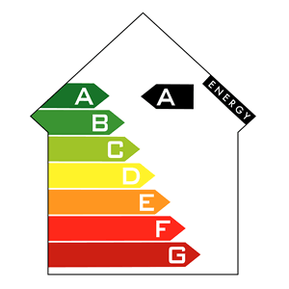
Focus
Do respondents prefer ‘green’ buildings with rooftop PV, energy storage and higher energy efficiency rating?
Do preferences of property owners and renters differ?
Do ‘green features’ add customer value?
Notes:
The idea of having a lable to certify energy origin or energyperformance is not new. A lot of consumers in our sample report look at energy labels when purchasing household applicances. If we look at labels when buying a fridge, why wouldnt we look at energy lables when buying the whole house?

Slide 3
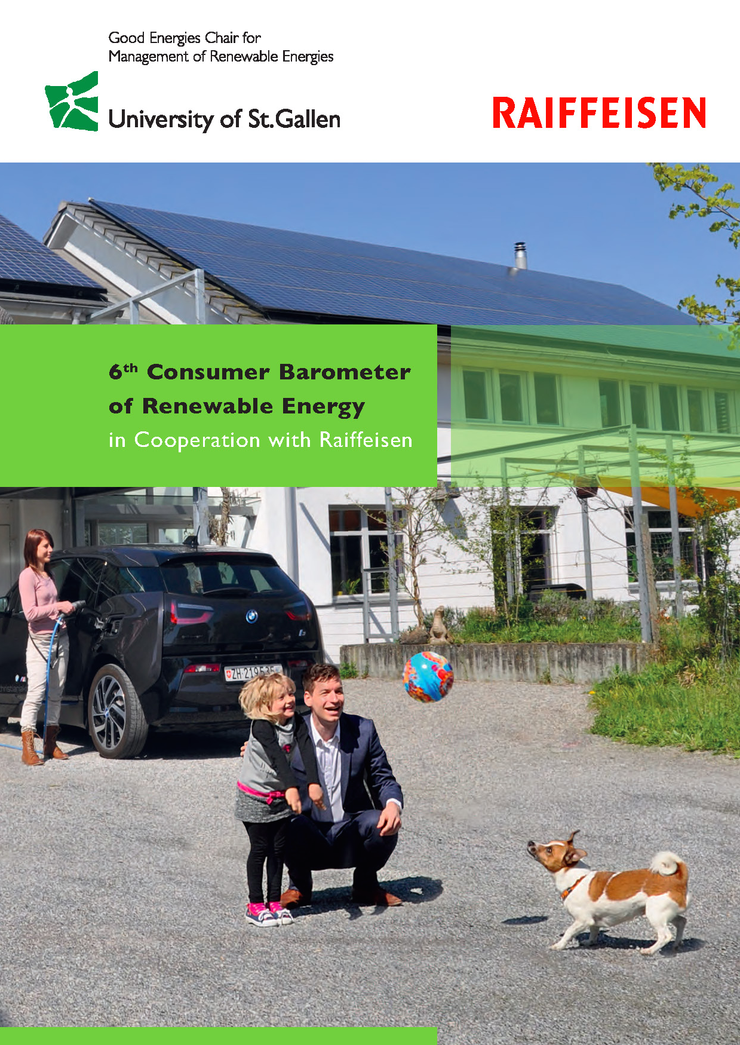
Data
1,001 Swiss respondents
German- and French-speaking
Population representative sample
Online panel >50,000
Jan-Feb 2016
Renters = 51% apartment, 4% house
Property owners= 31% house, 14% apartment
Notes:
450 respondents who own their domiciles: 31% of all participants are house owners and 14% are apartment owners. The remaining 55% of respondents (N=551) live in rented apartments (51%) or rented houses (4%).
The number of men and women in the main sample is roughly equal. The sample is also representative of the broader Swiss population with respect to respondents’ education level. A third of respondents obtained higher education and 42% have vocational training. Geographically, the sample corresponds to the distribution of the overall population among the German- and French-speaking regions of Switzerland. 29% of respondents reside in the Eastern Midlands, 24% in the Pre-Alpine region, and 22% in the Western Midlands. The remaining quarter of respondents live in the French-speaking part of Switzerland.

Slide 4
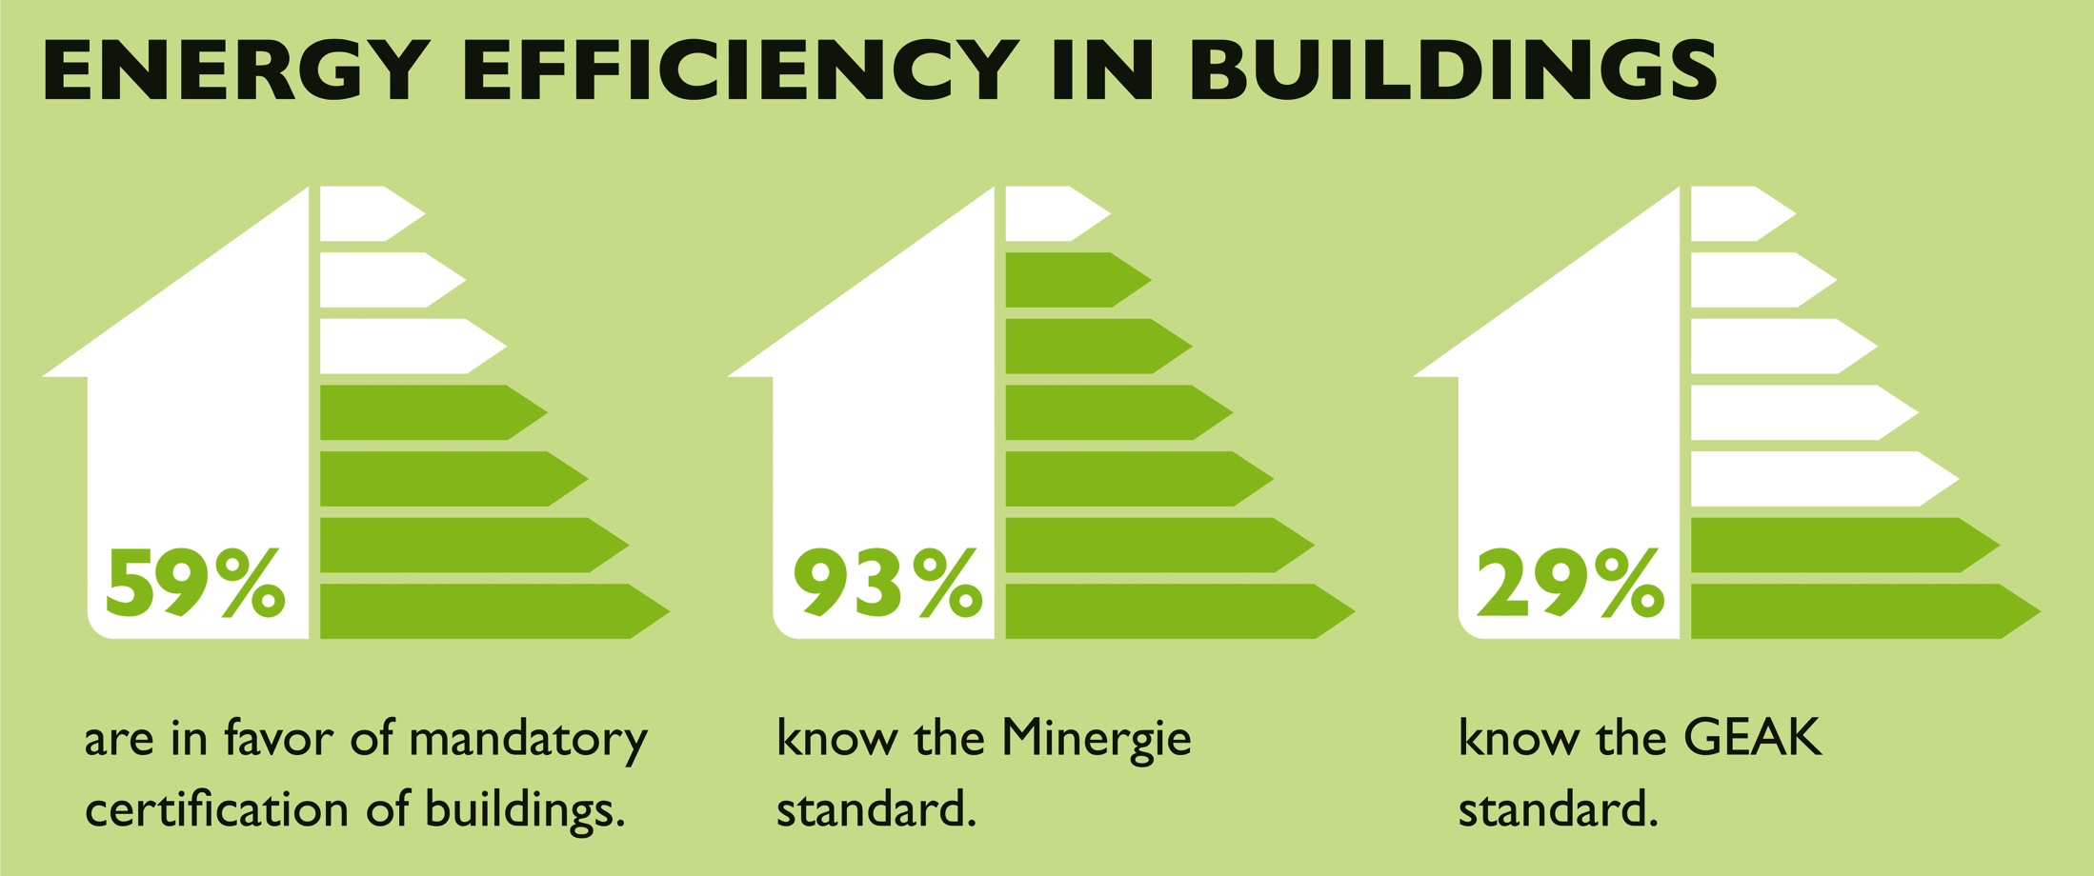

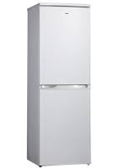
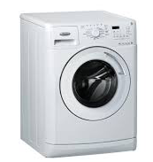
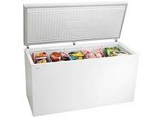
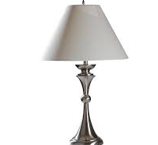
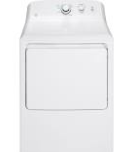

=80-85%
?
1/3 of respondents
=73-57%
Notes:
According to our survey, respondents show a prevailing support for mandatory energy certification of buildings at the time of purchase. Compared to last year, this support for mandatory certification has increased by 6%. This support for mandatory certification is higher among renters (66%), who may see building ratings as helping them pay less for energy, than among owners (50%).

Slide 5
Notes:
According to our survey, respondents show a prevailing support for mandatory energy certification of buildings at the time of purchase. Compared to last year, this support for mandatory certification has increased by 6%. This support for mandatory certification is higher among renters (66%), who may see building ratings as helping them pay less for energy, than among owners (50%).

Slide 6
Notes:
Some energy standards are known better than others, for example, nearly all respondents have heard about Minergie. In contrast, the Swiss certification scheme, known in German as GEAK, around a third of respondents were familiar with it. It is worth mentioning that Minergie standard has been around for 20 years, while GEAK was launched in 2009.

Slide 7
Info on energy efficiency ratings

Slide 8
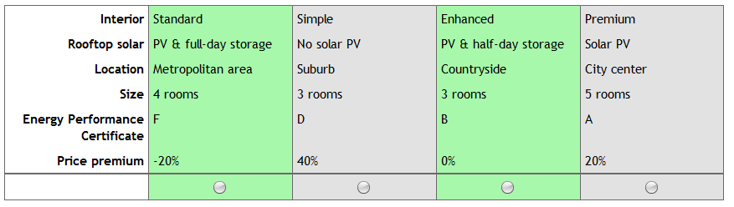
Evaluation of ‘green’ attributes
Choice experiments:
  10 randomly generated choice tasks
Notes:
We assumed a solar PV system size of 6 kWp, a half-day battery storage capacity of 7 kWh, and a full-day battery storage capacity of 15 kWh, which should be enough to cover an average household electricity consumption of 5,400 kWh per year.

Slide 9
Importance of property attributes

Slide 10
PRICE PREMIUM
LOCATION
SIZE
ENERGY EFFICIENCY
RATING
SOLAR PV
INTERIOR

Slide 11
Take aways
majority of respondents would welcome mandatory efficiency standards @ purchase
‘green’ building attributes contribute positively to customer value (28.5%)
energy efficiency rating is slightly more important (16.5%) than rooftop solar (12%)
energy efficiency ratings A or B strongly preferred to D or F ratings
preferences of renters & owners are similar

Slide 12
Practical implications:
owners: offers combining a solar system with full- or half-day battery storage
untapped potential: make energy efficiency part of property buying decision, like household appliances
Research:
further segmentation to understand group characteristics
evaluate price premium for green attributes

Slide 13
Thank you
aebers@umd.edu
anna.ebers@unisg.ch
Study available at:
www.iwoe.unisg.ch/kundenbarometer

