Slide 1
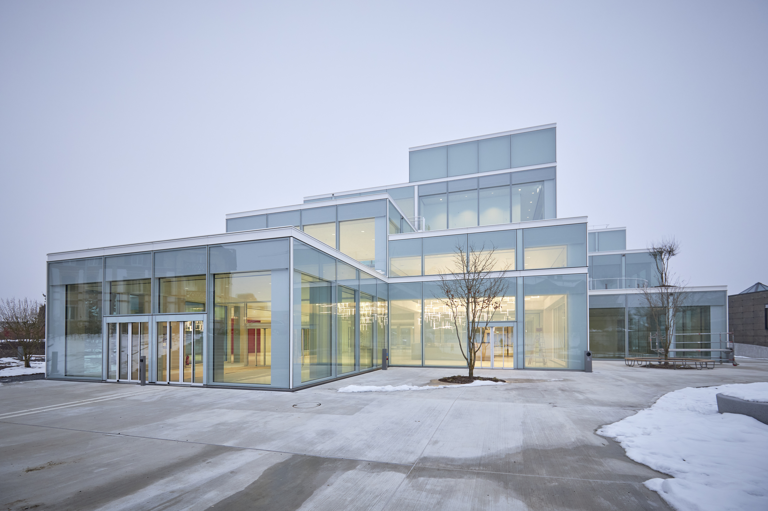


Panel - Reimagining learning spaces in higher education institutions
Amsterdam, 12th October 2023
Prof. Dr. Bernadette Dilger
Discovering SQUARE with Sou Fujimoto - YouTube

Slide 2


