Slide 1
Contextualized Non-Market Strategies:
Insights on ESG & Geopolitical Risks from Reactive (Transitional) Contexts
84th Academy of Management Conference
August 11th 2024
Panel Symposium Contribution
By Catherine McDonald

Slide 2
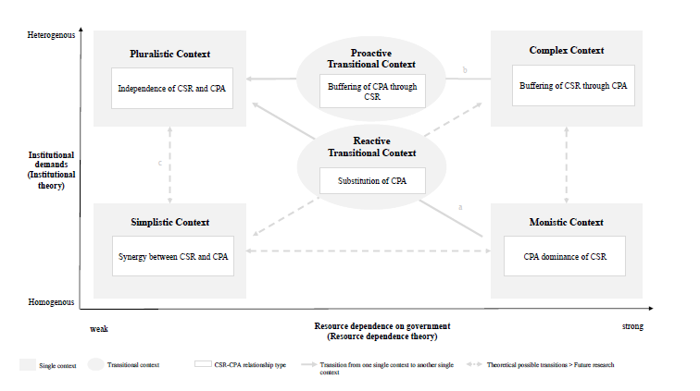
1. Contextualizing Transitional Contexts
  Scholarship on the CSR-CPA relationship in transitional contexts remains nascent (Winkler et al., 2024)
  Transitional contexts refer to a context in flux, between one single context to another (Liedong and Frynas, 2018; Nyberg and Murray, 2020)
  Reactive transitions as well as proactive transitions present significant geopolitical risks, due to their dynamic nature.
Source: Winkler & Krzeminska, 2024)

Slide 3
2. Transitional Contexts
Reactive Transitions
May occur as a result of an externally induced shift (i.e. a regime change or volatile political landscape)
Proactive Transitions
May occur due to an internally induced shift (i.e. from a highly regulated or controversial industry)
In transitional contexts, CSR oftentimes assumes a more political role, to promote good government relations, in the place of CPA (Winkler & Krzeminska, 2024)
Such CSR activities focus on gaining legitimacy and reputational benefits and at times may err towards bribery
However, there remains scope to further understand how CSR is conducted in such contexts, due to the predominance of a Western perspective and definition of CSR (Winkler et Krzeminska, 2024: 22).

Slide 4

3. Non-market Strategies in Transitional Contexts
Firms in transitional contexts may focus on and substitute CSR for CPA by:
  Focusing on Environmental, Social and Governance (ESG) Criteria
  Minimizing their geopolitical risk
  Seeking legitimacy and reputational benefits both in their home and host markets
These strategies may border or complement normative ethical approaches, such as political corporate social responsibility (PCSR) (Scherer & Palazzo, 2011) by:
  Engaging in forms of deliberative democracy with stakeholders
  Contributing to global public goods and regulation

Slide 5



4. Transitional Reactive Contexts: An Example
Kilitch Estro Biotech is a joint venture pharmaceutical company, which manufactures generic drugs in Ethiopia
The war in Ethiopia, coupled with local conflict, creates a transitional reactive conflict, where the firm operates
In recent years, Kilitch Estro Biotech has begun to increase their CSR activities by engaging in ESG related activities.
Key activities include:
  Providing 24/7 treated water for free to approximately 700 households in the surrounding area
  Hosting events for employees and the local community that celebrate both Indian and Ethiopian culture
  Providing housing and commonplaces for the distribution of consumer goods

Slide 6


5. Transitional Proactive Contexts: An Example
Cobalt mining in the Democratic Republic of Congo (DRC) is highly controversial and presents significant ESG, geopolitical and regulatory risks.
In January 2018, well in advance of the elections in December 2018, Trafigura initiated the Mutoshi Pilot Project, alongside Chemaf, a collective of artisanal and small scale miners (COMIAKOL) and the international NGO, PACT.
Mutoshi Pilot Project aimed to address issues associated with artisanal and small-scale mining (ASM).
Although the project closed in 2020, it highlights how firms may engage in CSR with external stakeholders to contribute to public infrastructure, when involved in controversial industries and to pre-empt political change.

Slide 7

6. Conclusion
In transitional contexts, firms often emphasize CSR over CPA, to mitigate geopolitical risk and build legitimacy with stakeholders (Winkler & Krzeminska, 2024).
There remains scope to understand normative non-market strategies, including PCSR and corporate diplomacy.
A normative, ethics-oriented perspective may provide further insights for firms operating in transitional contexts.
Future research should also account for non-Western perspectives that account for the local context (George et al., 2016; Winkler & Krzeminska, 2024).
Firms can mitigate geopolitical risks and contribute to ESG related criteria by addressing topics such as human rights, environmental impact and health and safety.

Slide 8
THANK YOU!
Catherine McDonald
PhD Candidate, University of St. Gallen
catherine.mcdonald@unisg.ch

