Slide 1
Adaptation Strategies to the Biophysical Environment as a Source of Competitive Advantage
Kerrigan Unter, University of St. Gallen
Jorge Rivera, George Washington University

Slide 2

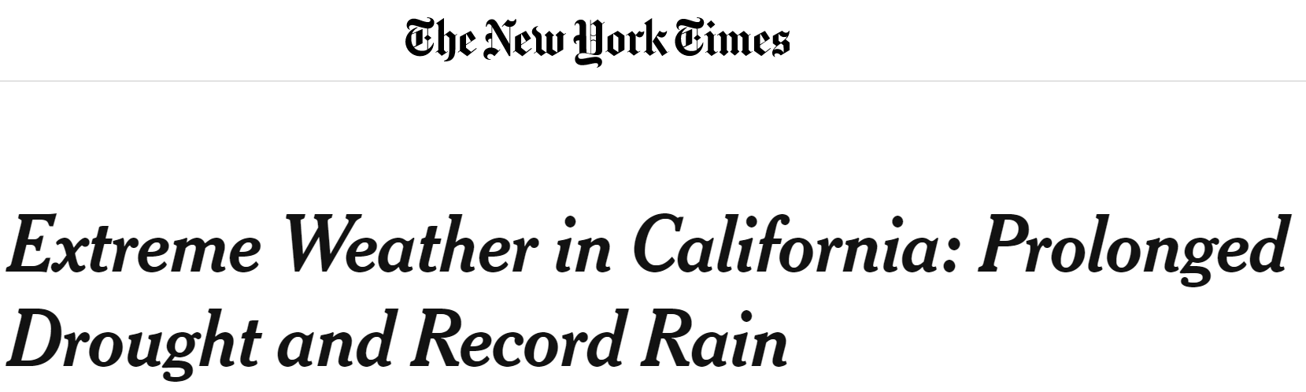
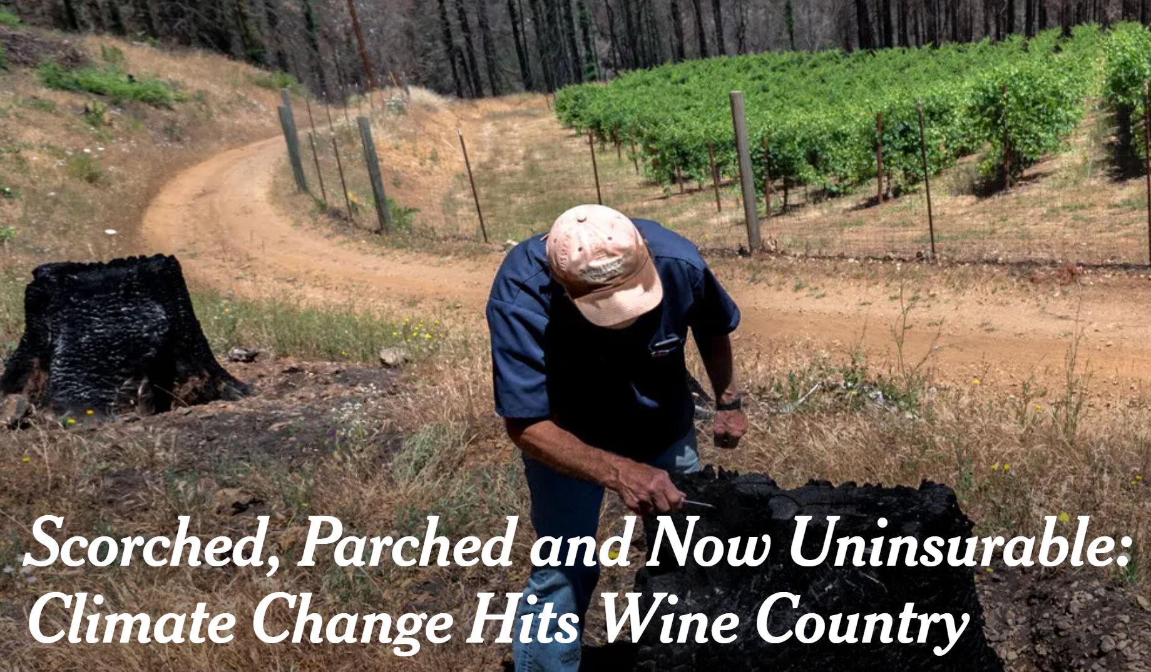
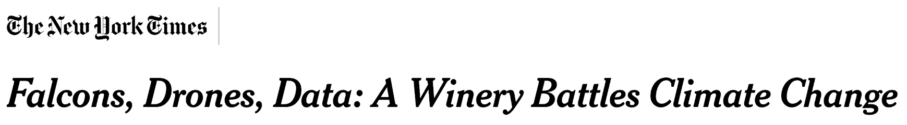


Slide 3
Research Questions
How does the external biophysical environment affect firm climate change adaptation strategies and performance?
Are climate change adaptation strategies a source of competitive advantage for firms?

Slide 4
The biophysical, adaptation, and performance
Firms aim to minimize uncertainty from the natural environment:
    Maintain access to critical natural resources through adaptation, so that they can continue operating (Bergmann et al., 2016; Tashman & Rivera, 2016).
    Adapting to adverse natural conditions can reorient the organization to better respond and ensure that opportunities are not lost and new costs are not incurred (Hoffmann et al., 2009; Linnenluecke et al., 2012).
    The adoption of climate change adaptation strategies can buffer the firm against resource and operational instability (Clement & Rivera, 2017; Rivera & Clement, 2019; Weinhofer & Busch, 2013).
Adaptation strategies have consequences for firm performance.

Slide 5
Resource-based view
RBV does not consider how unstable natural conditions. Even NRBV (Hart, 1995) focuses primarily on mitigation strategies.
Climate change adaptation is of value to the firm:
    Increases the firm's resilience against future adverse conditions (Clement & Rivera, 2017; Linnenluecke et al., 2012).
    Effective long-term adaptations in developing resilience and buffering the firm against adverse conditions are more costly and difficult it is to implement (Linnenluecke & Griffiths, 2013).
    Synergizing several resources within the firm to adapt is not easily replicated by other firms (Becerra, 2008).
    Necessary to respond to the inevitable environmental changes organizations are facing and will continue to face (Bowen et al., 2012; Schneider, 2011).

Slide 6
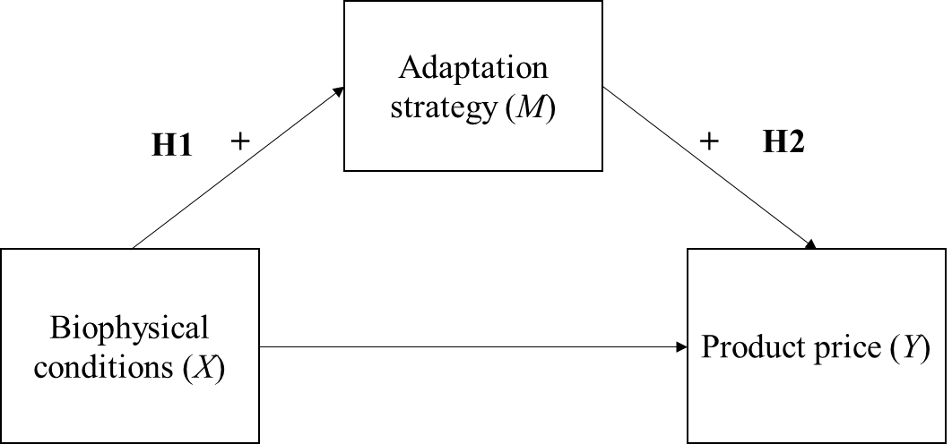
Hypotheses
H1: Biophysical conditions are directly and positively related to the adoption of climate change adaptation strategies.
H2: The adoption of climate change adaptation strategies are directly and positively related to product price.
H3: The adoption of climate change adaptation mediates the relationship between biophysical conditions and product price.

Slide 7
California and wildfires
Climate change exacerbates underlying natural conditions, such as warming and drought, which can lead in more intense, frequent, and longer lasting wildfires (IPCC, 2014; 2021).
Smoke damage is the main concern for wineries.
  Smoke damage from wildfires within the same region, especially prior to harvest, can damage grapes and negatively impact subsequent wine quality (Krstic et al., 2015; McIntyre, 2021).

Slide 8
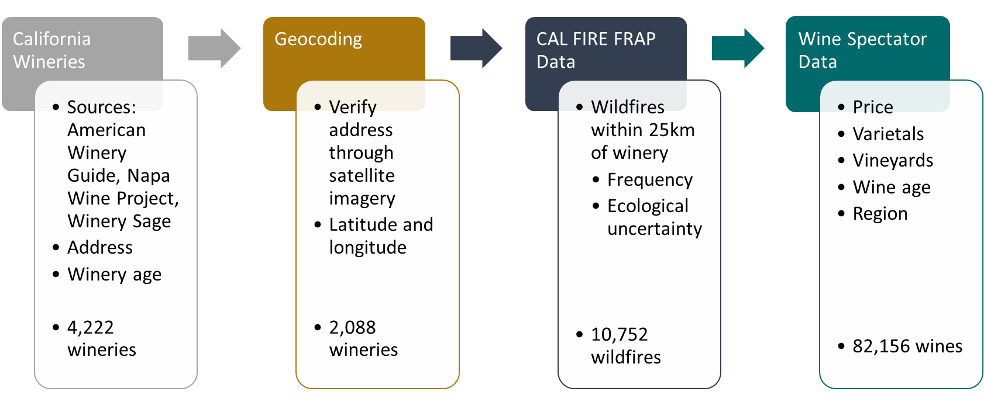
Data and sample
50,156 wine-winery-year observations for 535 wineries covering the years 1981-2019

Slide 9
Measures
IV: Number of wildfire events within 25 km of a winery
Mediator: Number of vineyards
DV: Wine price
Controls:
  Dummies for varietals including cabernet sauvignon, chardonnay, merlot, pinot noir, sauvignon blanc, syrah, zinfandel, and wines with no single varietal.
  Age of the wine.
  Winery level: winery age, number of varietals at each winery, and ecological uncertainty.
Notes:
effect of proximate wildfires on winery adaptation strategies and performance because of the adverse effects that wildfire smoke can have on grapevines and winegrapes

Slide 10
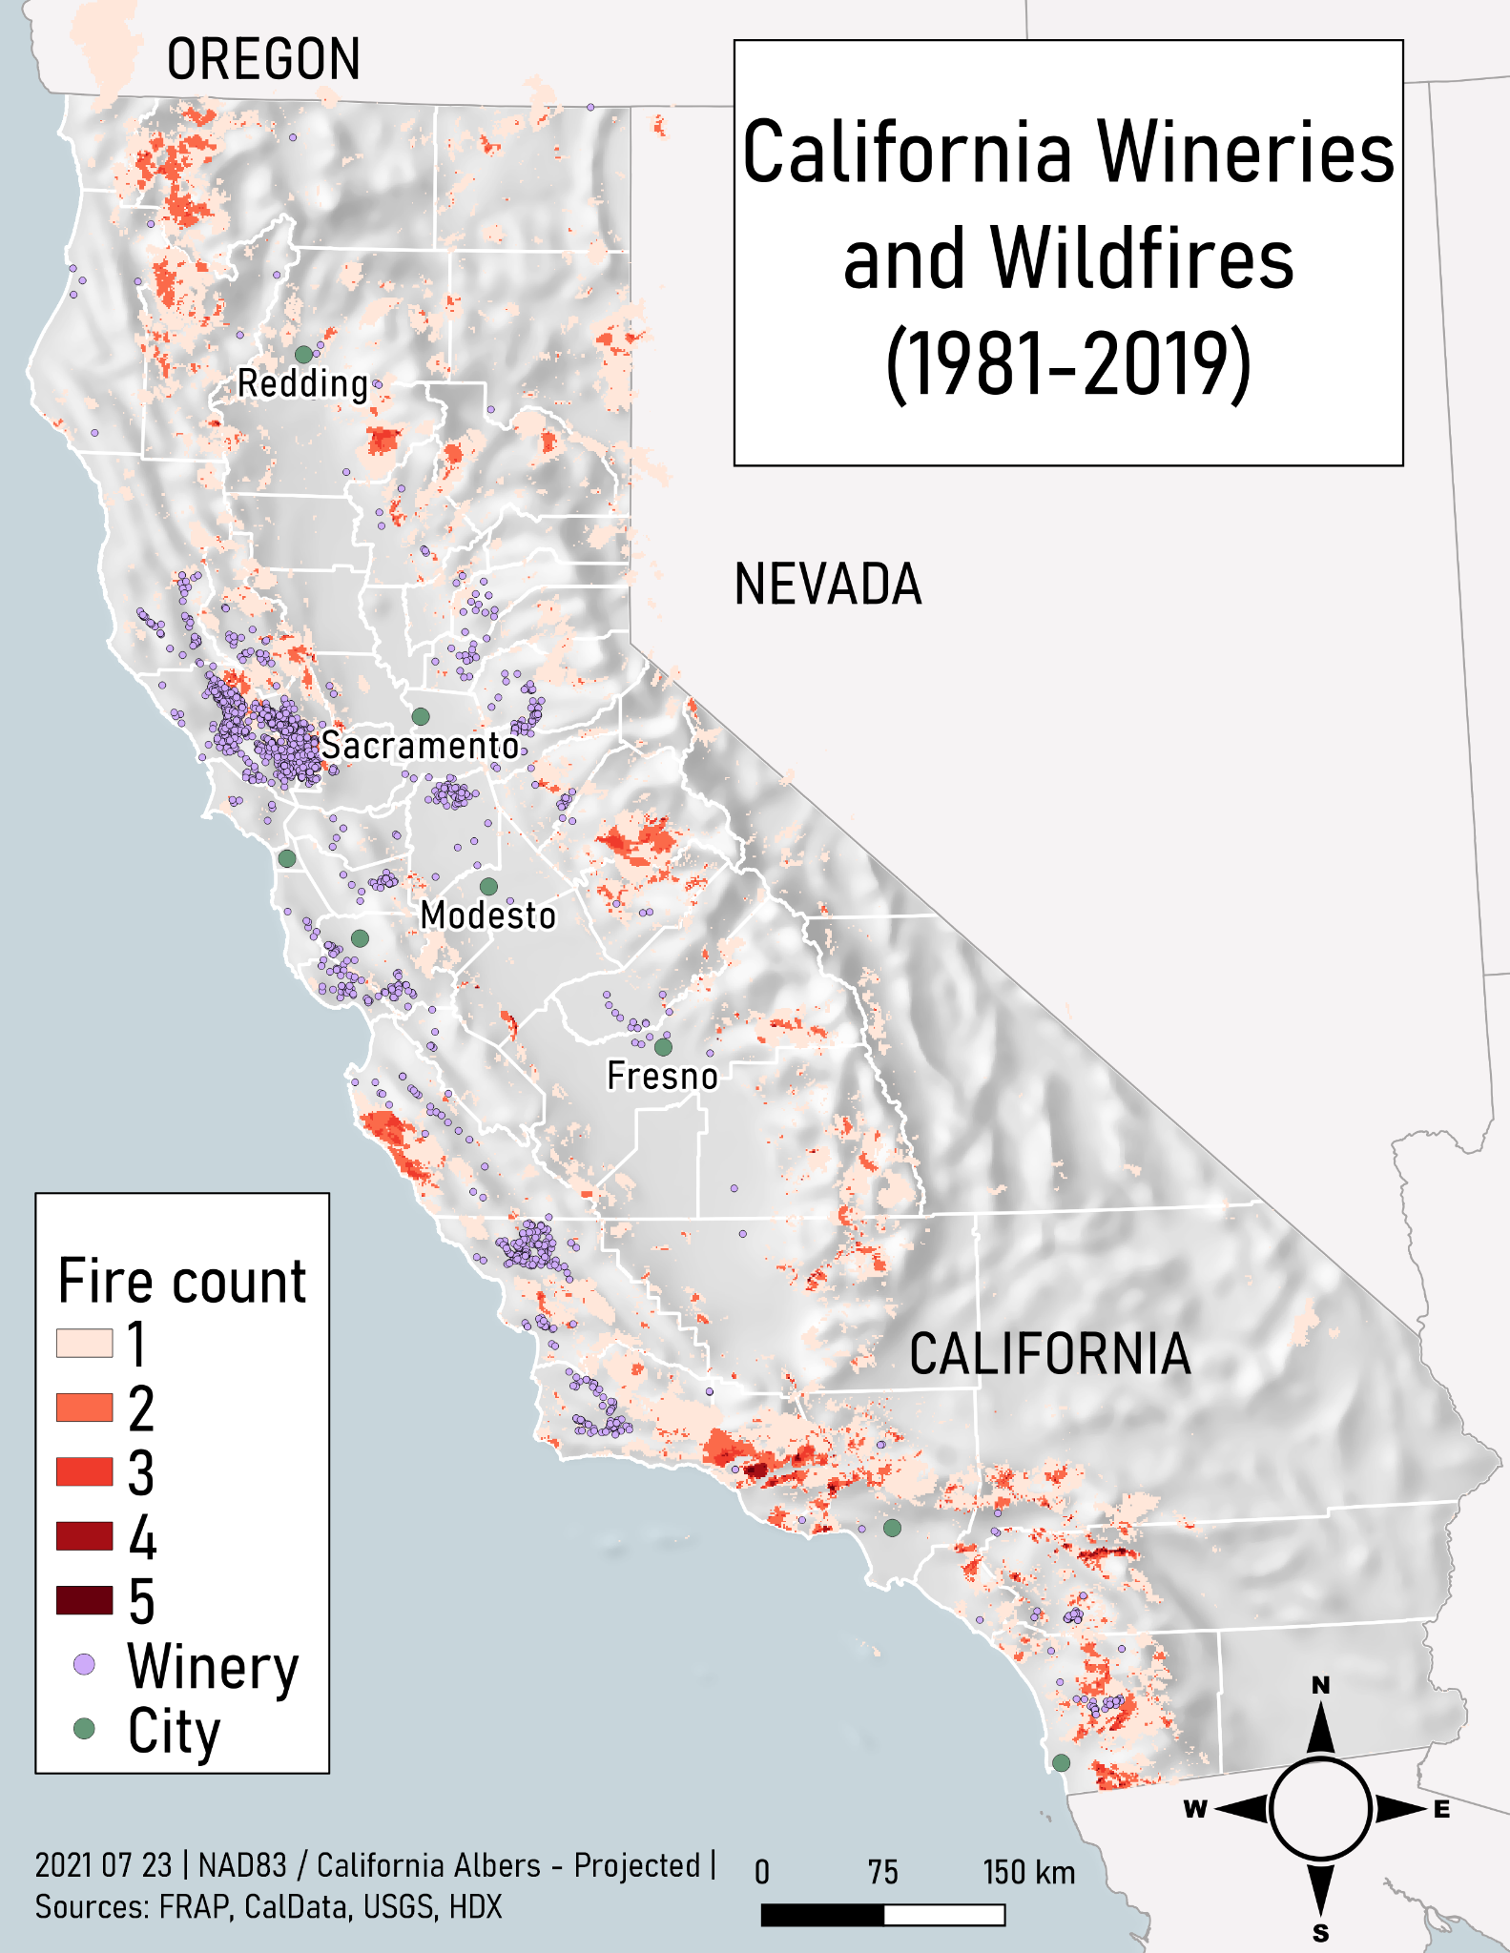
Methods
GIS to connect wildfire data to geocoded wineries.
Path analytic approach using Seemingly Unrelated Regression.
Winery, region, and vintage fixed effects.
Wildfire frequency was lagged for the path connecting it to firm adaptation.
Notes:
Due to challenges with perception and properly evaluating climate impacts (Kaufmann et al., 2017; Moore et al., 2019), there may be a delay in decision making in response to external biophysical conditions.

Slide 11
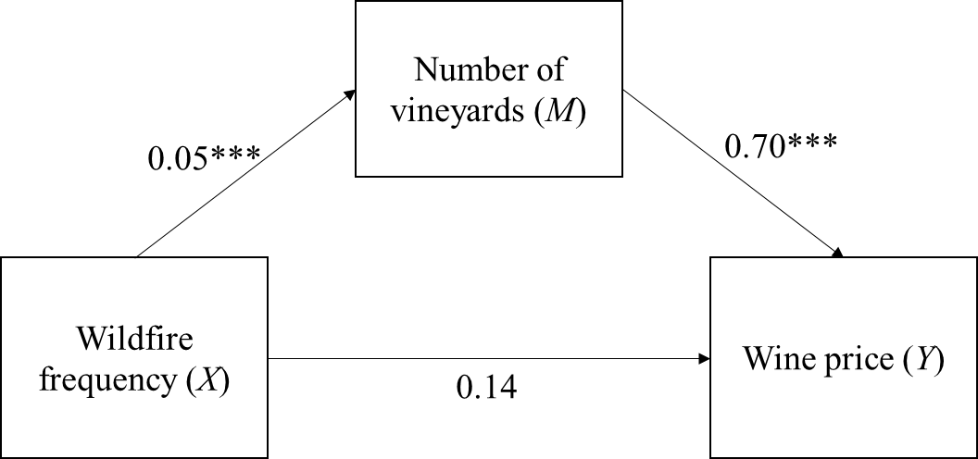
Results
H1: Supported (robust for 2 year lag)
H2: Supported (robust for 2 and 3 year lag)
H3: Supported (robust for 2 year lag)
In response to increased wildfires, wineries adapt by increasing their number of vineyards.
Adapting adapting to natural biophysical conditions can result in higher product prices.

Slide 12
Contributions
The role of nature in business management research has been long overlooked (Rivera et al., 2022).
RBV was designed for stable natural conditions and does not consider how unstable natural conditions may impact the ability of a firm to gain a competitive advantage.
  Extends the boundary conditions of RBV to show that firm responses to the natural environment can be a source of financial value for firms.
Expands beyond the role of nature that is discussed in NRBV view of the firm (Hart, 1995) to show that firms can also gain value from responding to the effects of nature.
Notes:
NRBV primarily focuses on how practices to mitigate harm to the natural environment (i.e., pollution prevention, product stewardship, and sustainable development) can be a source of sustained competitive advantage to a firm (Hart, 1995).

Slide 13
Questions?
Kerrigan Unter
Postdoctoral Research Fellow
Institute for Economy and the Environment
University of St. Gallen
kerrigan.unter@unisg.ch

