Slide 1

The Return of the Leviathan: Public Policy and Evoluting Corporate Strategy

Slide 2
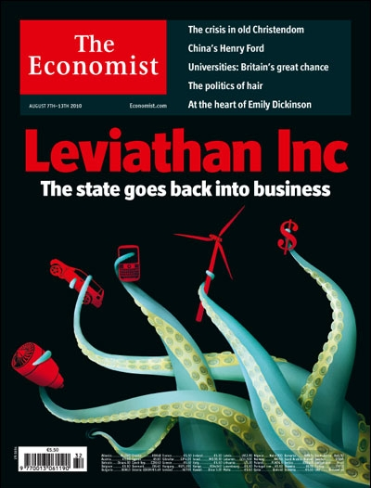
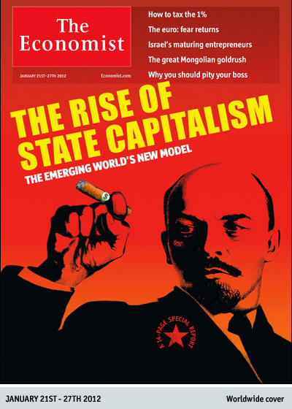
Motivation: In what ways is international business adjusting to...

Slide 3
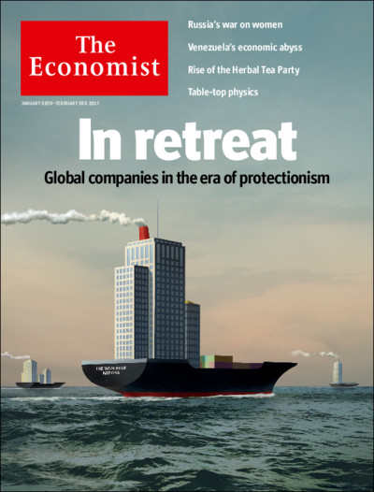
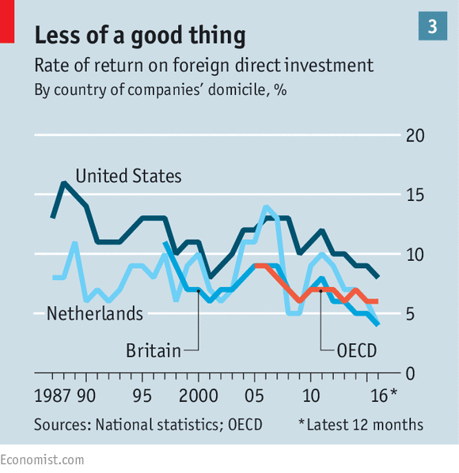
Returns on FDI by OECD firms have fallen sharply
Source: The Economist, 28 January 2017.

Slide 4
Unidirectional logic developed here
Policy Change
Business environment change
Change in corporate strategy
If you want, ask me about the causation going the other way in Q and A

Slide 5
Hints of changing corporate strategies (1)
“I think, without a doubt, any form of protectionism or nationalism, on the whole, is not beneficial for a company like ours, any global company… We will adjust. We will have to adjust, but it takes time for a manufacturer to adjust. It’s much more efficient if we can have open free trade, understandably fair trade, but free trade.” Samuel Allan, CEO and Chairman, Deere
“Our strategy has changed. If you go back [several] years, there was a strategy of producing at huge facilities at certain places around the world, and shipping it to other countries. But now we have a strategy of localisation and regionalisation. We think you should invest in your domestic market as much as you can.” Inge Thulin, CEO, 3M

Slide 6
Hints of changing corporate strategies (2): May 2016 GE CEO statement
“In the face of a protectionist global environment, companies must navigate the world on their own. We must level the playing field, without government engagement. This requires dramatic transformation. Going forward: We will localize. In the future, sustainable growth will require a local capability inside a global footprint.”
GE has already begun adjusting. Rather than produce locomotives at a single location in the US, Immelt noted “now we have multiple global sites that give us market access.”
GE is pursuing similar strategies with its other manufacturing, services and software businesses. “A localisation strategy can’t be shut down by protectionist politics.”
As foreign investment shifts to serve local demands: “We will produce for the U.S. in the U.S., but our exports may decline. At the same time, we will localize production in big end-use markets like Saudi Arabia.”

Slide 7
Investment policy hasn’t been as benign as the UN reports claim
Source: Evenett and Fritz (2016).

Slide 8
Trade in investment goods heavily affected by discriminatory policy
Source: Evenett and Fritz (2016).

Slide 9
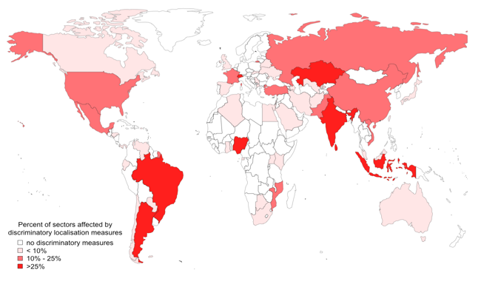
Localisation requirements have spread since the onset of the crisis
Source: Global Trade Alert database.

Slide 10
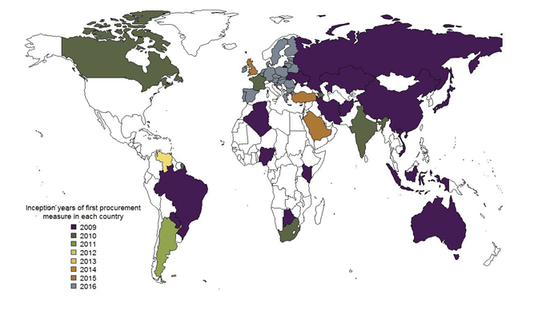
Bad practices spread fast—example of 2009 Buy America measures
Source: Global Trade Alert database.

Slide 11
The growing scale of crisis-era trade distortions faced by G20 exporters
Recall: 10% of G20 exports exceeded $900 billion in 2016.

Slide 12
But then add in the impact of 230+ crisis-era export incentives schemes…

Slide 13
Don’t take my word for it...roll up your sleeves and dig into the data yourself
Check out the source at www.globaltradealert.org
Data freely downloaded at http://www.globaltradealert.org/data_extraction
Report focusing on crisis-era policy response and FDI available at http://www.globaltradealert.org/reports/13
Report with a chapter on localisation measures available at http://www.globaltradealert.org/reports/15
Analysis of Kazakhstan’s industrial policy soon available too.

