Slide 1
Popular Sovereignty
HS2045 Concepts Topic #3

Slide 2
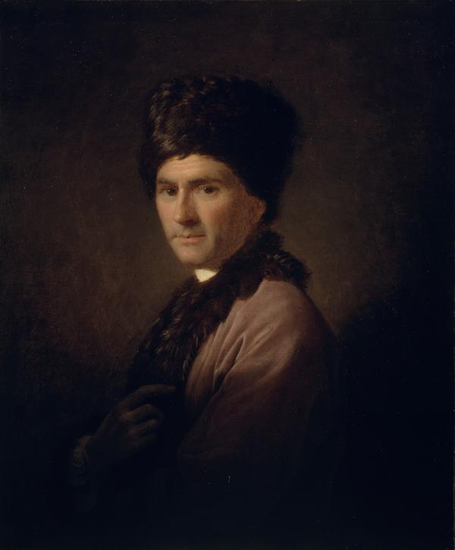
Jean-Jacques Rousseau
1712-78: died long before Revolution but cast a long shadow on French culture and ideas
Major ‘political’ works: Discourse on the Origins of Inequality (1755) and The Social Contract (1762)
Many leading Revolutionaries of different backgrounds read Rousseau, but particularly popular among Jacobins.
Phrases like ‘general will’ became such a part of political vocabulary that they feature in e.g. Declaration of the Rights of Man and the Citizen

Slide 3

The Jacobins
Jacobin Clubs: began in Paris, first met in a Jacobin [Dominican] convent; eventually network of >6,000 clubs
Officially: Society of the Friends of the Constitution, then Society of Friends of Liberty and Equality
20 April 1792: War against Austria
2-7 September 1792: September Massacres – Jacobin tacit and sometimes explicit endorsement – perpetrators ‘saved’ the Revolution – concerns other republicans
22 September 1792: Republic declared; Jacobins enthused
31 May-2 June 1793: Montagnards (led by Robespierre) purge more moderate Girondin wing

Slide 4
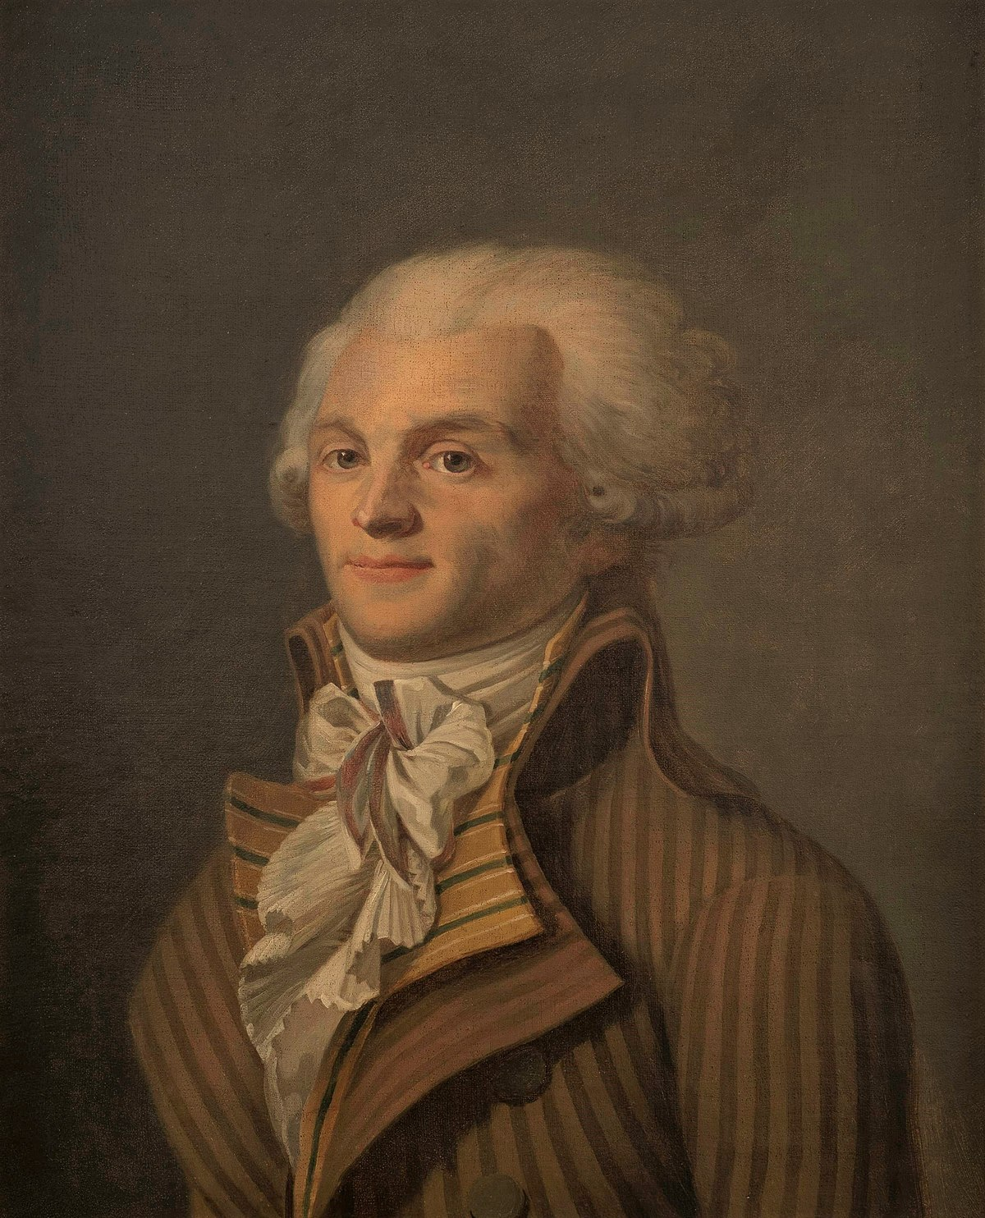
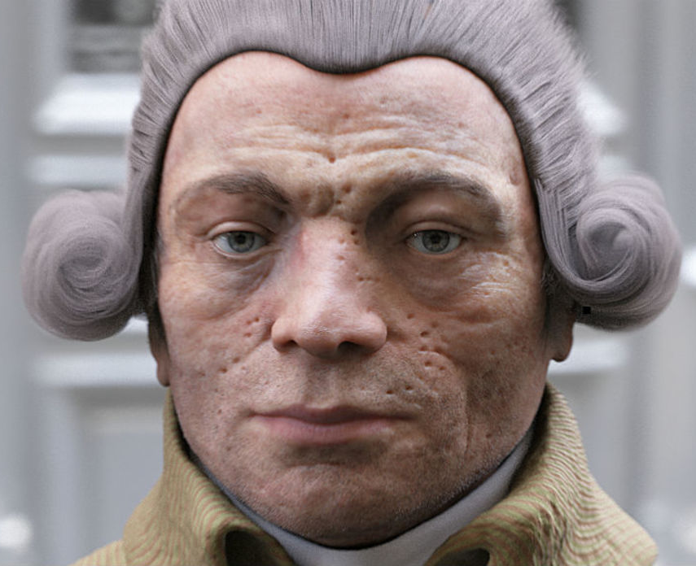
Maximilien Robespierre
27 July 1793 elected to Committee of Public Safety
Late 1793 becomes dominant figure
9 Thermidor Year II (27 July 1794) arrested and then executed by enemies
Identified with the most violent phase of the Revolution (the ‘Terror’) but not just a tyrant, also advocated radical social policies
weird 2013 reconstruction of Robespierre’s face made by forensic scientists based on an alleged death mask owned by Mme Tussaud

