Slide 1
Does insurance regulation adequately reflect cyber risk?
An Analysis of Solvency II, the Swiss Solvency Test, and the US RBC Standards
ARIA 2016 Annual Meeting
Presenting author:
Werner Schnell, Ph.D. Student, Institute of Insurance Economics, University of St.Gallen
(joint work with Martin Eling, Institute of Insurance Economics, University of St.Gallen)

Slide 2
Content
Cyber Risk and Insurance
Methodology
Solvency II and Cyber Risk
US Risk Based Capital (RBC) and Cyber Risk
Swiss Solvency Test (SST) and Cyber Risk
Conclusion & Extensions

Slide 3
Cyber Risk and Insurance
Operational Cyber Risk
Solvency II: Factor approach
US Risk Based Capital: Reporting requirements (Factor approach is planned)
Swiss Solvency Test: Reporting requirements
Underwriting Cyber Risk
Solvency II: Factor approach
US Risk Based Capital: Factor approach
Swiss Solvency Test: Stochastic modelling

Slide 4
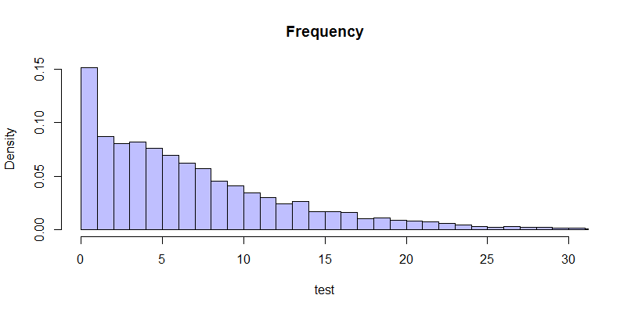
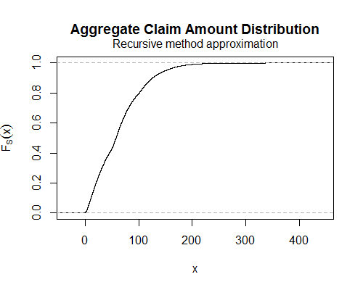
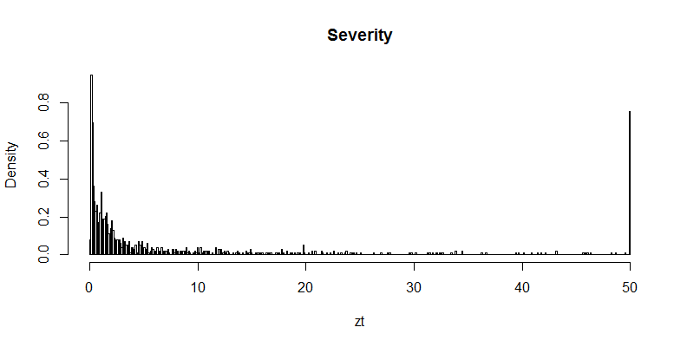
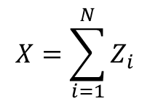
Methodology
Using SAS Operational Risk Data (Cyber incidence extracted) to evaluate the adequacy of regulatory models:
1 (2)
$$X=\sum_{i=1}^{N}{Z_{i}}$$
Empirical (required)
safety level
Regulatory Model
Required (empirical) capital
Notes:
From right to left:
Frequency: for a portfolio of 50 (0.15*50), here Poisson model
Severity: Caped at 50 Mio. USD, empirical distribution (defined on a lattice, h=0.1 Mio. USD)
SAS Data from Biener et al. (2015)
Aggregation: Panjer alg. (recursive)

Slide 5
Methodology
Base Scenario Assumptions:
  Frequency distribution: Poisson (negative binomial with correlations as additional test)
  Severity distribution: Coverage limits of 50 Mio. USD, not correlated, histogram is taken (no correction for outliers, no smoothing, approximation, or estimation techniques applied)
  Portfolio size: 50 policies
  SAS Data representative for a specific underwriting portfolio / operational cyber risk exposure

Slide 6
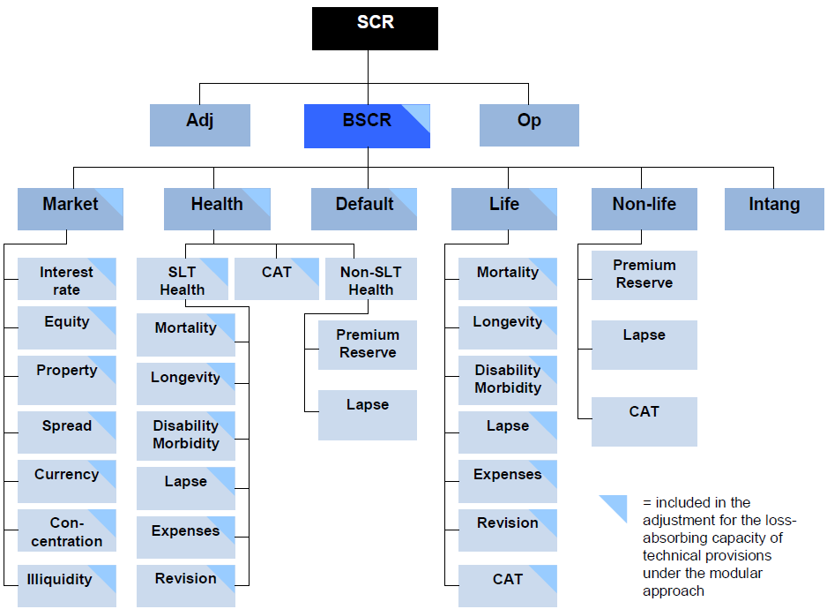
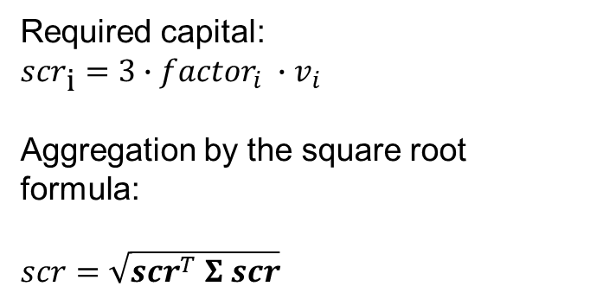
Solvency II and Cyber Risk
Operational Cyber Risk
Underwriting Cyber Risk
Required capital:
$${scr}_{\text{i}}=3∙{factor}_{i} ∙v_{i}$$
Aggregation by the square root formula:
$scr=\sqrt{{scr}^{T} Σ scr}$
Notes:
SCR relevant to avoid interventions
Square root formula simmilar to the calculation of a potfolio’s standard deviation (SCR is simply a linear transformation of the variance)
Correlation matrix

Slide 7
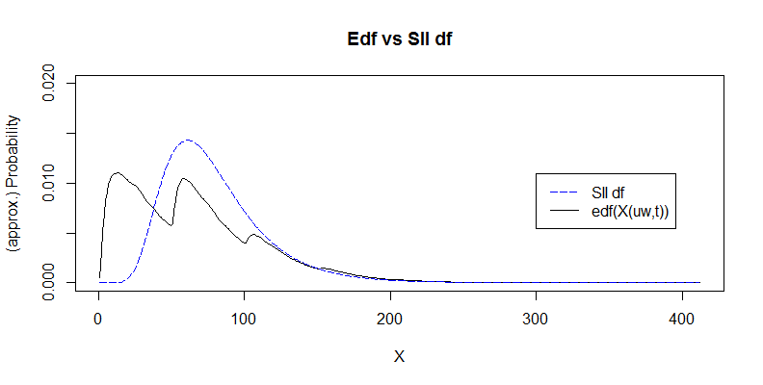
Solvency II and Cyber Risk (Underwriting)
The SII model is meant to approximate ${{}_{}^{}{VaR}}_{(0.995)}^{}$ of log-normally distributed losses:

Slide 8
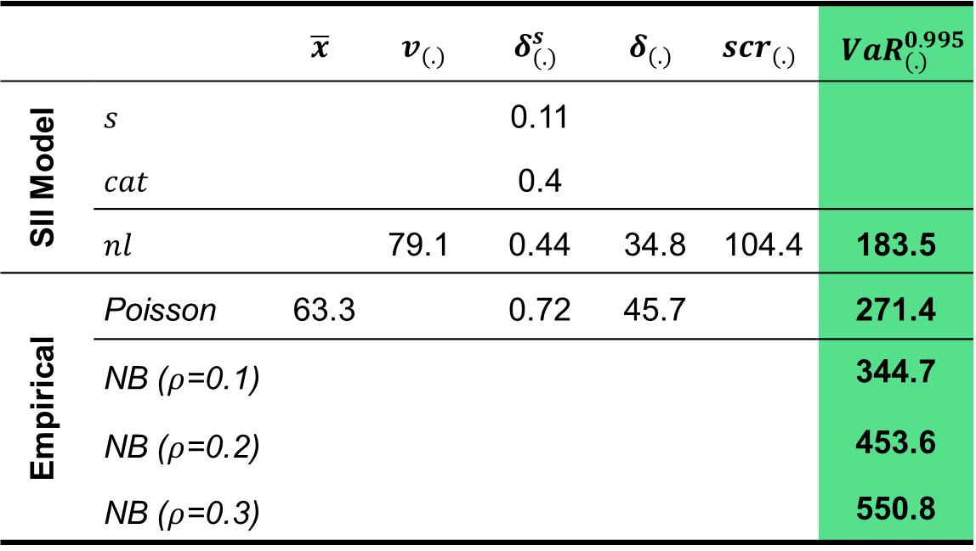
Solvency II and Cyber Risk (Underwriting)
 |  | $$\overline{x}$$ | $$v_{(.)}$$ | $$δ_{(.)}^{s}$$ | $$δ_{(.)}$$ | $${scr}_{(.)}$$ | $${{}_{}^{}{VaR}}_{(.)}^{0.995}$$
SII Model | $$s$$ |  |  | 0.11
 | $$cat$$ |  |  | 0.4
 | $$nl$$ |  | 79.1 | 0.44 | 34.8 | 104.4 | 183.5
Empirical | Poisson | 63.3 |  | 0.72 | 45.7 |  | 271.4
 | NB ($ρ$=0.1) |  |  |  |  |  | 344.7
 | NB ($ρ$=0.2) |  |  |  |  |  | 453.6
 | NB ($ρ$=0.3) |  |  |  |  |  | 550.8
Solvency II misses the safety level it aims for (1 in 200) when an insurer underwrites cyber risk (even higher mismatch as the correlation increases)
Notes:
where the factor (coefficient of variation) is given by the regulator (depending on the LoB, normal vs cat risk, and premium vs reserve risk) and $v$ stands for the volume measure (usually total written premium or reserves).

Slide 9
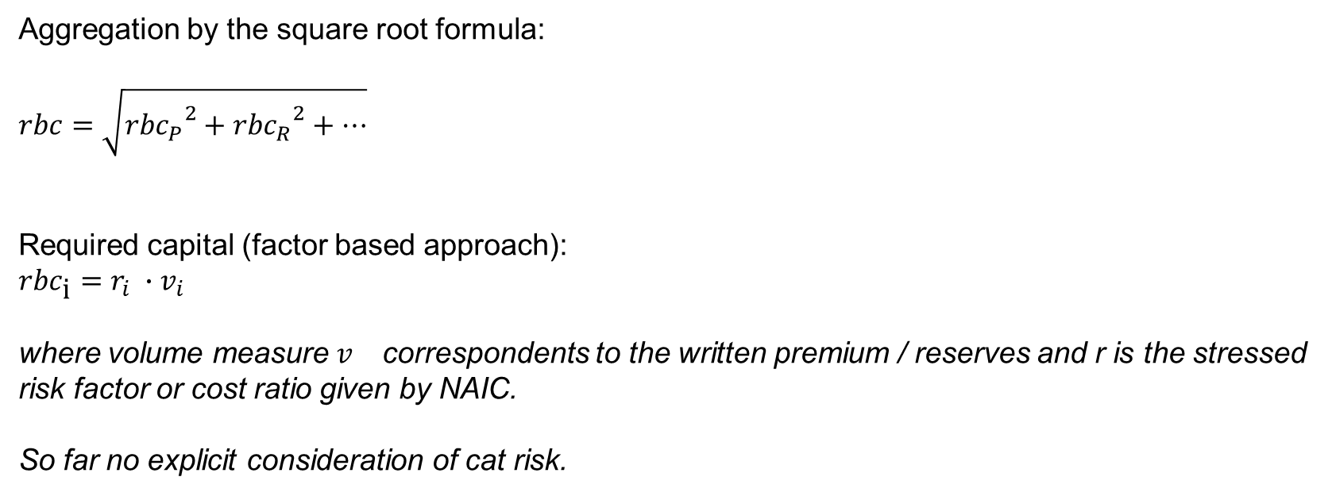
Cyber Risk and US Risk Based Capital (Underwriting)
Aggregation by the square root formula:
$$rbc=\sqrt{{{rbc}_{P}}^{2}+{{rbc}_{R}}^{2}+…}$$
Required capital (factor based approach):
$${rbc}_{\text{i}}=r_{i} ∙v_{i}$$
where volume measure $v_{}$ correspondents to the written premium / reserves and r is the stressed risk factor or cost ratio given by NAIC.
So far no explicit consideration of cat risk.
Notes:
Authorized Control Level (ACL): 50% * RBC
No correlation between different risk type (R0 – Investments in Insurance Affiliates & Off-BS Risks, R1 – Fixed Income Securities, R2 – Equity Investments, R3 – Credit Risk, R4 – Reserving Risk (incl. basic & growth), R5 – Premium Risk (incl. basic & growth)

Slide 10
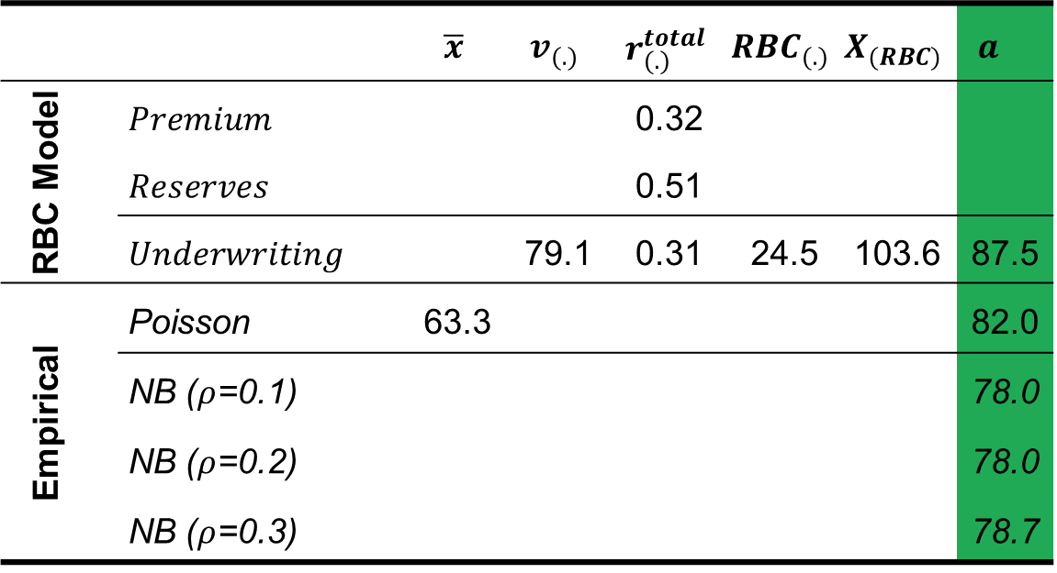
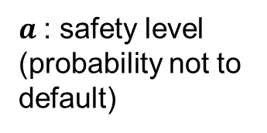
Cyber Risk and US Risk Based Capital (Underwriting)
 |  | $$\overline{x}$$ | $$v_{(.)}$$ | $$r_{(.)}^{total}$$ | $${RBC}_{(.)}$$ | $$X_{(RBC)}$$ | $$a_{}$$
RBC Model | $$Premium$$ |  |  | 0.32
 | $$Reserves$$ |  |  | 0.51
 | $$Underwriting$$ |  | 79.1 | 0.31 | 24.5 | 103.6 | 87.5
Empirical | Poisson | 63.3 |  |  |  |  | 82.0
 | NB ($ρ$=0.1) |  |  |  |  |  | 78.0
 | NB ($ρ$=0.2) |  |  |  |  |  | 78.0
 | NB ($ρ$=0.3) |  |  |  |  |  | 78.7
$a$: safety level (probability not to default)
Safety level of 87.5 is rather low

Slide 11



Cyber Risk and Swiss Solvency Test (Underwriting)
Reserves ($μ_{R}$, $σ_{R}^{2}$)
LogN($μ_{R}+μ_{N}$, $σ_{R}^{2}+σ_{N}^{2}$)
CY: Premium risk
Normal losses ($μ_{N}$, $σ_{N}^{2}$)
Convolution
Total Loss
Extreme Losses
(comp. Pareto)
Notes:
- Mu and standard deviation are calibrated according to the insurers own data.
- Extreme Losses >5 Mio. CHF

Slide 12
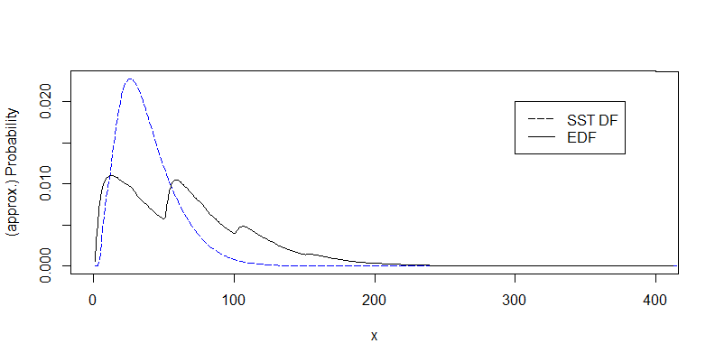
Cyber Risk and Swiss Solvency Test (Underwriting)

Slide 13
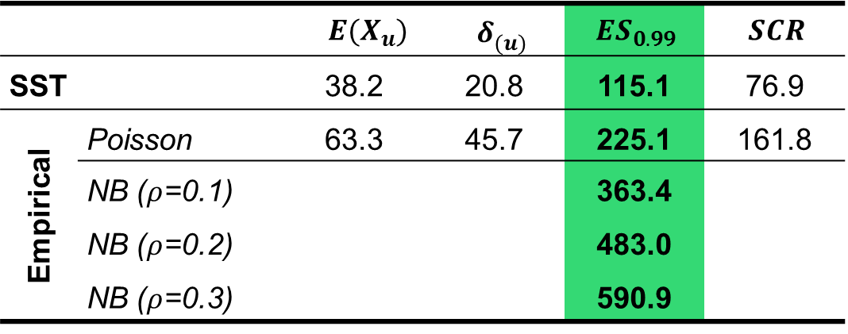
Cyber Risk and Swiss Solvency Test (Underwriting)
 |  | $$E(X_{u})$$ | $$δ_{(u)}^{}$$ | $${ES}_{0.99}$$ | $$SCR$$
SST |  | 38.2 | 20.8 | 115.1 | 76.9
Empirical | Poisson | 63.3 | 45.7 | 225.1 | 161.8
 | NB ($ρ$=0.1) |  |  | 363.4
 | NB ($ρ$=0.2) |  |  | 483.0
 | NB ($ρ$=0.3) |  |  | 590.9

Slide 14
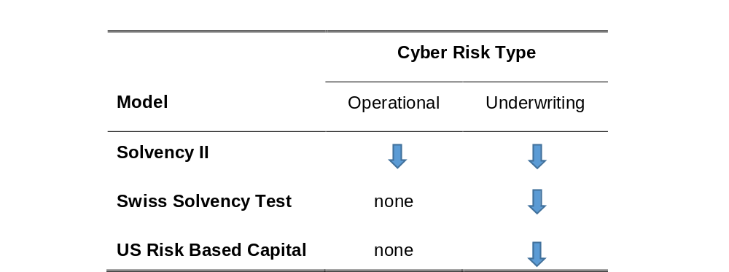
Conclusion & Extensions
Possible extensions:
  Severity distribution: Other coverage limits, correlated, smoothing or approximation techniques
  Correlation between frequency & severity distributions, non linear dependencies
  Other portfolio size
  Other data sets

Slide 15
Questions and Discussion
Thanks a lot for your attention and feedback!

