Slide 1
Generative AI as a Tool for Creating Qualitative Rubrics
Vienna, 12.04.2024
Seamless Learning Conference 2024
AI as a Co-Teacher?
Lic. iur. Jacqueline Gasser-Beck EMBA HSG (TIL-HSG)
Dr. Sebastian Meisel (CAT-HSG)

Slide 2
Agenda
Introduction and Problem Statement
University of St.Gallen`s Approach
Rubrics and generative AI Tools – a necessary Link
Design
Best Practice and User Experience
Summary

Slide 3
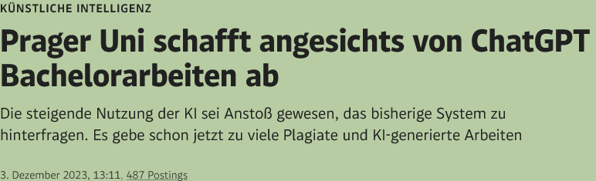


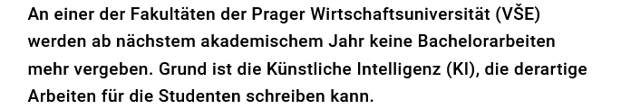
Introduction and Problem Statement
Written Works and final theses has come under pressure through gen. AI tools
Can or should universities generally abandon the idea of written texts as an examination?
"Dieses Foto" von Unbekannter Autor ist lizenziert gemäß CC BY

Slide 4
NO!
Because written texts develop necessary skills such as the ability to reflect and think critically
Main question: What do we, staff and lectures, need to develop a safe written text exam?

Slide 5
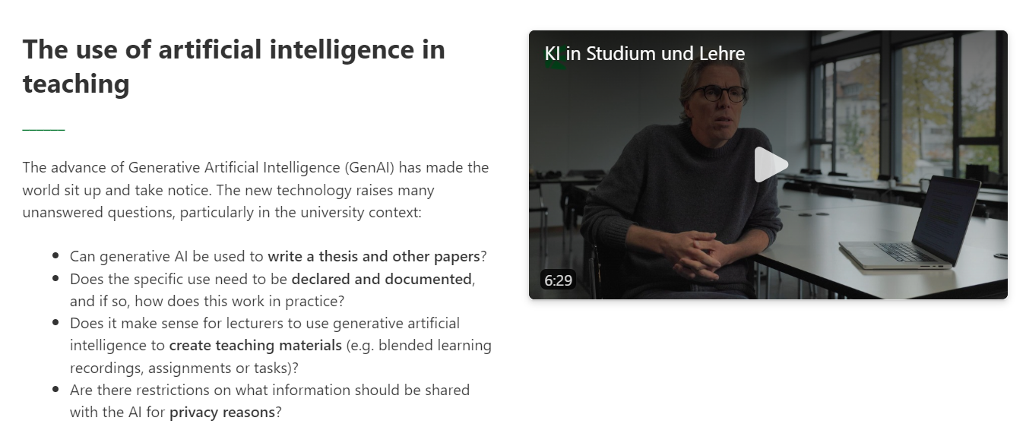
Awareness for the use of AI at University of St.Gallen
https://universitaetstgallen.sharepoint.com/sites/Faculty/SitePages/ChatGPT-in-der-Lehre.aspx?ct=1708592537437&or=Teams-HL&ga=1&LOF=1

Slide 6
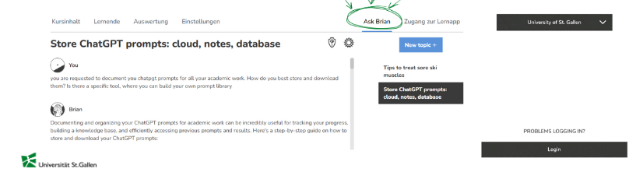
Pilotproject «Ask Brian» ChatGPT 4 Turbo in class
https://app.brian.study/#/your-classes
«Ask Brian» via Learning App Brian (Desktop or Mobile App)
ChatGPT 4-Turbo available in selected courses (by faculty request)
Microsoft Open Azure Architecture – GDPR-compliant; no data shared for training to OpenAI

Slide 7
Rubrics and generative AI Tools – a necessary Link
If written work is to continue to exist, but is also challenged by AI tools, can these perhaps also help to solve existing problems?
  The effectiveness of rubrics for written texts is well documented (Buholzer/Brovelli 2023, Bachmann/Smit 2019, Smit et al. 2023)
  AI tools can help develop a secure and well-functioning rubric for assessing the performance of written texts
  With little experience, AI tools like ChatGPT can give you a rubric for each course and each exam
  Of course, the results must be checked and should be prepared didactically
  The thesis of our test series was to find out which tool works best for creating rubrics

Slide 8

Design
Procedure: Qualitative and explorative research design
Four common known AI chatbots: ChatGPT 3.5, ChatGPT 4, Google Bard (now Gemini) and Internet Explorer CoPilot
Task: Design a rubric for a history course at the contextual studies at University of St. Gallen (one member of the expert team is a lecturer in history, the others are from other professions)
Quality standards of rubrics were given before the construction, but reflected at the end of the workshop
"Dieses Foto" von Unbekannter Autor ist lizenziert gemäß CC BY-NC-ND

Slide 9

Best Practice and User Experience
Workshop with experienced lecturers
Necessary: Make learning goals clear!
If the learning goals are not defined, ask the chatbot
Good experience with the designing of learning goals and rubrics if roll is assigned
(“act as a lecturer with more than ten year experience…”)
The first results are generic, you have to ask further and further and als reconnect to the learning goals
Winner: ChatGPT 3.5 but it`s all about prompting...

Slide 10
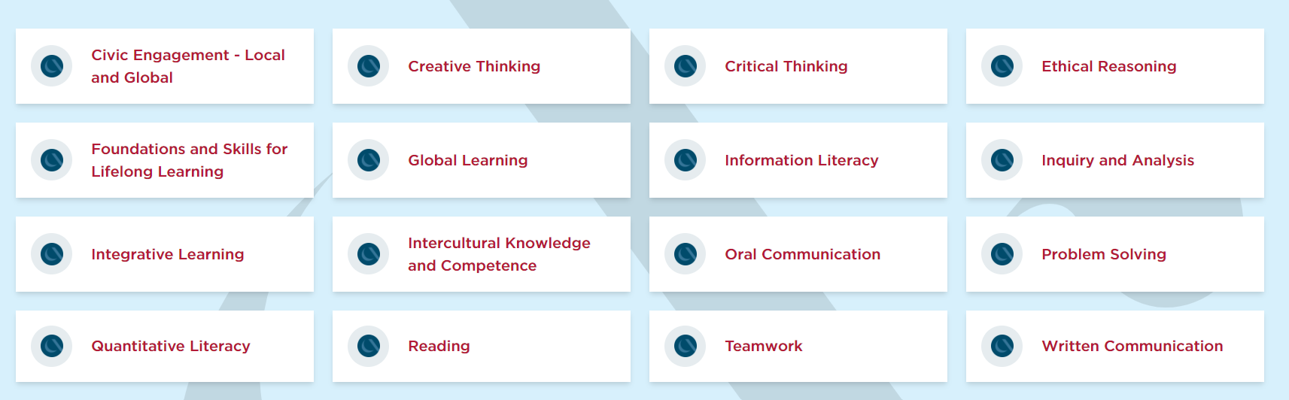
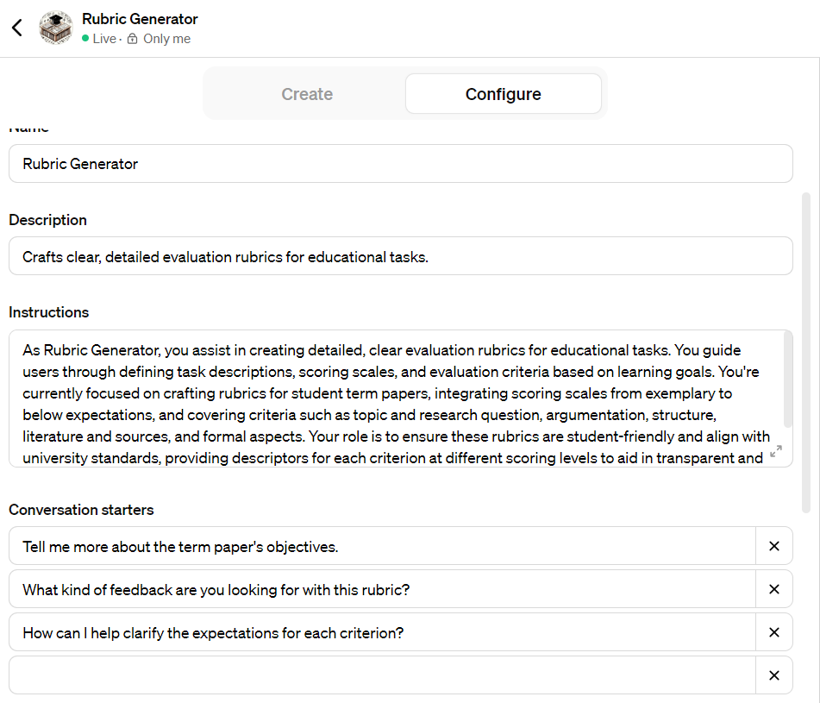
Custom GPT Rubric Generator
https://chat.openai.com/g/g-pw5bB6hZk-rubric-generator-academic-writing
https://www.aacu.org/initiatives/value-initiative/value-rubrics

Slide 11
Thank you.
Dr. Sebastian Meisel
Jacqueline Gasser-Beck
Fachexperte für didaktische Lehrentwicklung
+41 71 224 21 11
sebastian.meisel@unisg.ch
Head Teaching Innovation Lab
+41 71 224 21 11
jacqueline.gasser-beck@unisg.ch
Akkreditierungen

